Slide 1

Make a Date!
Sidney Schuttrow, MPA, CNP, CRS-A/D
Tennessee Commission on Aging and Disability

Slide 2
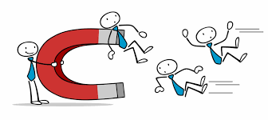
Why is knowing your volunteers important?
RETENTION

Slide 3
Traditional
Non-Traditional
Name
Address
Phone Number
Email
Communication method
Availability
Emergency Contact
Date of Birth
Volunteer State Date
Employer
Skills/Talents
Interests
Favorite Snack
Fun Fact
Reason for Volunteering

Slide 4


Slide 5
Make a Date!
1. Find your Yellow sheet of paper with a clock on it
2. You will have 7 minutes to make 12 dates with 12 different people around the room.
3. Write the persons name in the time slot to “Make a Date” with them.

Slide 6
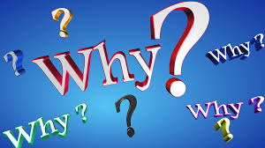
Find your 3 O'clock Date
Why did you attend this conference? Session?

Slide 7
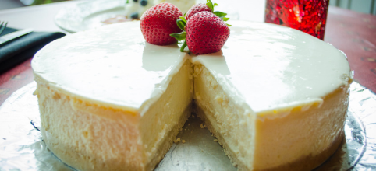
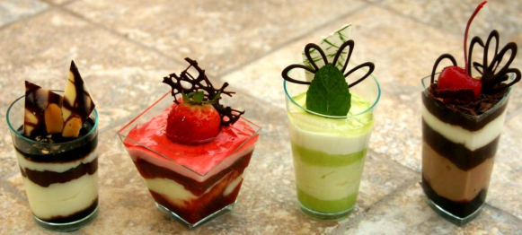
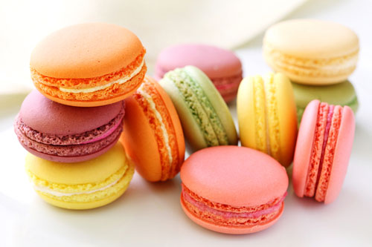
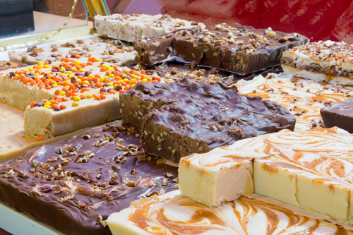
Find your 7 O'clock Date
What was your favorite food/dessert/treat that your parent (mom, dad, grandma, grandpa, etc.) would make for you when you were little? Do you know how to make it?

Slide 8


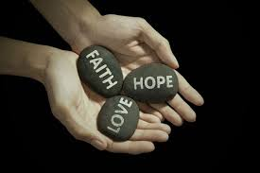




Find your 12 O'clock Date
Who is your favorite organization to volunteer for and why?

Slide 9



Find your 5 O'clock Date
What is your favorite guilty pleasure TV Show or movie?
A guilty pleasure is something that one enjoys despite feeling that it is not generally held in high regard

Slide 10
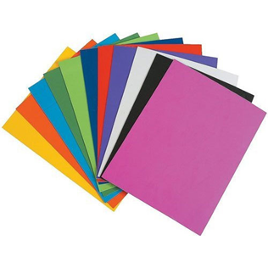

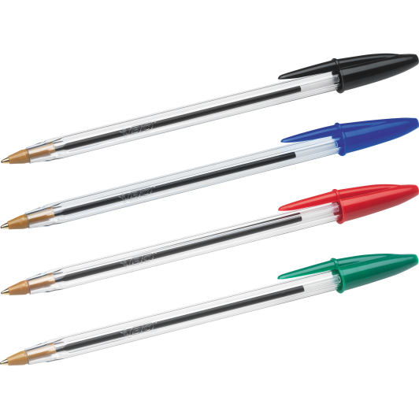
Make a Date Cost
Colored paper
36 sheets
$1.00
at Dollar Tree
Color copies
$.53
for 100 at Staples
B&W copies
$.11
for 100 at Staples
Ballpoint Pens 15 count
$.97 at Walmart

Slide 11
Name Planes Game
Everyone should have a blank colored sheet of paper
Write your name and a description of yourself (what you are wearing, glasses, hair up/down, etc.)
Write down 2 appropriate questions.
Fold your paper into a paper airplane!
When I say go, throw your airplane in any direction around the room
Pick up a paper airplane (not yours), find the person and ask them their questions.

Slide 12
Name Planes Game Cost
Colored paper
36 sheets
$1.00
at Dollar Tree
Ballpoint Pens 15 count
$.97 at Walmart

Slide 13
Would You Rather?
The facilitator will read a scenario starting with the phrase “Would you Rather” and gives the audience 2 options
The facilitator will signal to the right and left side of the room to indicate where the audience members should go.
The audience members will move to right or left side of the room to pick the option they would rather

Slide 14



Would You Rather? Cost
3000 Would you Rather Questions $7.00
at Books a Million
Would you Rather Game box
$5.00
at Five Below
FREE!!!

Slide 15

Breaking into Groups
Traditional ways
- Counting off
- Choose your own
- Splitting the room in half
- Your table
- Your row

Slide 16
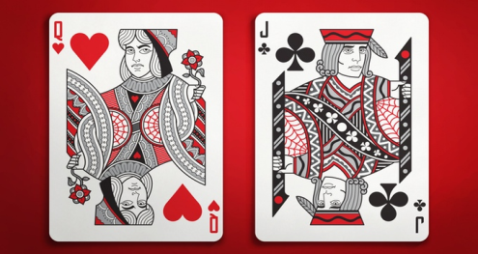
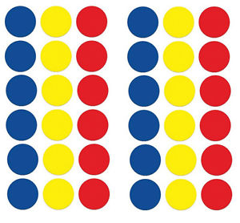
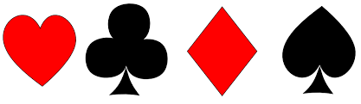
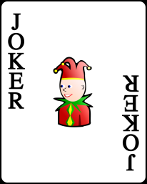

Breaking into Groups
Everyone should have one (1) card from a deck of regular playing cards.
Suites (4 Groups)
Red cards/Black cards (2 large groups)
Dots/Color marks
(odd number groups)
Jokers – wild cards!
They can pick their groups.
Values – Up to 13 groups

Slide 17
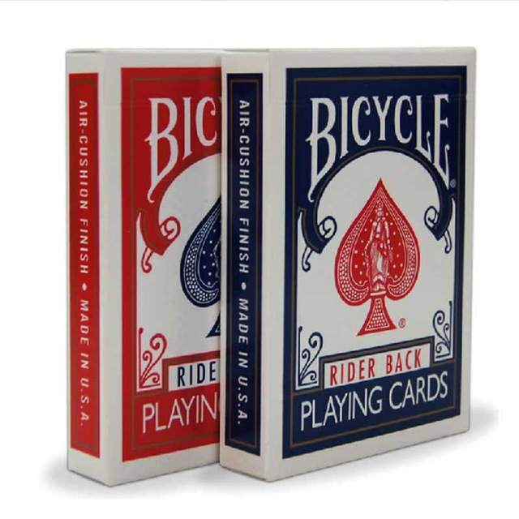
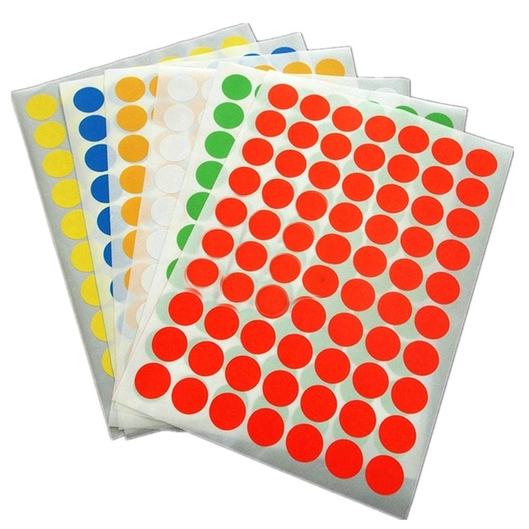
Breaking into Groups Cost
Deck of Playing Cards
$.88
at Walmart
Adhesive Stickers
1536 pack
$8.68
at Walmart

Slide 18
Whodunit?
Find your sticker color groups on the back of your playing card
Each of you should have a blank colored index card
On the blank colored index card write down something interesting you have done in your life…Make it Fun!
Fold your index card and put it in your groups plastic cup
One at a time, each person takes a card and reads it to the group.
The reader must then try to guess “who done it” and why they came to that conclusion

Slide 19
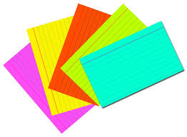
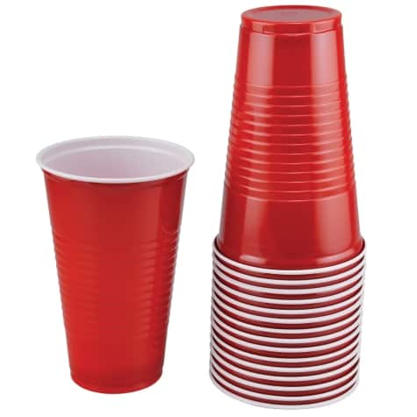
Whodunit? Cost
Plastic Cups
16 count
$1.00
at Dollar Tree
Colored index cards
100 count
$1.00
at Dollar Tree

Slide 20

Other simple games
  Each person has to come up with 2 truths and 1 lie about themselves and say it to the group. The group determines which is a lie

Slide 21
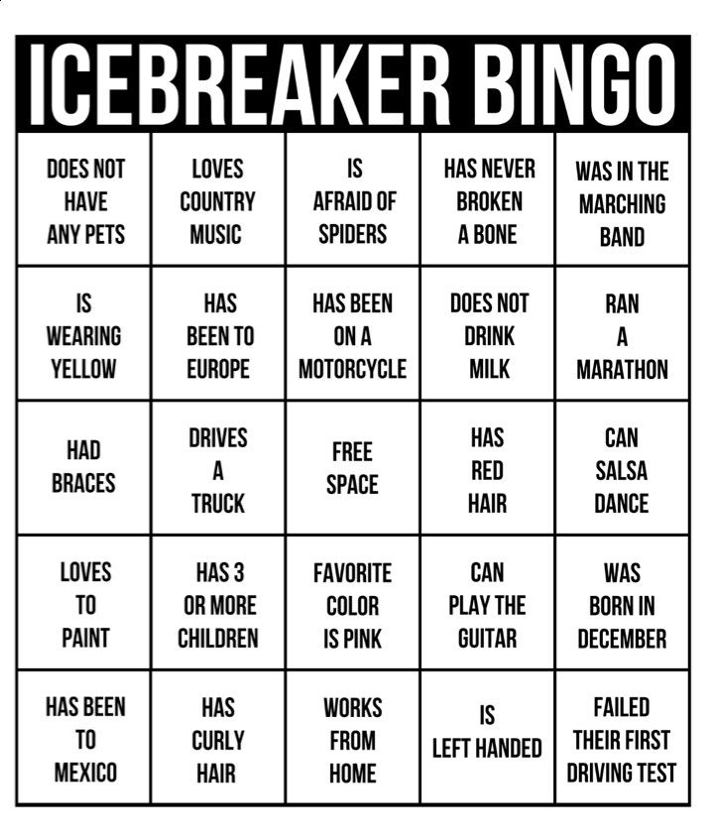
Other simple games
Many free versions online. Everyone has a board and goes around the room finding someone who relates to one of the BINGO Squares. Set a timer, traditional BINGO rules or the ultimate BLACKOUT to win!

Slide 22
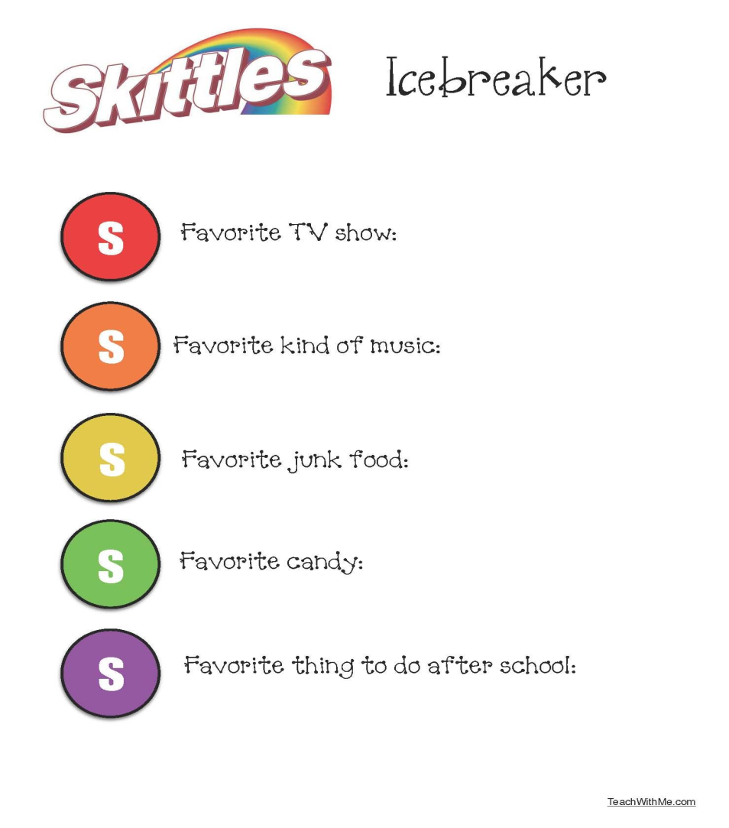
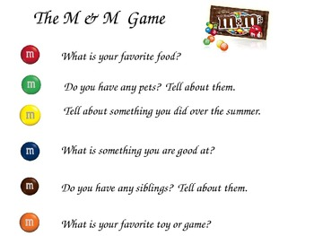
Other simple games
CANDY INTRODUCTIONS

Slide 23

Other simple games
NAME GAME
Everyone sits/stands in a circle. The first person says their name and something they like at starts with the first letter of their first name. The second person says the first persons name and what they like, then their name and what they like. The third person says the first and second persons name and what they like, then their name and what they like. This pattern continues until it returns to the first person and the first person must repeat the entire groups names and likes.

Slide 24

QUESTIONS

Slide 25

Sidney Schuttrow, MPA, CNP, CRS-A/D
Director of Volunteer Services
Tennessee Commission on Aging and Disability
502 Deaderick Street, 9th Floor
Nashville, TN 37243
615-741-1585
fax: 615-741-3309
Sidney.Schuttrow@tn.gov

