Slide 1
TENNESSEE DEPARTMENT OF TRANSPORATION
CHEATHAM COUNTY
Pre-Bid Meeting
November 20, 2020
10:00 AM
Please make sure your microphone is muted at this time unless you are speaking. Thank you!

Slide 2
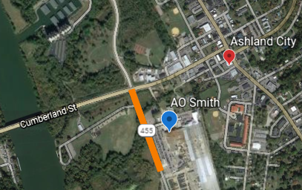
Cheatham County
State Route 455 (Tennessee Waltz Pkwy)
From 1,500 ft. South of SR-49 to SR-49
Letting Date: December 11, 2020
Completion Date: July 15, 2022

Slide 3
Cheatham County
Prequalification Requirements
Mandatory Pre-Bid Attendance
Standard Prequalification Applies
Make sure your TDOT prequalification is currently valid
Contractors with an expired prequalification that has surpassed the 90 days grace period will not be authorized to bid.
Prospective bidders must have filed their standard prequalification questionnaire at least 14 days prior to the date of the letting.

Slide 4
Cheatham County
Meeting attendance does not guarantee bid authorization.
All prime/joint venture contractors pre-qualified by the Department must obtain authorization to bid through the standard bid authorization procedure. BID AUTHORIZATION MUST BE OBTAINED PRIOR TO 4:00 P.M. CST ON THE DAY PRECEDING THE LETTING.

Slide 5
Cheatham County
Scope and Overview of the Project
0.29 miles section of SR-455 From 1500 ft south of SR-49 to SR-49 will be reconstructed to go over levee, constructed by others
ADT: 8,400 (2020)
ADT: 10,920 (2040)
Designer: Neel Schaffer, Inc.
Grading, Drainage, Base, Paving, Box Bridge Replacement, Signing and Pavement Marking.

Slide 6
Cheatham County
Scope and Overview of the Project
1 Box Bridge ( double barrel ) ( 2@ 14’ X 14’ )
16,688 CY Graded Solid Rock – 41,382 CY Borrow
13,852 Tons Base Stone – 3,281 Tons Asphalt Mix
Coordination with levee contractor for fill placement
Maintain city park access while placing high fill

Slide 7
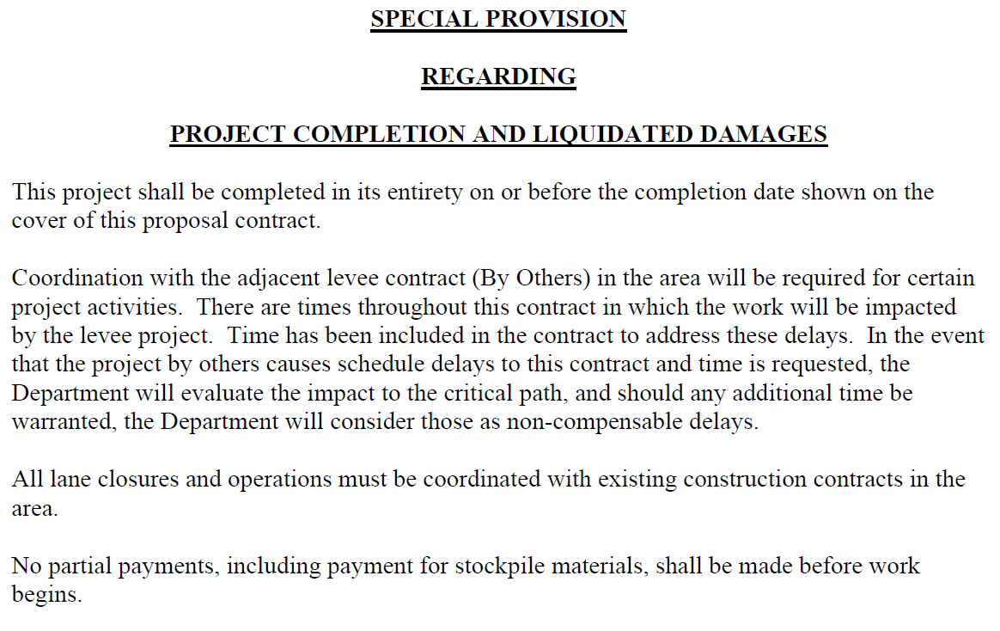
Cheatham County
Special Provision 108B

Slide 8
Cheatham County
Traffic Control Notes Highlights
Road is closed to traffic for construction:
SR 455 closure to be coordinated with the levee contractor.
SR 455 closure needs to be minimized to the extent possible due to increased traffic congestion resulting from the detour in Ashland City.
Access to Riverbluff Park (Old Cumberland Street) shall be maintained at all times during project construction.
Phased construction of Old Cumberland Street will be required.

Slide 9
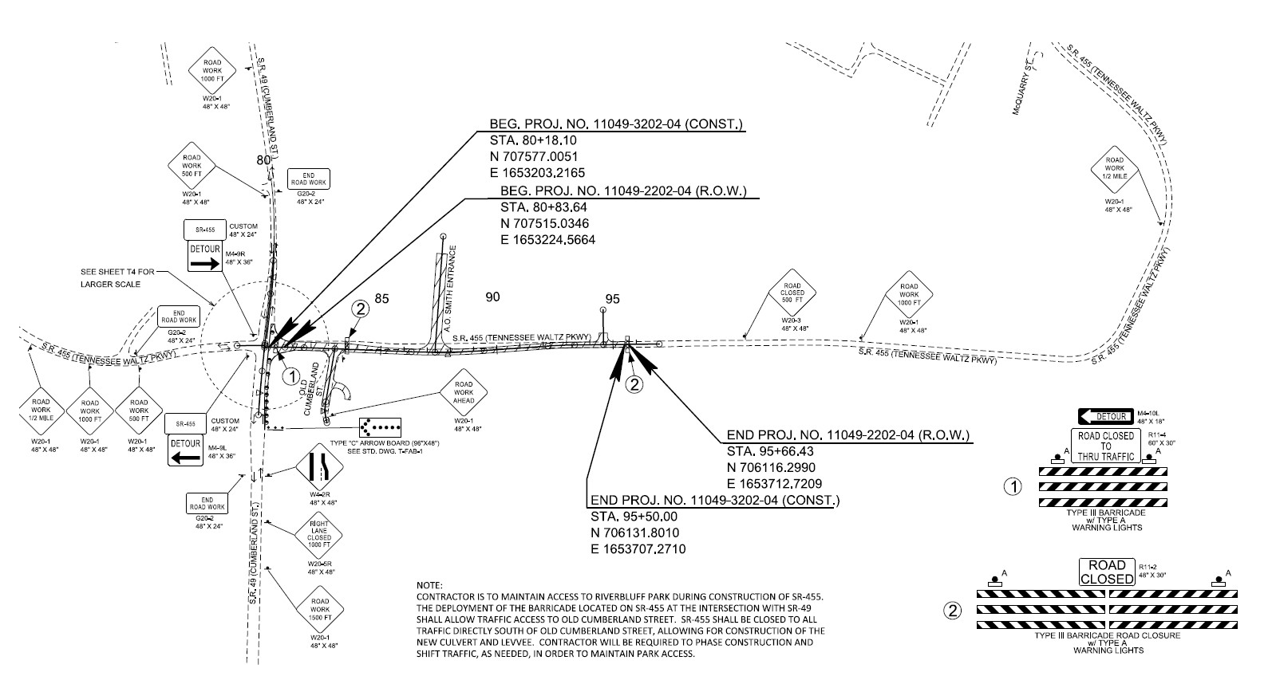
Cheatham County
Traffic Control Highlights
Maintain access to Old Cumberland St. (Riverbluff Park)
Phase construct Old Cumberland Street:
Shift traffic and build-
up roadway base in
lifts to maintain park
access
Road Closure: SR-455 closed to thru traffic directly south of Old Cumberland St. (park entrance)
Detour takes traffic through Ashland City

Slide 10
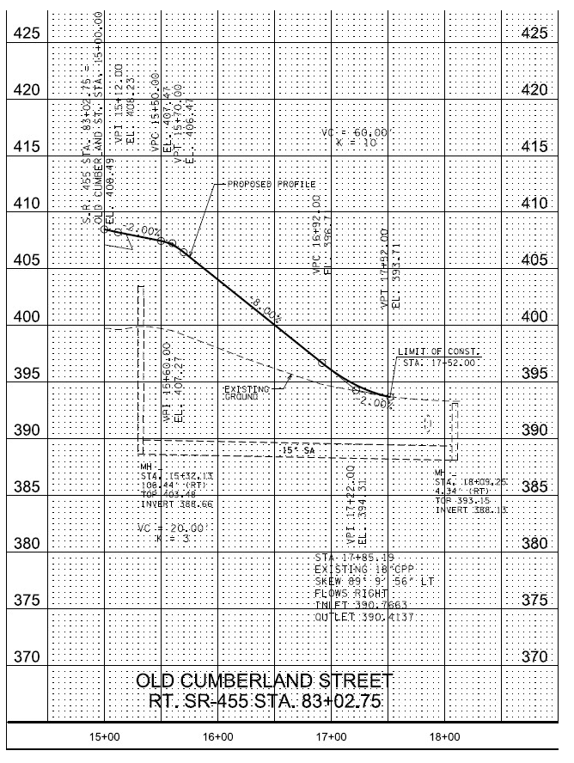
Cheatham County
Profile:
Old Cumberland Street

Slide 11
Cheatham County
Utilities
CEMC utility items are in the contract.
Power poles are to be relocated before levee construction can begin due to vertical clearance restrictions.
Poles have been pre-purchased and are on site in Ashland City.

Slide 12
Cheatham County
Other Points of Interest
The existing 2@8’x4’ box culvert is to be removed by the levee project contractor and “existing conditions” will be an open channel stream.
The proposed 2@14’x14’ box culvert is to be constructed offset from the existing stream channel and under no traffic.
There will be a 6-month settlement period for the newly constructed levee before embankment over the levee will be allowed.
Coordination with the levee construction project and its completion date will be required.

Slide 13
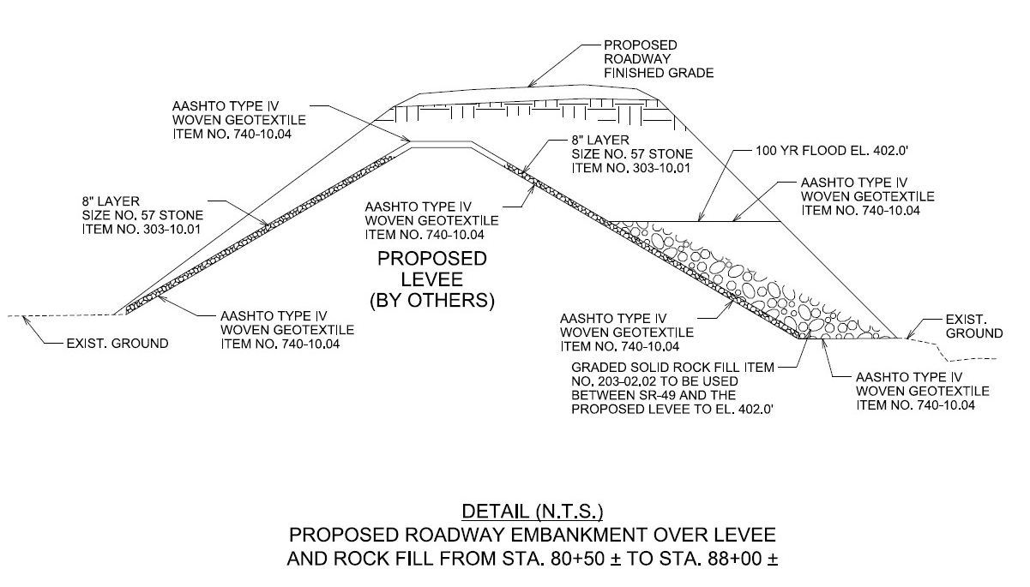
Cheatham County
Levee Details

Slide 14
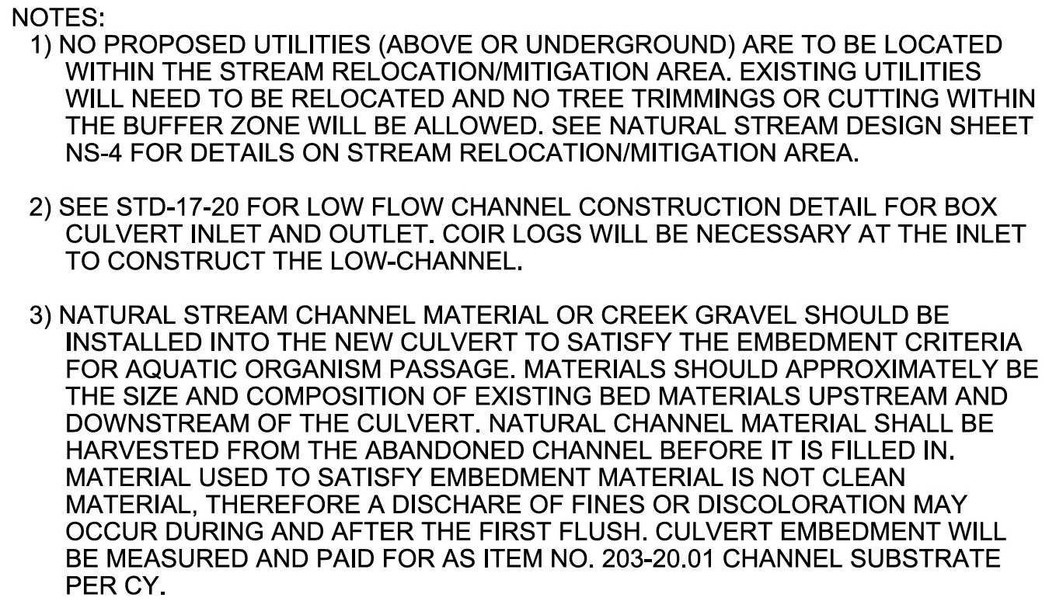
Cheatham County
Stream Crossing Mitigation Highlights

Slide 15
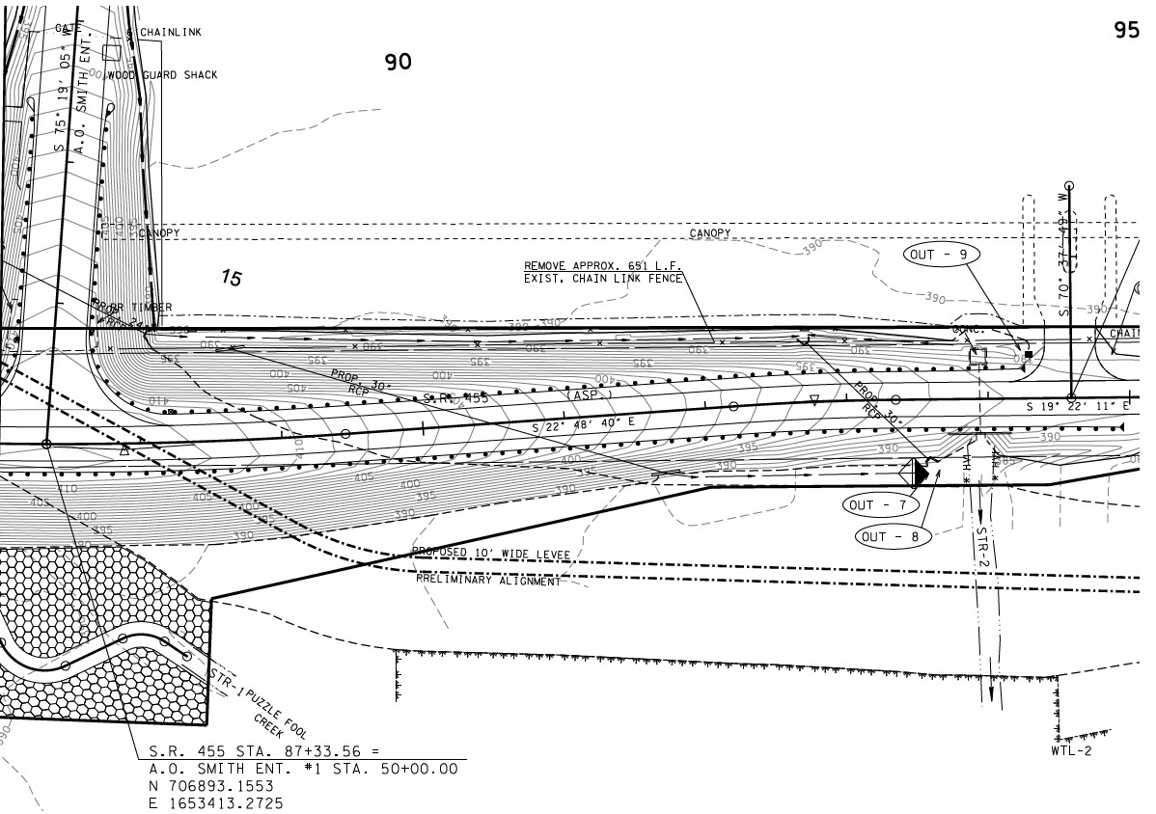
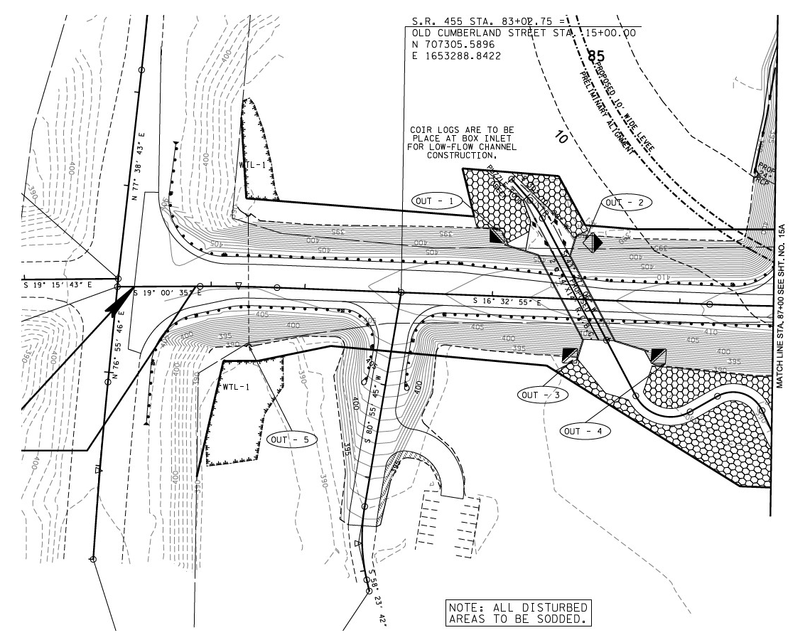



Cheatham County
Streams

Slide 16
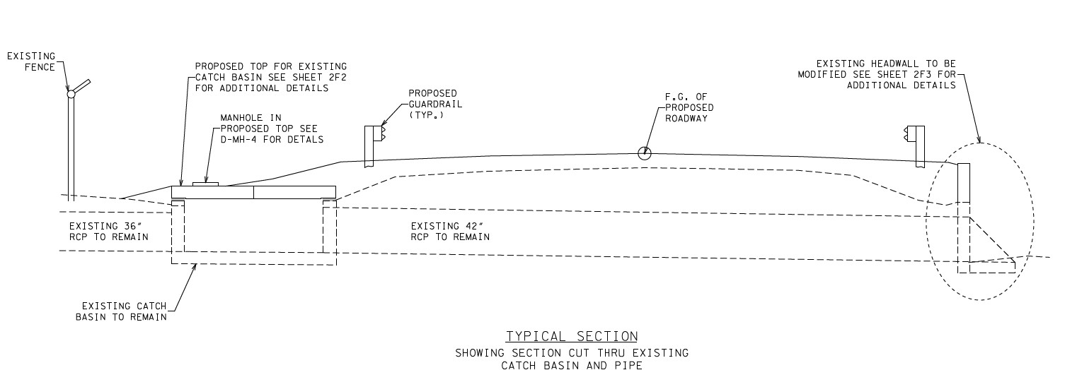
Cheatham County
Stream STR-2
NOTE:
THE CONTRACTOR SHALL USE ANY MEASURE NECESSARY TO ENSURE THAT
CONSTRUCTION EQUIPMENT WILL NOT ENTER ANY PORTION OF STR-2 WEST OF SR-455
(FROM OUTLET TO R.O.W.) AND THAT THE STREAM AND SURROUNDING VEGETATION
WILL NOT BE DISTURBED. HIGH VISIBILITY FENCING (S-F-1) SHALL BE PLACED AROUND
ALL NON-IMPACTED SECTIONS OF WATER QUALITY FEATURES WITHIN THE ROW OR EASEMENTS.

Slide 17
Cheatham County
Questions

Slide 18
Cheatham County
Contractor Roll Call

