Slide 1
Module 5
Developing Emergent Writers
Early Literacy Matters
8-1-2017 launch

Slide 2
Module 5: Developing Emergent Writers
Module 5 at a glance…
In Module 4, you considered ways learning spaces and activities provide valuable opportunities for scaffolding and supporting listening, speaking, vocabulary, and phonological awareness skill development.
In this module, you will:
Explore specific activities for developing hand-eye coordination, finger and hand muscle strength, and left-to-right directionality needed for writing.
Gain a better understanding of the important role of teachers in modeling meaningful purposes for writing.
Learn how to create age-appropriate activities to develop emergent writing skills.

Slide 3
Learner Outcomes for Module 5
Learner Outcomes:
LO1: Learners will describe the ways fine motor activities prepare children for writing.
LO2: Learners will describe the role teachers play in modeling purposeful writing and in providing opportunities for children to experiment with writing tools.
LO3: Learners will create age-appropriate activities to develop emergent writing skills for children in their classroom.

Slide 4
Connections to the “Read to be Ready” Campaign:
This module aligns to the current Read to be Ready Campaign’s following key beliefs:
Early Literacy Matters:
Teachers are critical:
It takes a community:
Video link to “Early Literacy Matters” from Read to be Ready Website:
https://www.youtube.com/watch?v=60J8qRjRPkE

Slide 5
Module 5 Overview
Overview: Module 5 will consist of 3 instructional presentations. These presentations will help you reflect on the special role a literacy-rich classroom environment plays in providing opportunities for children to develop emergent writing skills and interest in writing tools and materials.
In Presentation 1, you will learn the importance of providing activities for children to develop muscles for hand-eye coordination, finger control, hand muscle strength, and left-to-right directionality. These skills physically prepare children for writing.
In Presentation 2, you will focus on the important role teachers play in modeling the use of writing tools and meaningful purposes for writing.
In Presentation 3, you will examine developmentally appropriate activities for developing emergent writing skills for children in the classroom.
Following each presentation, you will have the opportunity to apply your learning through Application Activities included in the Learning Guide.

Slide 6
Suggested Timeline for Completing Module
Modules contain 4 short presentations that are designed to be completed during relaxed ratios or other times as set by your school or agency. Your director or program coordinator may suggest or establish a timeline for each presentation to be completed within the module. Please take a moment to confirm your site’s requirements while noting the submission deadline for the final Learning Application Assignment that you will submit electronically to your literacy coach for feedback and support. All other completed activities will remain in your participation guide and available for your coaches review.
Section 1: Start at beginning of module and complete Presentation 1 and Practice Activity 1.
Section 2: Complete Presentation 2 and Practice Activity 2.
Section 3: Complete Presentation 3 and Practice Activity 3.
Section 4: Complete the Learning Application Assignment for Module 5 and submit it electronically to your literacy coach for feedback and support.

Slide 7
Let’s begin with a look at your books…
Before we dive into our Module 5 Presentations, let’s start by having you look again through the books you received in your Early Literacy Matters start-up bag.
This time, you are looking for books that build children’s knowledge, and would create opportunities for children to respond to in “writing”.
Keep in mind that “writing” is not formal at this stage. Emergent writing includes all activities leading up to writing.
For infant teachers, think of which books you might use to create activities that would entice infants to crawl or to reach out.
After looking through the book set, select one book that you think children would enjoy interacting with. Read the story aloud to yourself and briefly respond to these questions in the Learning Guide:
Which book did you select?
What parts of the book would children likely respond to?
What are some ways your children could respond to the book (scribbles, drawing, pictures, dictated stories, others?)
How could you capture children’s response to text read?

Slide 8
Presentation 1:
Developing Fine Motor Skills for Writing
Presentation 1: Developing Fine Motor Skills for Writing
Let’s begin with a video clip which discusses why it is important to provide opportunities for children birth to five to develop their fine motor skills for early writing, and the important role the teacher plays in supporting this development.
https://youtu.be/hp8gRvPepP8
Notes:
Tristan fine motor story

Slide 9
Developing Fine Motor Skills
As you just heard in the video clip, the adult plays a critical role in providing children opportunities for developing fine motor skills essential for writing including:
Hand muscle strength
Finger grasp
Hand-eye coordination
Transfer of objects or liquids from left-to-right establishing directionality
Let’s look at each of these strategies more closely so you can reflect and on activities you can set up in the classroom to help develop your children’s fine motor skills.

Slide 10
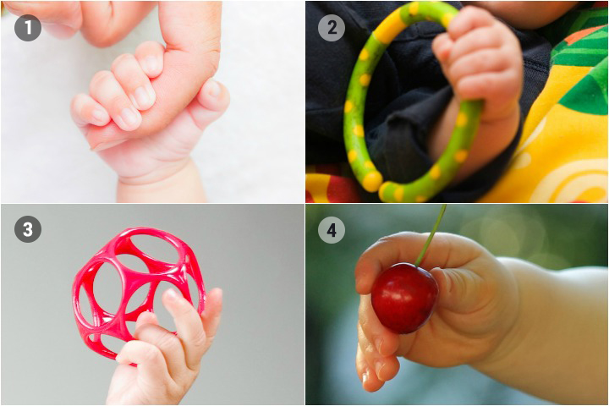
Hand Muscles and Finger Grasp
Hand muscles and finger grasp strength begins developing in infants. Infants are quick to grasp an adult’s finger tightly. Holding and shaking rattles and other hand toys adds challenge and opportunity to further strengthen muscles.
Critical hand muscles for later handwriting are developed as babies crawl. Babies who skip crawling and go right to walking often experience difficulty holding a pencil later as a kindergartener. It’s important to create time and space for babies to crawl. Consider adding interesting objects or toys for babies to crawl towards.

Slide 11
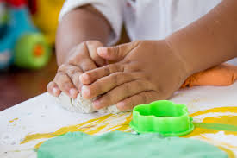
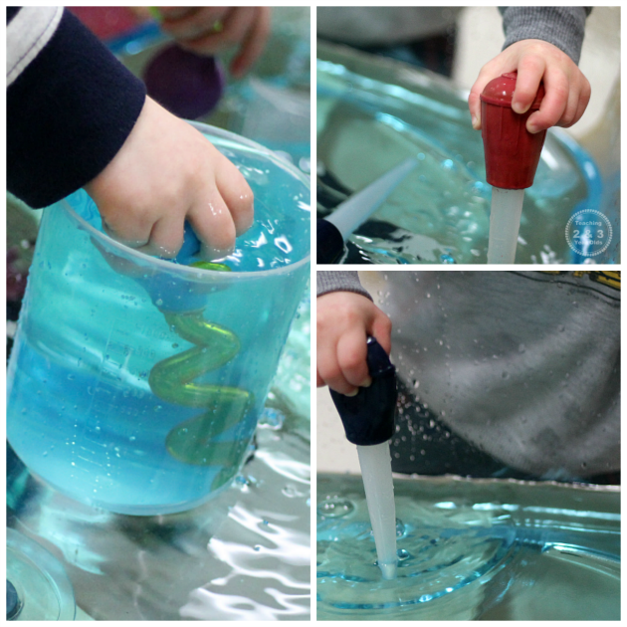
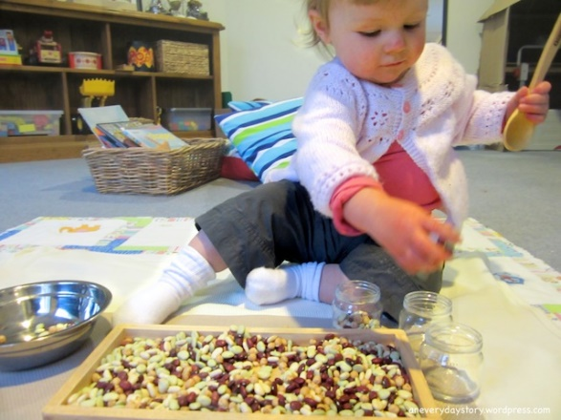
Hand Muscles and Finger Grasp
During the toddler years, hand muscles and finger grasp continues to strengthen through scooping, pouring, squeezing, pulling, pushing, stacking, and building activities that are developmentally appropriate and safe.

Slide 12
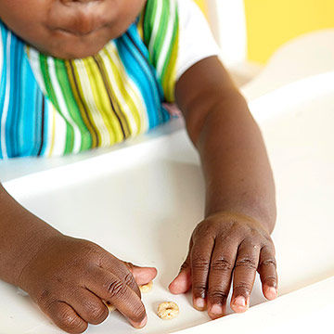
Hand Muscles and Finger Grasp
Picking up finger foods to eat such as Cheerios requires infants and toddlers to coordinate fingers to grasp the small object and hold it tight.
Infants and toddlers are curious and interested in using eating utensils. Something many people are not aware of is that the way you hold a spoon is also the way you hold a pencil.
Puzzles with large knobs are also great for developing fine motor control.

Slide 13
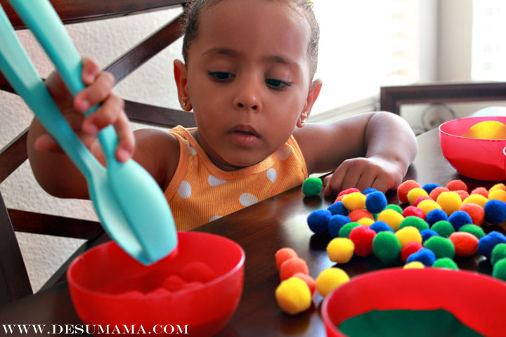
Activities for Developing Hand Muscles and Finger Grasp…
Beginning with older toddlers and considering safety, the following activities develop hand muscles and finger grasp:
sculpting with playdough
finger painting
building with blocks and/or Legos
buttoning, snapping, zipping
stringing beads
using tongs and turkey basters
washing tables with sponges
wringing out sponges
easel painting with various size brushes
Stamping
Lacing cards
What other activities can you think of that are not listed here?

Slide 14
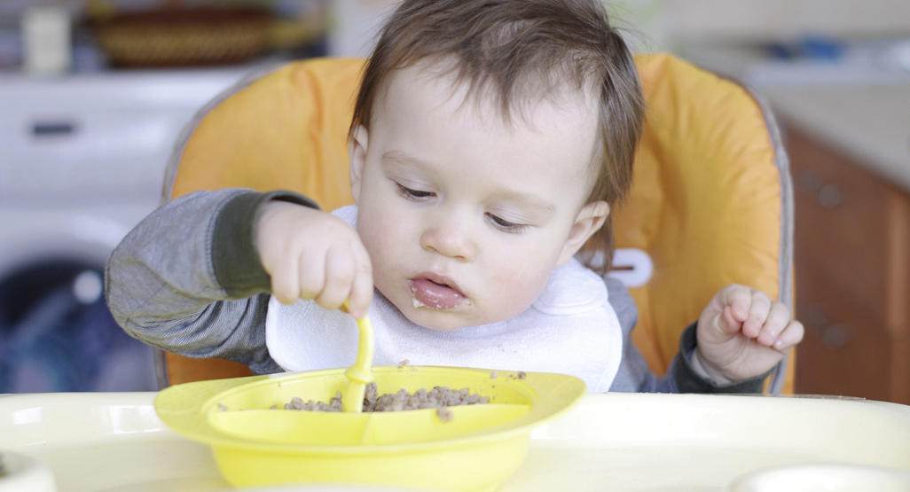
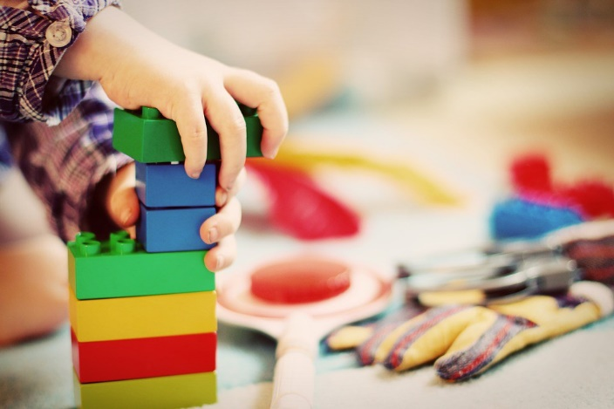
Developing Hand-Eye Coordination
Hand-eye coordination develops with time, exploration, and practice. Once infants discover that their hand can move, they are eager to gain control over its movements.
Reaching towards and picking up objects are early signs of developing hand-eye coordination.
Using eating utensils and drinking from bottles and cups offer opportunities to use hand-eye coordination.
From working with puzzles, stacking blocks, filling and pouring out water cups, cutting with scissors, to scribbling or writing on paper--all require hand-eye coordination.

Slide 15
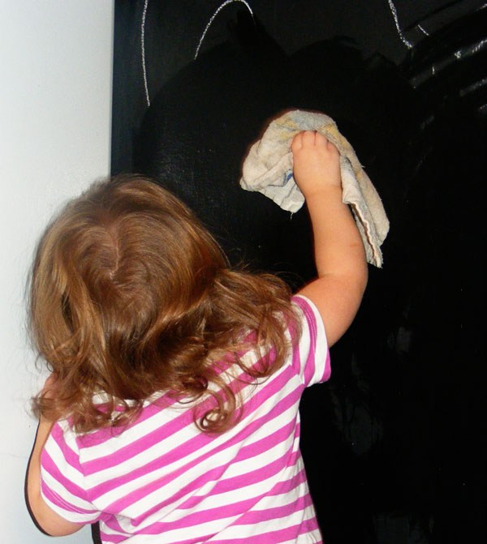
Reinforcing Left-to-Right Directionality
Left-to-Right directionality is important for both writing and reading. It can be introduced and practiced through fine motor activities when the teacher models working from left-to-right to complete the activities.
For example, when demonstrating how to tong pom-pom balls, the teacher makes sure that the bowl full of pom-poms is on the left. She then uses the tongs to transfer the pom-poms to the empty bowl on the right.
Another example would be washing a table or chalkboard, moving the sponge in a left-to-right direction.
What other examples can you think of?

Slide 16
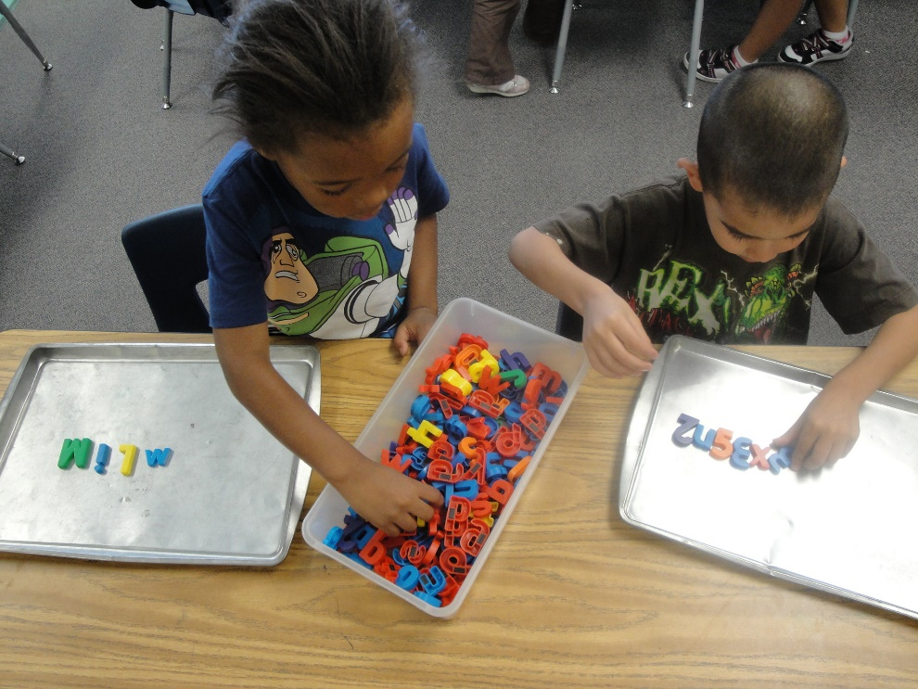
When to introduce writing tools
It’s never too early to model the purpose and use of writing tools; however, it is important to wait until children have developed fine motor control to hold the pencil. Children who are not able to physically hold or control the pencil, will become frustrated and will not want to write.
A great alternative is to use moveable alphabet pieces such as wooden, plastic, sponge, or magnetic tile letters that allow children to playfully explore with writing words.

Slide 17
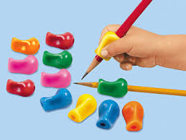
Pencil Grasp indicates stage of development
Pencil grasp indicates stage of development and should be modeled correctly, but not be corrected for children younger than four who likely use a fist grip.
Pencil grip supports can be added to pencils to help children with proper finger placement.
Using thicker pencils and crayons are also easier for young children to grip.

Slide 18
Modeling fine motor activities
It’s important to model slow, deliberate, and precise movement of fingers and hand required to complete fine motor activities.
Children learn through imitation and repetition.
Provide numerous opportunities for children to practice using fine motor skills.

Slide 19
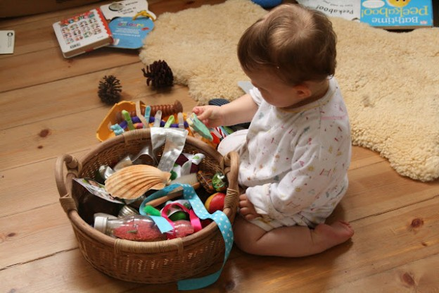
Practice Activity 1: Fine Motor Development Infants
For this Fine Motor development practice activity, you will:
Make accessible (on shelf, on trays, or in baskets) different size rattles and other safe objects to provide opportunities for infants to develop whole hand and finger grasp muscles.
Provide time for infants to explore the objects.
Observe the infant’s hand and finger movements when they are exploring the objects.
Record your observations in the Learning Guide.
Notes:
Remember:
Different size rattles and other safe objects provide opportunities for infants to develop whole hand and finger grasp muscles.
Objects that can be squeezed with the hands help develop hand strength.

Slide 20
Reflection on Fine Motor Development Activity
After engaging with an infant in a fine motor development activity, briefly reflect on these questions:
How did you interest the infant in the activity?
How did you model the use of fine motor skills?
Describe the exact hand and finger movements made the infant as objects were explored.
How did the infant respond to the 1:1 turn-taking with you to practice fine motor skills?
Why was it important to engage with the infant 1:1 rather than doing this as a group activity?
Include your responses in your Learner Guide.

Slide 21
End of Section 1
Congratulations, you just completed Section 1 of Module 5.
Be sure you have completed Section 1 activities in the Learning Guide.
When ready, move on to the presentation for Section 2.

