Slide 1
The McKendree Post Acute & Rehabilitation
CN2406-017
Tennessee Health Facilities Commission
Certificate of Need Meeting
Wednesday, August 28, 2024
Presenters:
Wells Trompeter, Attorney – Holland & Knight, LLP
John Wesley Williamson, Attorney – Holland & Knight, LLP
Dillion Carvier, Operations Director – The McKendree Post Acute & Rehabilitation
1

Slide 2
Company Overview
The McKendree Post Acute & Rehabilitation is a 180-bed nursing home facility in Hermitage, TN, which recently changed ownership through a bankruptcy acquisition.
McKendree was acquired during a bankruptcy proceeding, during which the prior operator struggled to adequately support the staff and implement adequate quality control processes.
In addition to the nursing home, McKendree’s campus includes an independent living facility and an assisted living facility to provide continuity of care.
McKendree has entered a consulting arrangement with Hill Valley Healthcare for the nursing home.
2

Slide 3

Company Overview
Hill Valley Healthcare, LLC is a skilled nursing and senior living consulting company rapidly positioning itself as a leader in the industry. Hill Valley applies its expertise and ingenuity to rejuvenate senior care communities.
Hill Valley has extensive partnerships with leading advocacy organizations such as the American Heart Association, American Lung Association, Alzheimer’s Association, and ALS Association.
Since its inception, Hill Valley has consulted with over 40 skilled nursing facilities with many of the facilities historically underperforming in terms of quality. With Hill Valley’s expertise and devotion to “People First,” the facilities have been turned around.
3

Slide 4
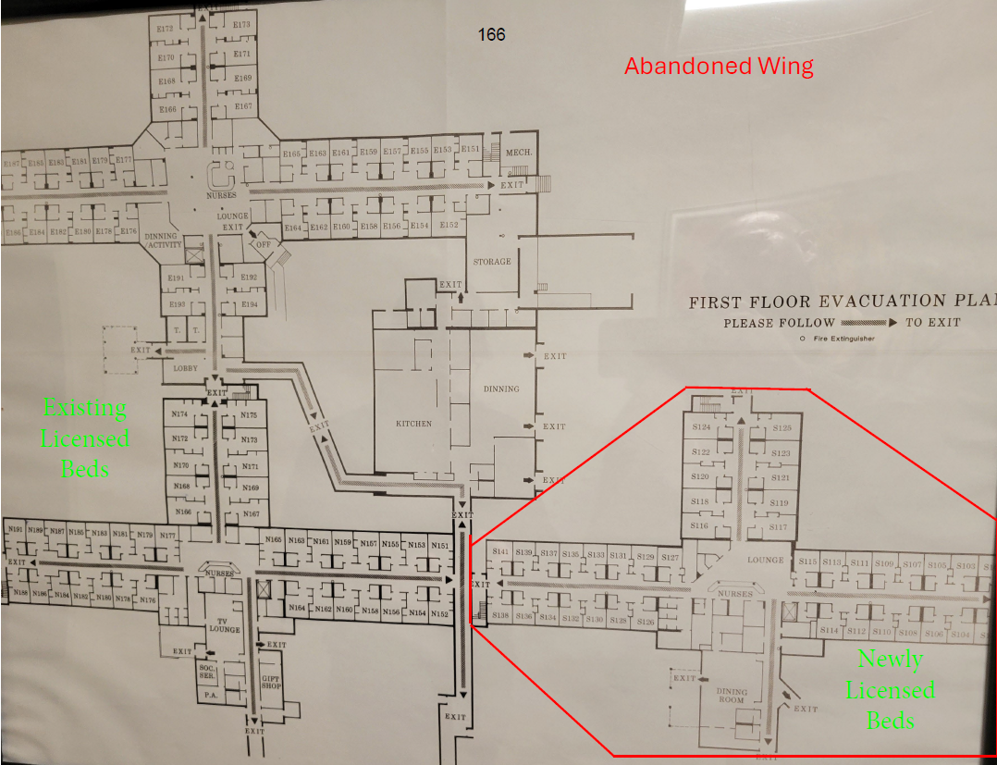
Proposed Project
The purpose of this Certificate of Need is for the addition of thirty (30) Medicare and TennCare dually certified beds.
The plan is to renovate a previously licensed area of the nursing home that is unoccupied to utilize the space to its full capability.
4

Slide 5
Need Criteria
No opposition from any competitor in the market
111 beds available from 2023 – 2024 bed pool
Recent closure of nursing home in the area – Signature Healthcare of Madison, which affects the licensed occupancy rates
Other suspended licensed nursing homes in Tennessee
Utilization rates are currently lower for McKendree due to the prior mismanagement but, through its consulting arrangement with Hill Valley Healthcare, improvement has already begun
5

Slide 6
Need Criteria
Building for the future
  The project is needed to meet the demand of Davidson County’s growing target population patient base, in which the State Health Plan Need Formula projects a need for an additional 2,435 beds in 2026.
  Expanded bed capacity will allow McKendree to evaluate the need for higher levels of care for its nursing home patients and potentially add them in the future as needed, including on-site dialysis, on-site pulmonary and ventilator care, cardio-pulmonary care, and wound care.
  If approved, the addition of the 30 beds at the facility will increase the number of licensed beds in Davidson County by less than 1%, having an immaterial impact on other nursing homes.
6

Slide 7
QUALITY STANDARDS
The Applicant will obtain Medicare certification, which involves passing an extensive survey to ensure compliance with Medicare conditions of participation.
McKendree will meet and maintain licensure requirements for state licensure and TennCare certification and submit annual Quality Measure reports as required.
McKendree will maintain appropriate patient/staff and specialty staff ratios according to patient volume and staff qualifications.
Third-party accreditation is not a standard practice for nursing homes. Based on the 2022 JAR, 317 SNFs were licensed for the calendar year 2022. Of those, only 102 reported obtaining the Joint Commission Accreditation, and 10 reported obtaining a different accreditation. This equates to only 35% of Tennessee’s SNFs obtaining a third-party accreditation.
7

Slide 8
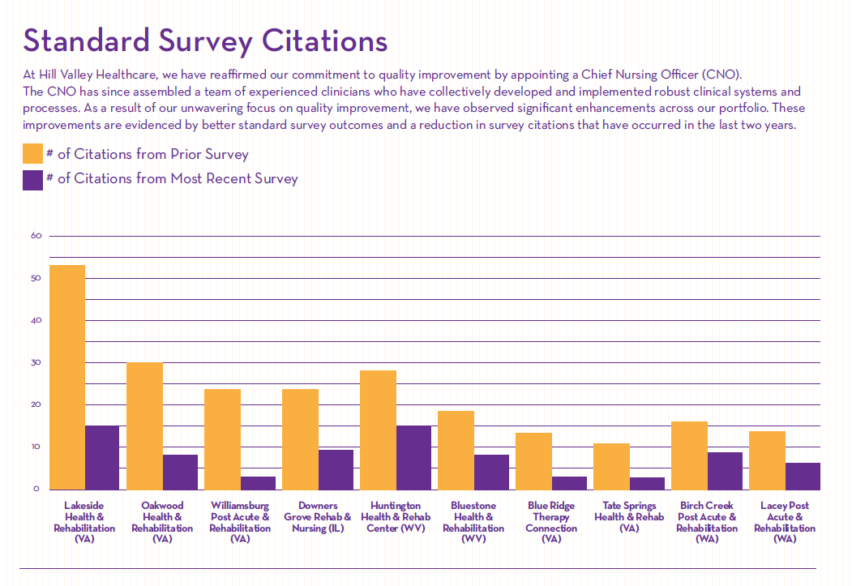
QUALITY STANDARDS
The Applicant has provided its Quality Assurance Performance Improvement (“QAPI”) Committee Documentation that outlines the QAPI program as an attachment. As indicated in the chart, this has been instrumental in the other facilities with which Hill Valley has consulted.
It is important to note that the 5-star CMS rating system requires three survey cycles to significantly improve the health inspection rating. As Hill Valley has not operated most of these facilities for the full three cycles, it has been challenging to fully showcase the improvements on a larger scale. Therefore, showing a comparison of the number of citations is a great indicator of improvement, and the progress we have made is substantial and indicative of our commitment to excellence in patient care.
8

Slide 9
CONSUMER ADVANTAGE
The McKendree Post Acute & Rehabilitation (“McKendree”) is contracted with numerous commercial private insurance plans and participates in Medicare and TennCare. McKendree is in contract with all service area TennCare Managed Care Organizations.
Committed to serving low-income and uninsured patients, as over 56% of the projected patient population will be Medicaid
Transfer agreement with TriStar Summit Medical Center
McKendree will offer affordable services, as evidenced by the patient charges, which are the average among all other nursing homes in Davidson County.
Improved continuity of care for those in the continuity care retirement community
9

Slide 10
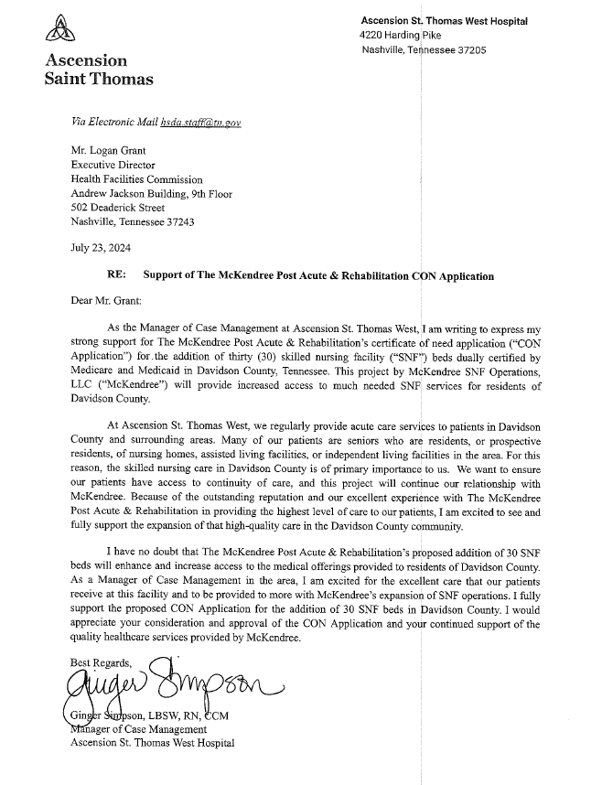
Letter of Support
“Because of the outstanding reputation and our excellent experience with The McKendree Post Acute & Rehabilitation in providing the highest level of care to our patients, I am excited to see and fully support the expansion of that high-quality care in the Davidson County community.”
“I have no doubt that . . . [the] addition of 30 SNF beds will enhance and increase access to the medical offerings provided to residents of Davidson County.”
Ginger Simpson, LBSW, RN, CCM
Manager of Case Management
Ascension St. Thomas West Hospital
10

Slide 11
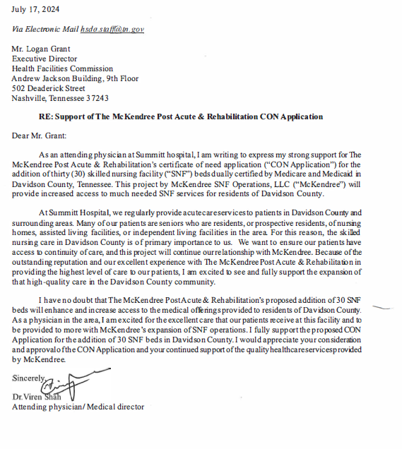
Letter of Support
“We want to ensure our patients have access to continuity of care, and this project will continue our relationship with McKendree”
Dr. Viren Shah
Medical Director
11

Slide 12
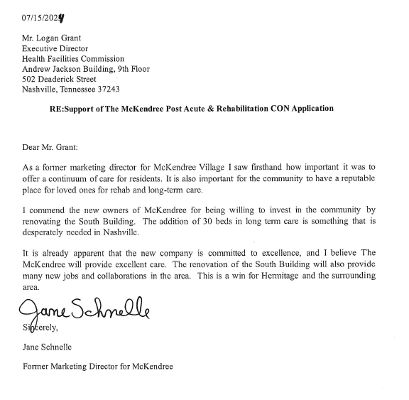
Letter of Support
“The addition of 30 beds in long term care is something that is desperately needed in Nashville.”
“It is already apparent the new company is committed to excellence, and I believe The McKendree will provide excellent care.”
Jane Schnelle
Former Marketing Director for McKendree
12

Slide 13

CONCLUSION
NEED
QUALITY
CONSUMER ADVANTAGE
We respectfully request you APPROVE this CON.
13

