Slide 1

TN Health Facilities Commission
Randy Porter, Putnam County Mayor

Slide 2
Major Points
Cedar Recovery’s history
Need
Safety
Existing Treatment and Recovery Facilities
Opposition

Slide 3
Cedar Recovery History
Started in Cookeville
Zoning interfered
Went to Overton County
Citizens raised up in massive numbers
Came back to Cookeville – zoning again
Started CON process out in Putnam County

Slide 4
Cedar Recovery
“We will not come to a place that doesn’t want us”
Yet here we are today…

Slide 5
Need
DMHSAS Data says there are only 105 people in the 12 county region in 2023 that were treated with Methadone
Out of over 300,000 citizens only 105 (0.00035%)
Cedar Recovery left out the OTP in Murfreesboro which is only 67 miles from Cookeville and even closer to other counties

Slide 6
Need
We have hundreds of people that drive every day to Nashville, Knoxville or Murfreesboro for specialized medical needs.
$2.5 million for 105 people $23,809 per person. That’s just building cost alone.
Why? Is it because it is so profitable?

Slide 7
Need
We have thousands with mental health issues in our region, but no one is building a new mental health facility.
We need more drug addiction in-patient treatment facilities. Spend the $2.5 million on one of those and we will support fully!

Slide 8
Safety of Surroundings
Same building as a Youth Sports Facility
Church - 175 feet
Church – 700 feet
Daniel First Homeschool Office – 1,135 feet
Daycare – 1,250 feet
Parkview Elementary School – 2,000 feet

Slide 9
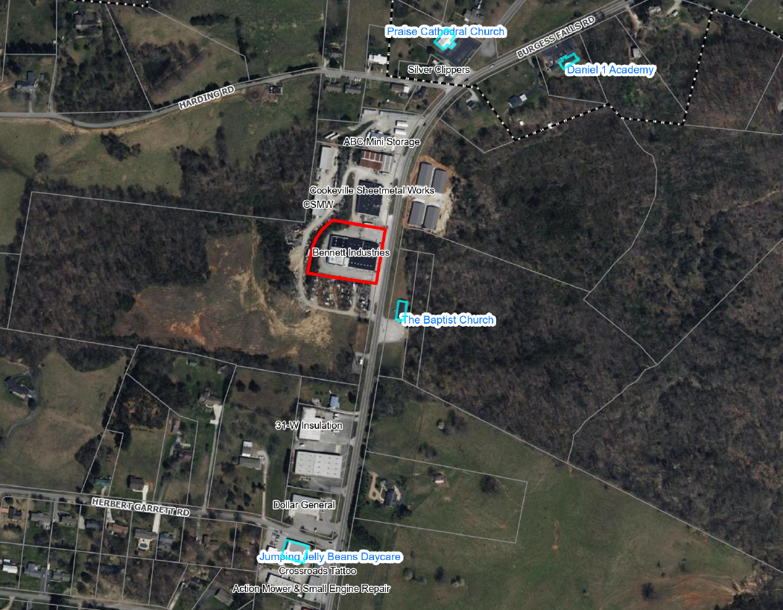

Slide 10
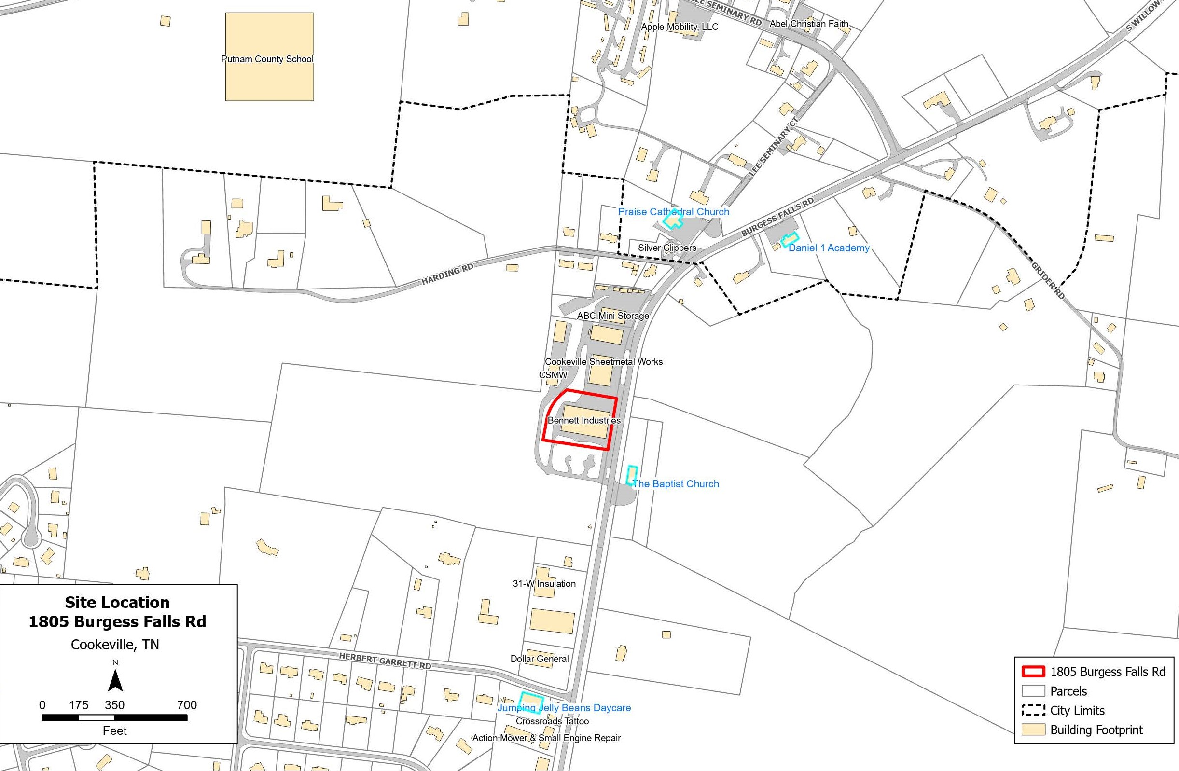

Slide 11
Safety
According to a study published by the National Library of Medicine:
“Violent crime associated with drug treatment centers is similar to that associated with liquor stores.”
The law would not allow a liquor store at this same location.

Slide 12
Existing Programs
Volunteer Behavior Health
Next Step for Life
Real Life Recovery
CASA
Willow Bend Farms
Power of Putnam
Cookeville Rescue Mission

Slide 13
Existing Programs
This is Living Ministries
Heart of the Cumberland
13th Judicial Recovery Courts
Life Regeneration Ministries
Cookeville Recovery Center
Cumberland Heights
Bradford Health Services

Slide 14
Existing Programs
Generations Health Center
SperoHealth Cookeville
Camelot Care Center
FamilyCare Services
Freeman Recovery Center

Slide 15
Existing Programs
Long list of existing treatment and recovery programs that don’t replace one addictive drug with another more addictive drug that is much harder to get off of.
We are putting our Opioid Funds out to a lot of these programs. (almost $1 million)

Slide 16
Opposition
County Commission – 24 members
County Mayor
Sheriff
District Attorney
Judges
Doctors
Citizens – over 4,000 signatures
746 pages of opposition vs 10 pages of support

Slide 17
Summary
Our community strongly opposes the CON, by the people here today and petition
Senator, DA, Mayor, Sheriff, Judges, Doctors are all opposed to it.
We feel there is not a need – safety issue
Our community safety-welfare is at stake here. Please deny the CON request

