Slide 1

Cedar Recovery
Nonresidential Substitution Based Treatment Center of Opiate Addiction
Putnam County
CON Application No. CN2405-014

Slide 2
Cedar Recovery of Middle Tennessee, LLC
Local company founded in 2015 and headquartered in Mt. Juliet.
Owns and operates 13 outpatient addiction treatment clinics in Tennessee and Virginia (“OBOTs” for Office Based Opioid Treatment), including 2 in Knoxville.
Cedar Recovery is a CARF Accredited Agency offering OBOT, intensive outpatient counseling, and outpatient mental health services.
Cedar Recovery offers full range of outpatient opioid addiction treatment modalities including recently approved OTP in Knoxville.

Slide 3
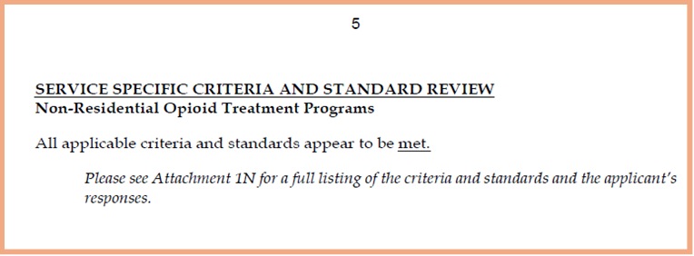
From page 5 of HFC Staff Application Review:

Slide 4
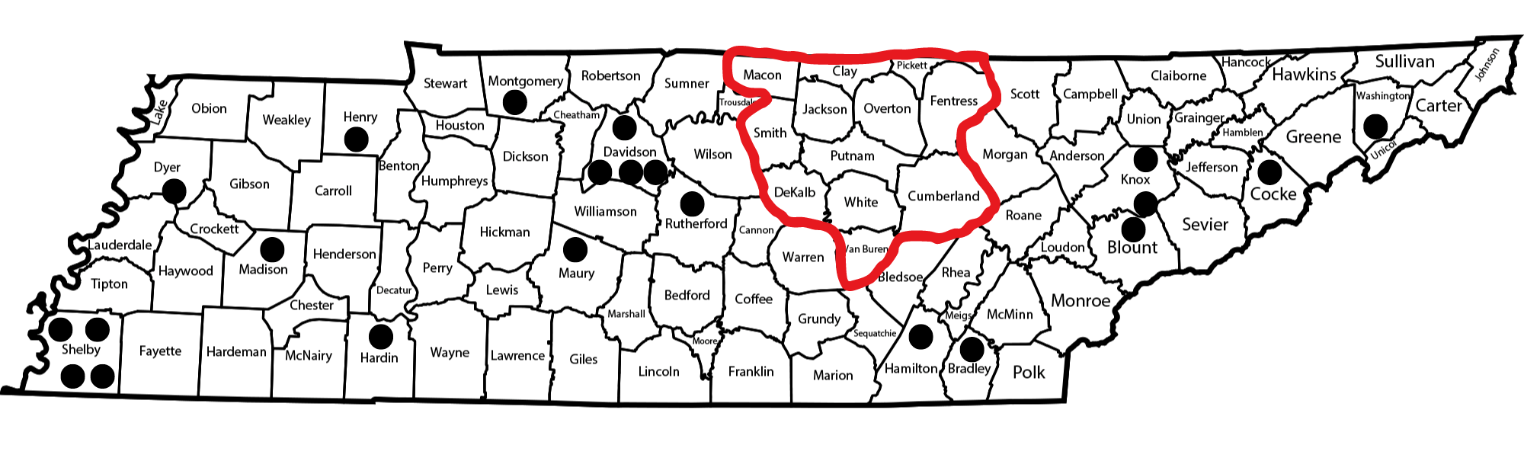
LOCATIONS OF OTPs IN TENNESSEE
Proposed Service Area

Slide 5
Driving Distances to OTPs from PSA Counties

Slide 6
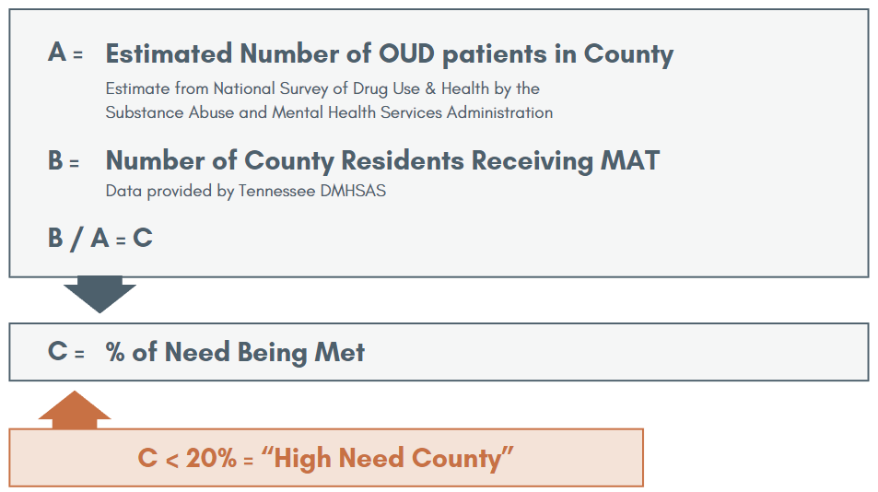
Need Formula in CON Standards & Criteria

Slide 7
All PSA Counties have a “High Need” for OTP Treatment

Slide 8
LOCATIONS OF OTPs IN TENNESSEE
Proposed Service Area

Slide 9
Mission
“Solve the Opioid Epidemic & Repair the Communities We Serve”
1200 3%

Slide 10
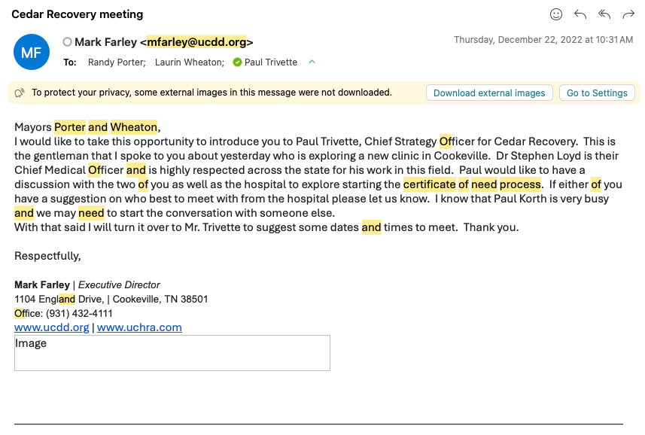
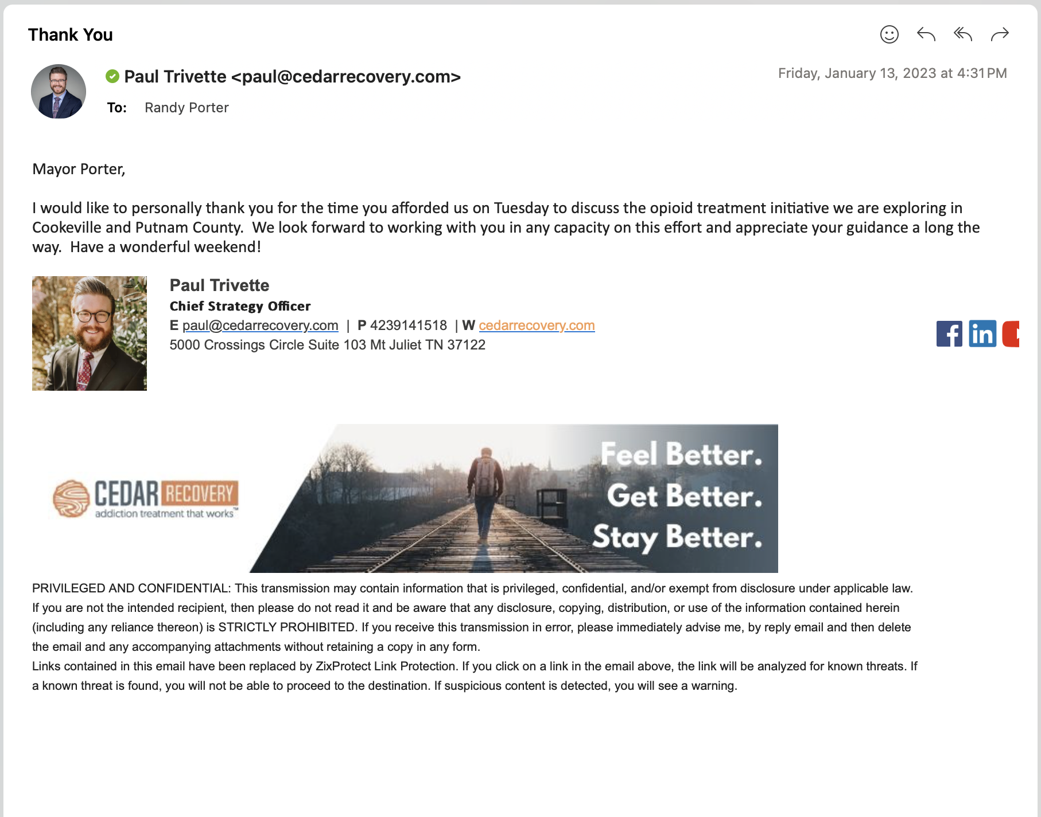
OTP to Putnam County

Slide 11
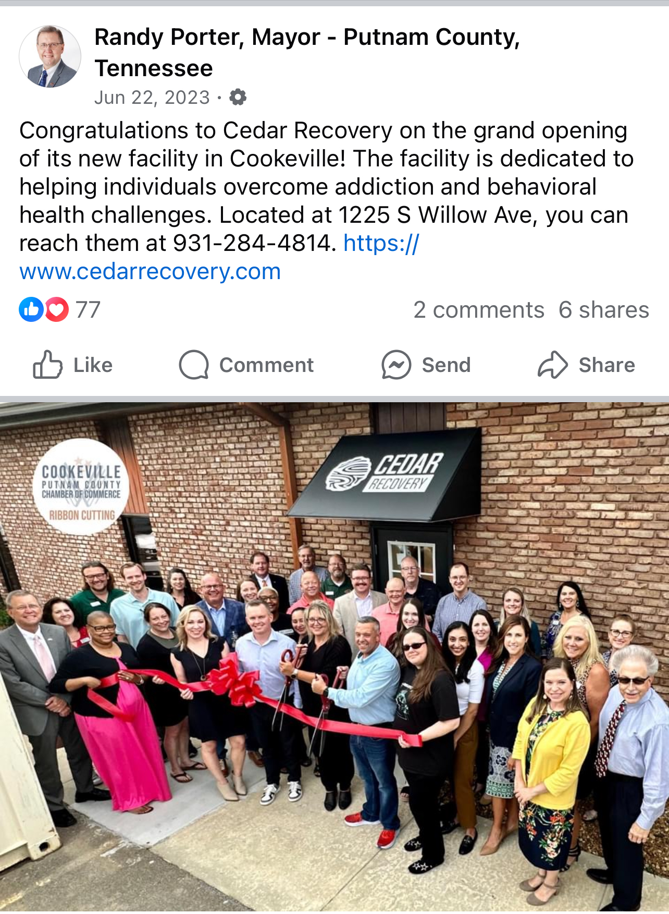
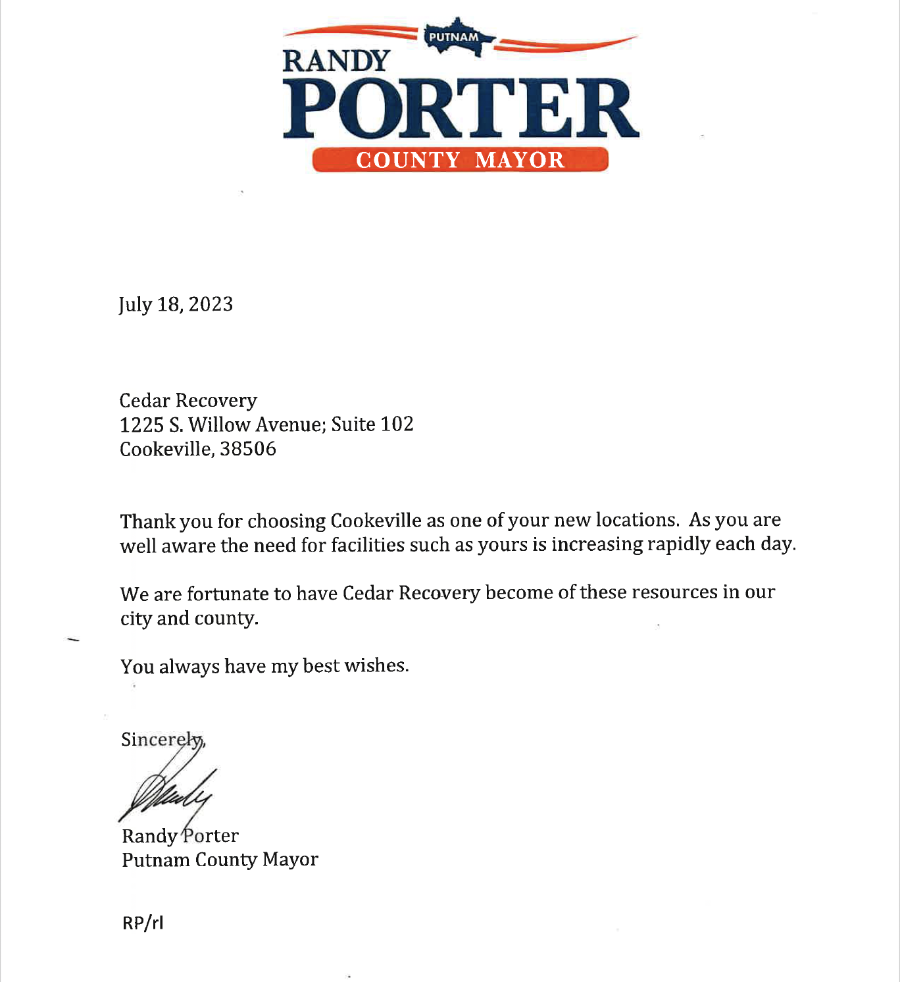
OBOT Grand Opening (6/22/23)

Slide 12
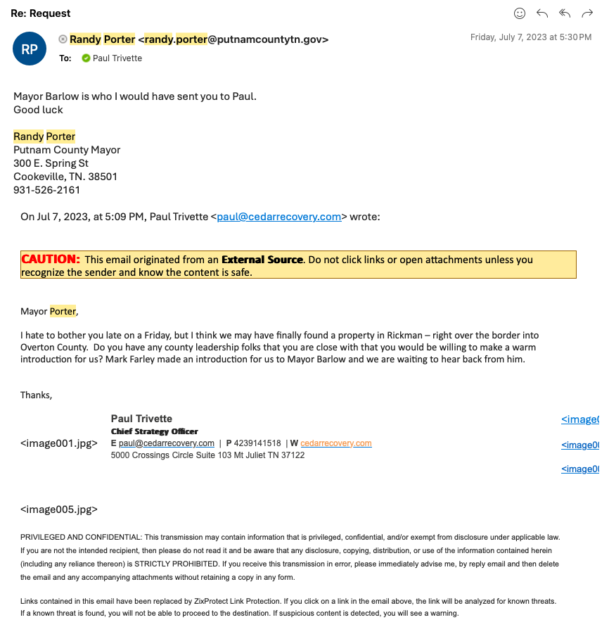
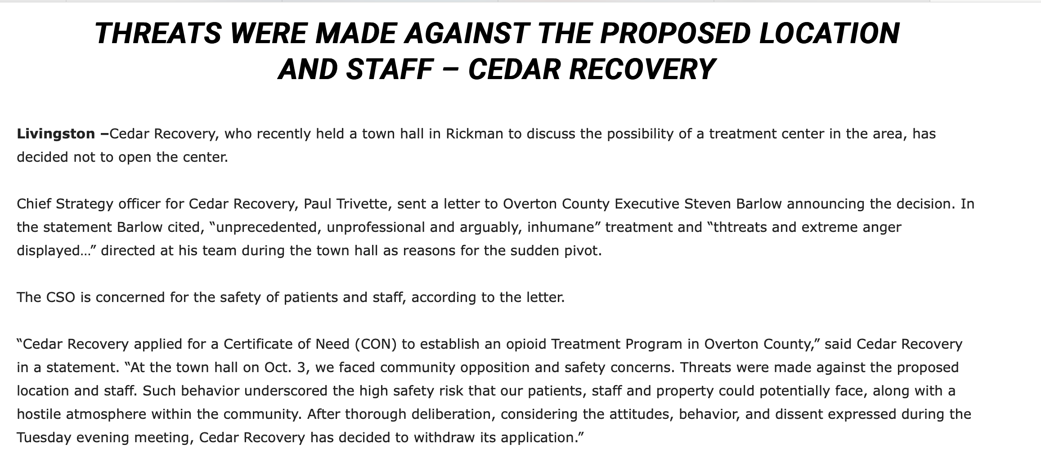
OTP – Overton County (October 2023)

Slide 13
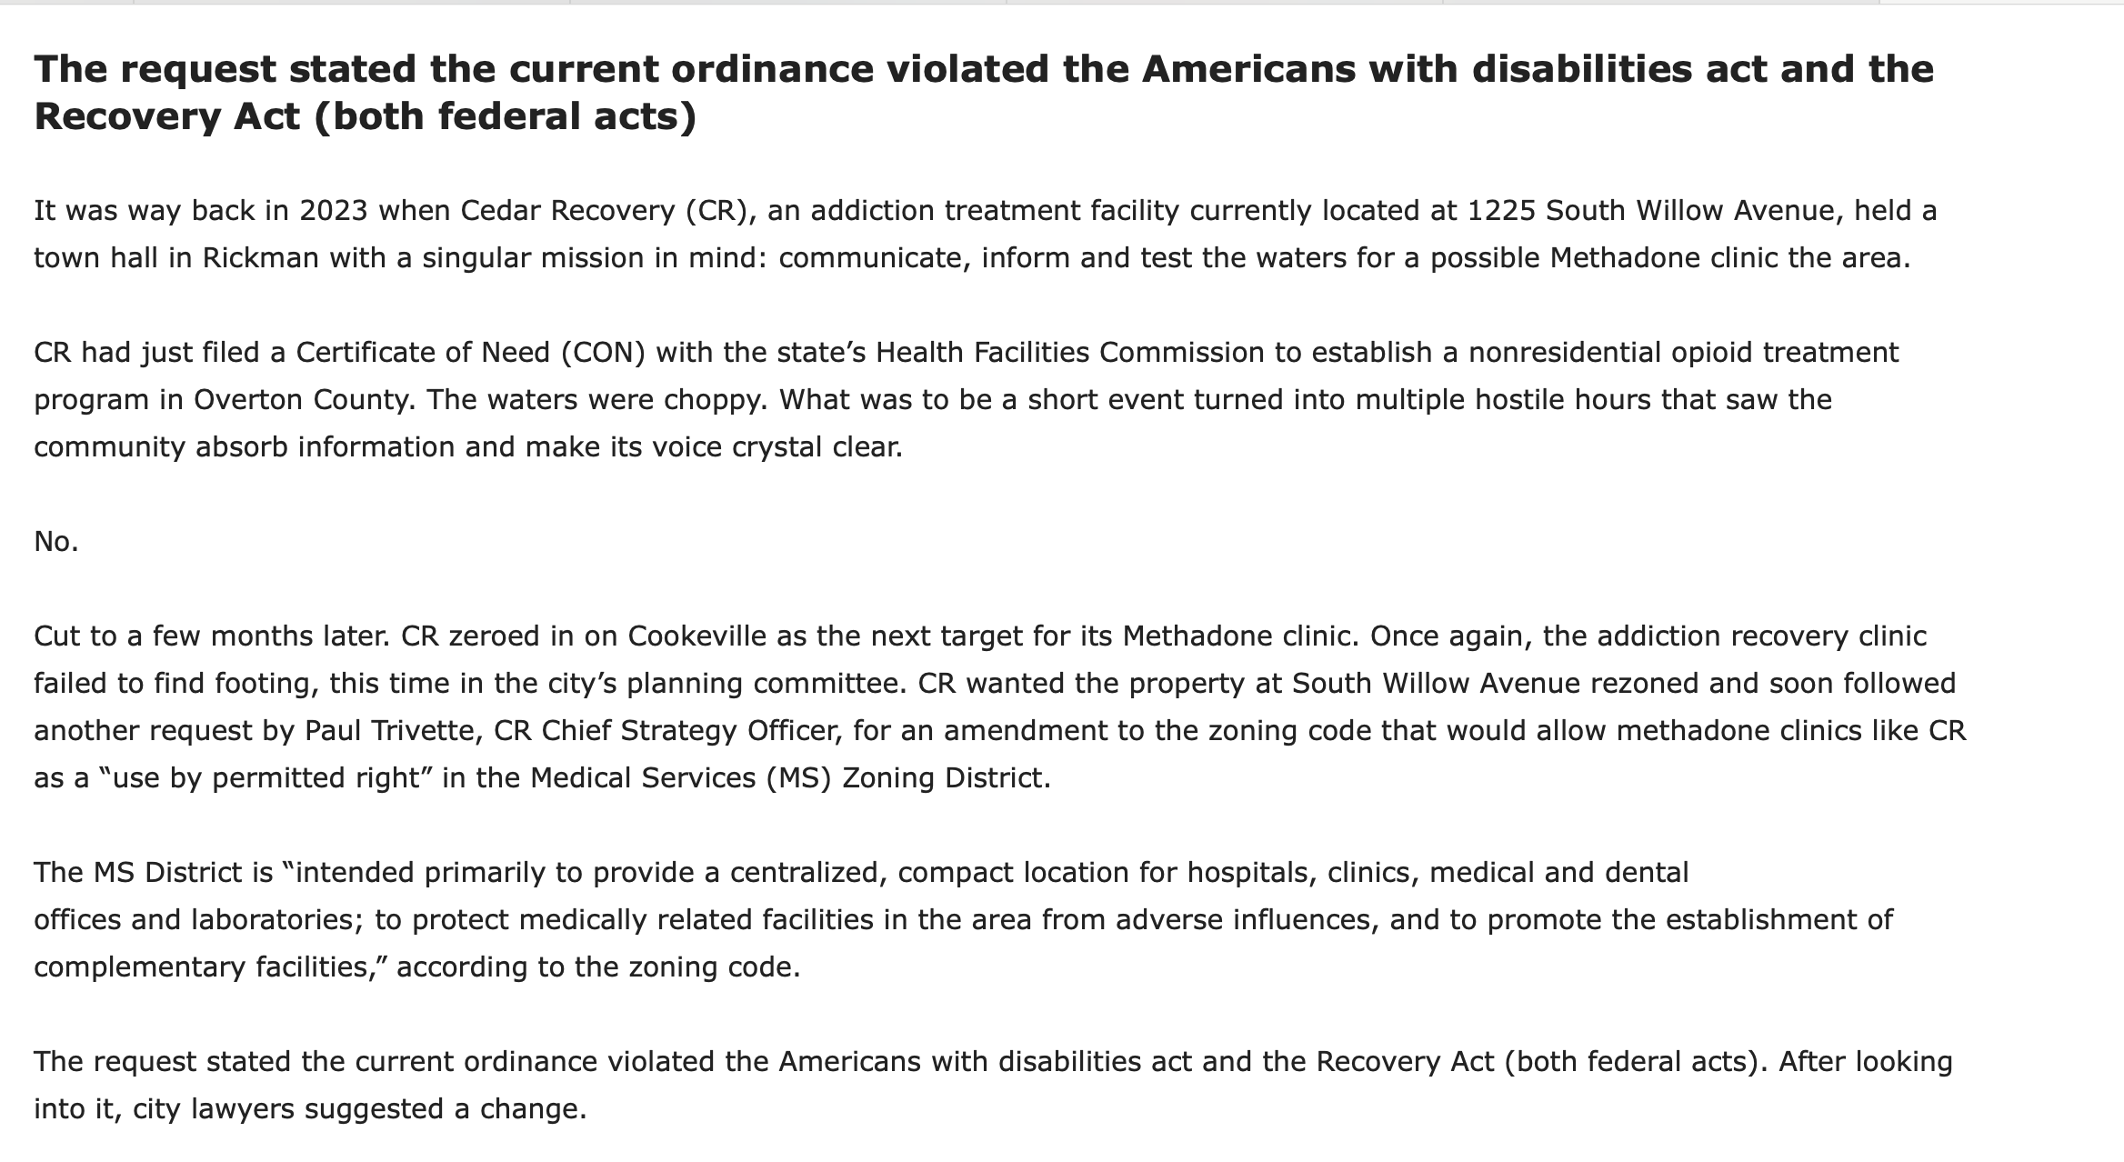
Cookeville

Slide 14
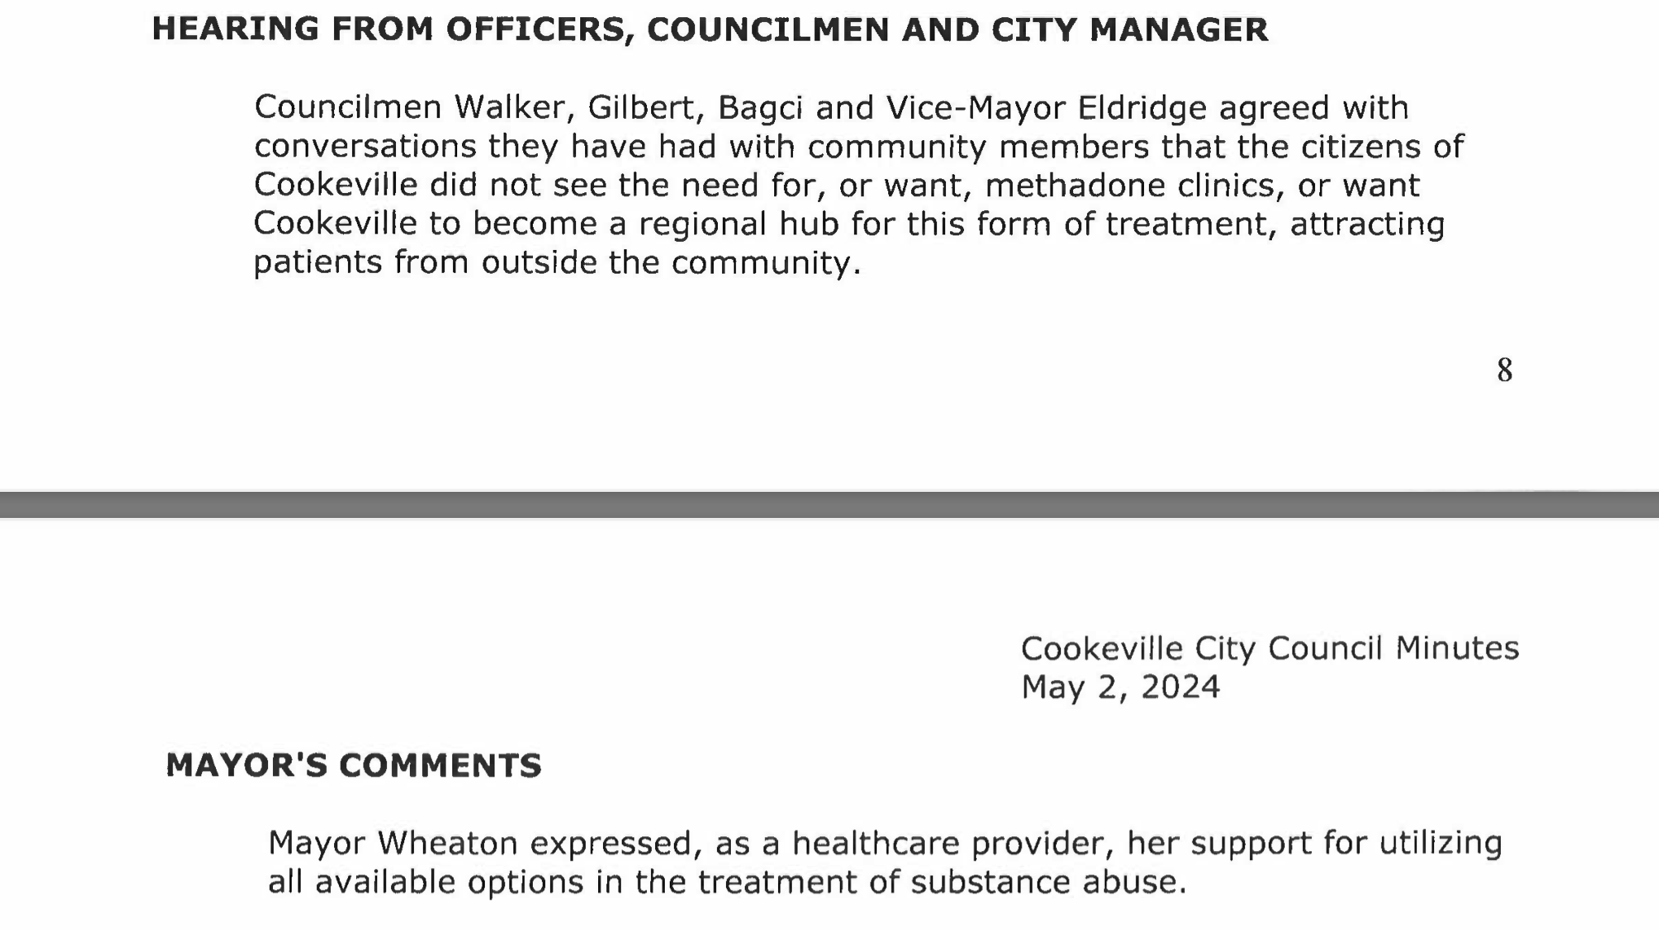
Mayor Wheaton

Slide 15
Commitment
Good Neighbor Agreement sent to elected officials – 6/20/2024
Community Advisory Board - Formed upon approval
Quarterly open house events for the community
Considerate Hours (931 Elite Sports & Churches)

Slide 16
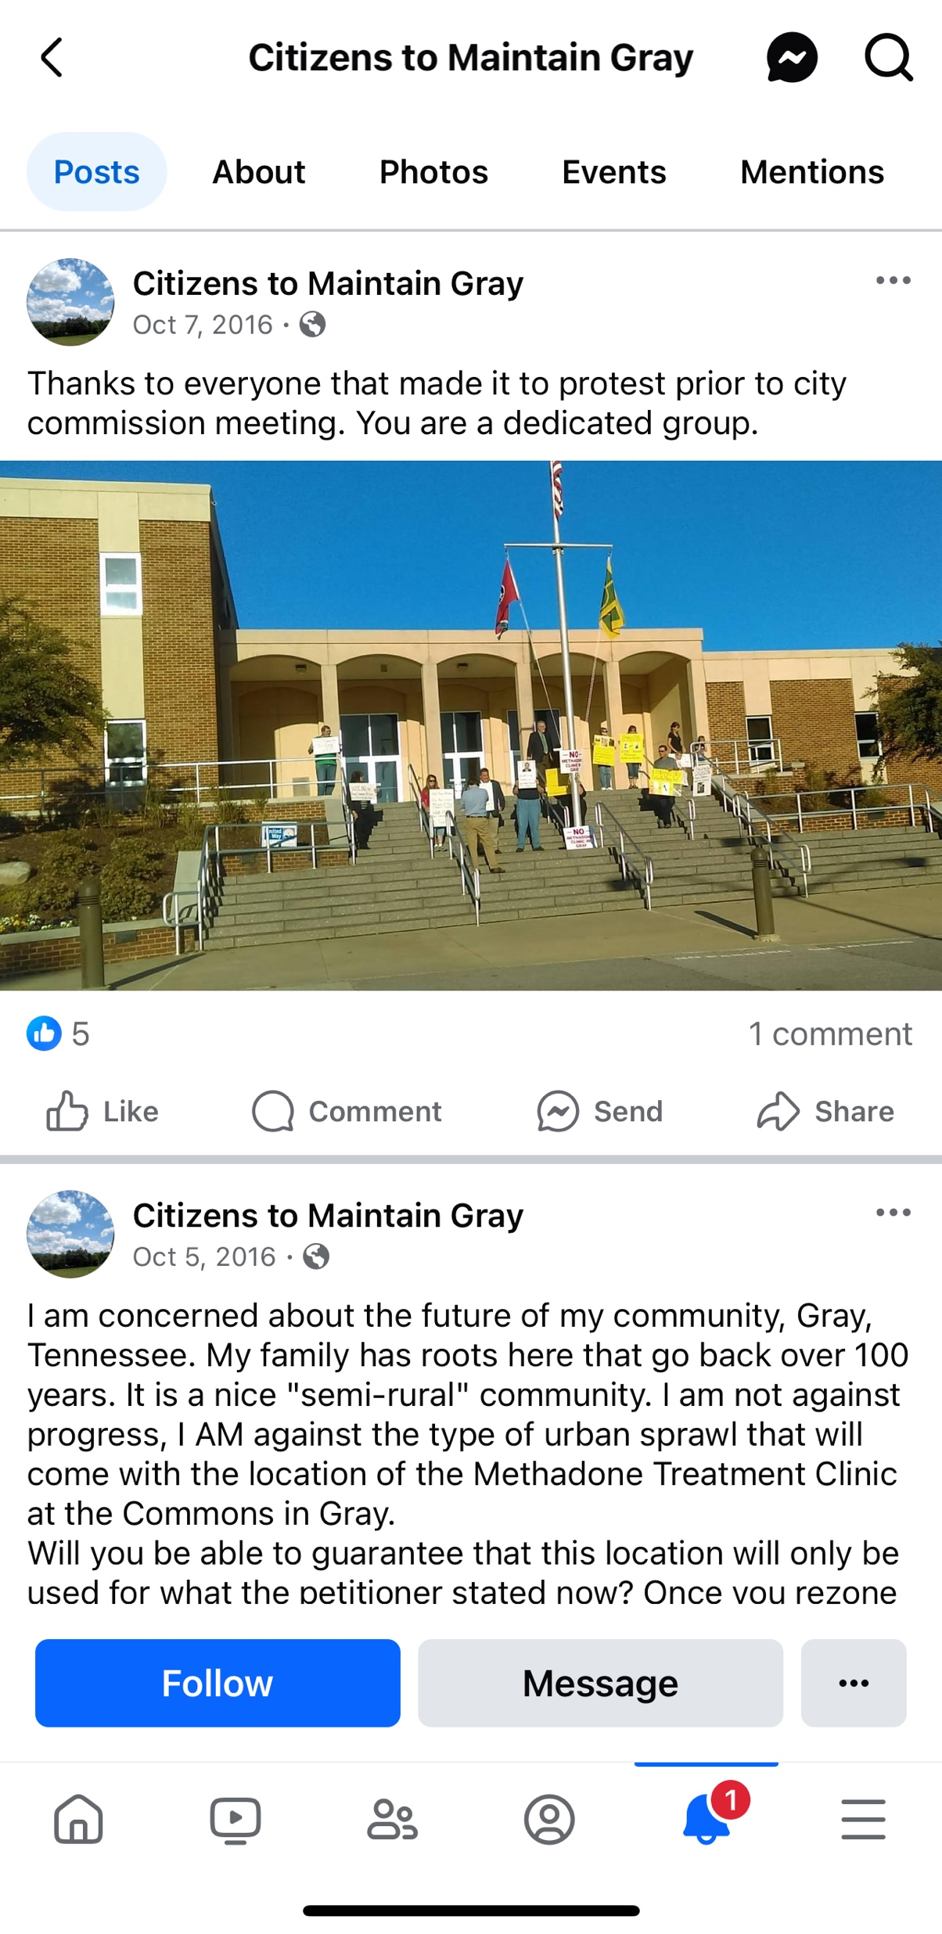
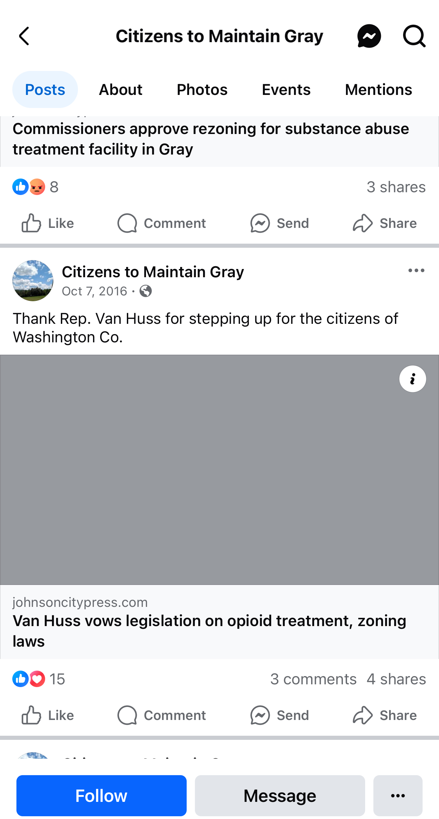
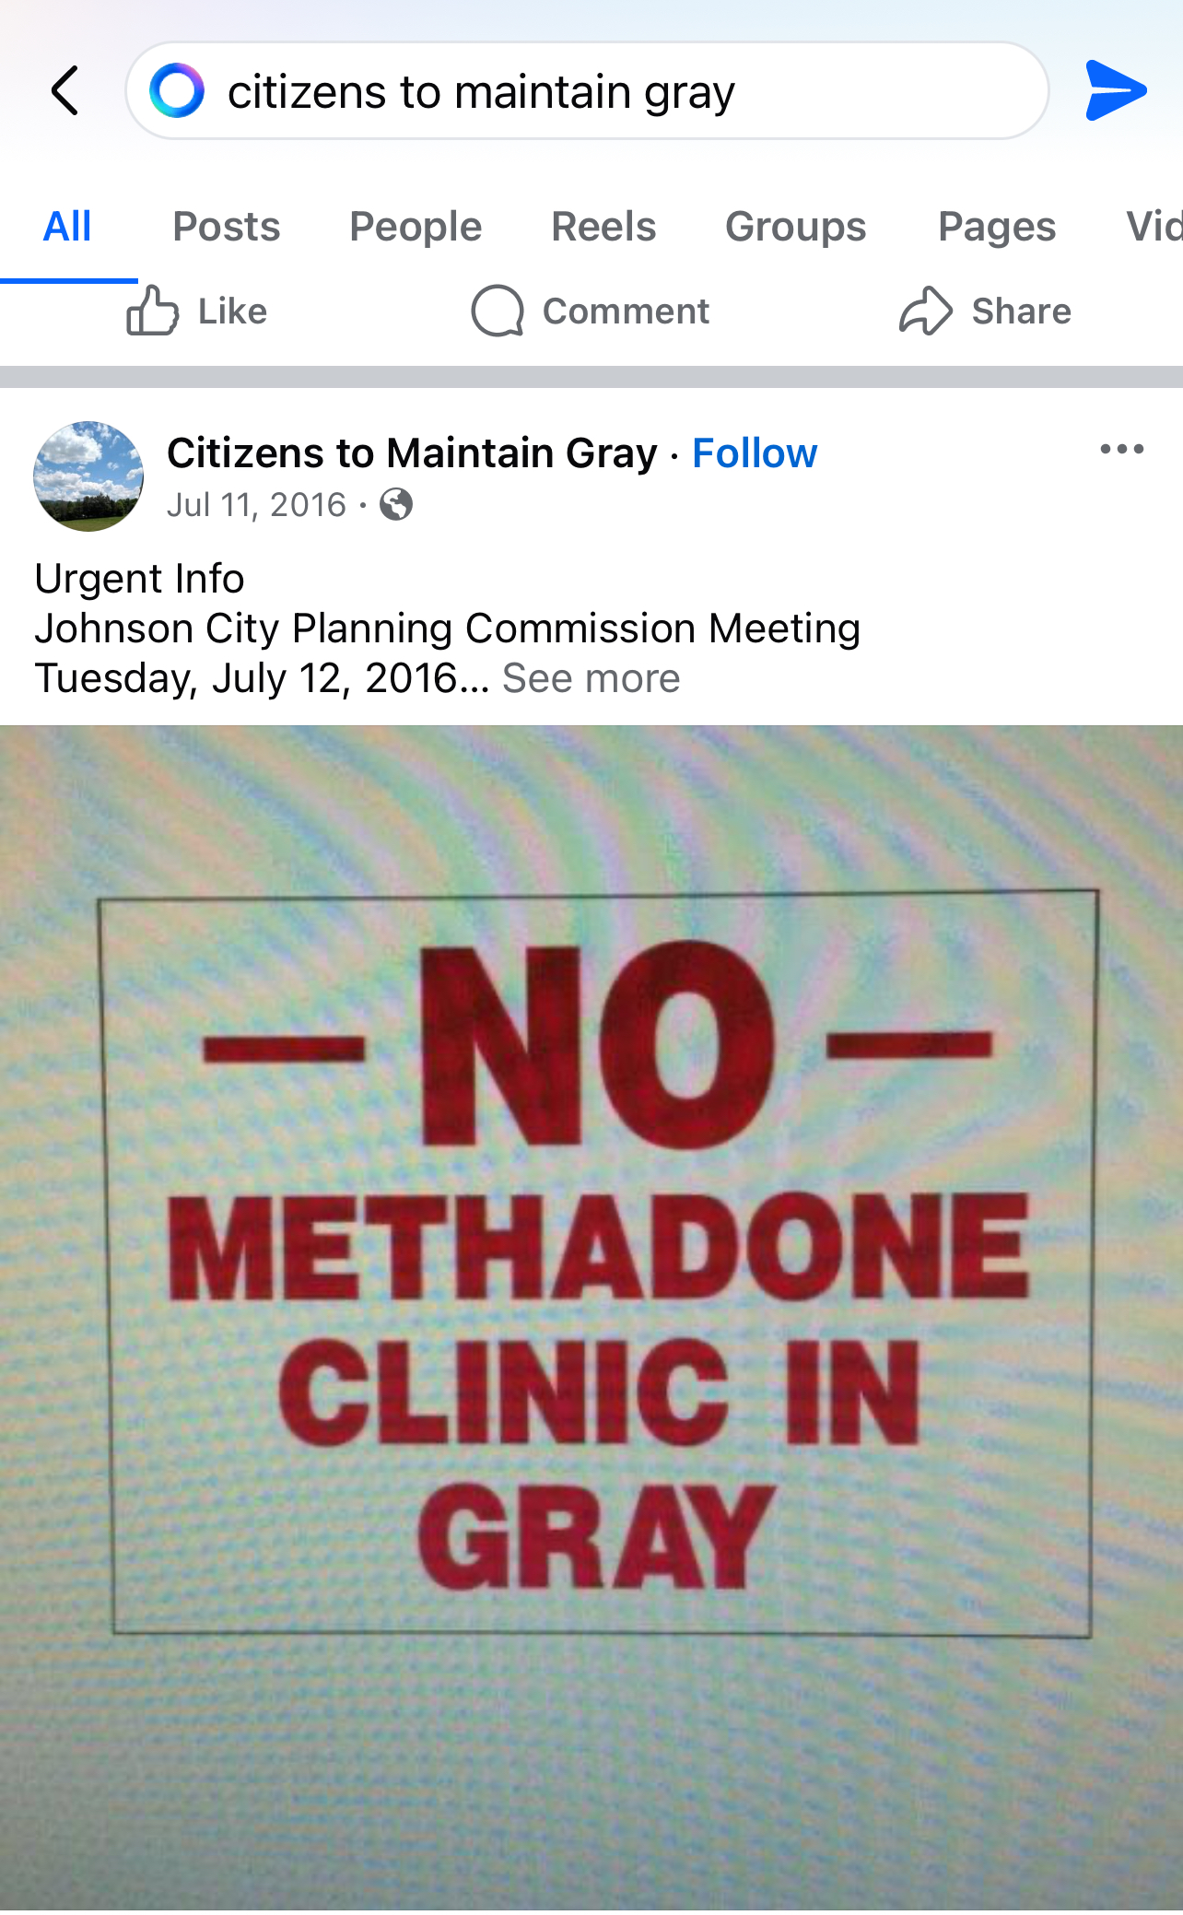
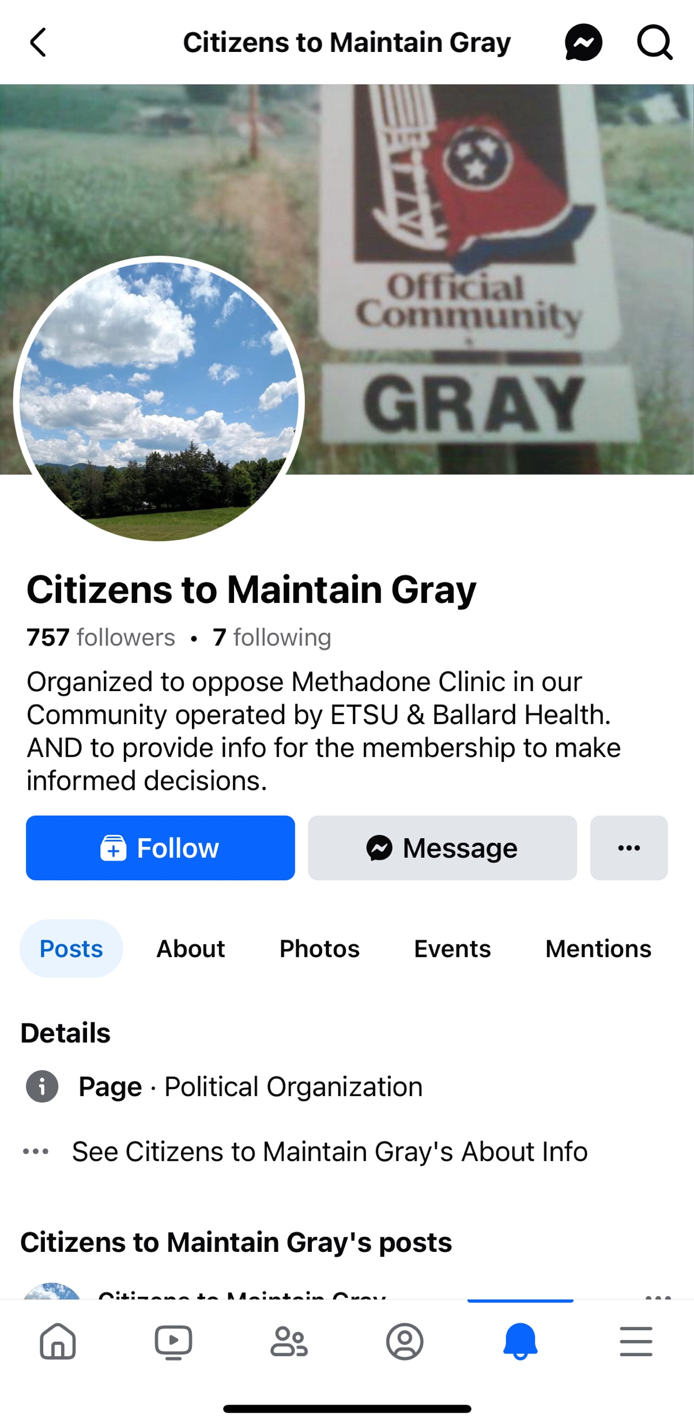
Gray (Washington Co.) – 2016 “Not in My Backyard”

Slide 17
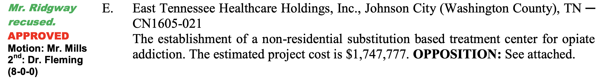
Gray (Washington Co.) – CON Decision – APPROVED

Slide 18
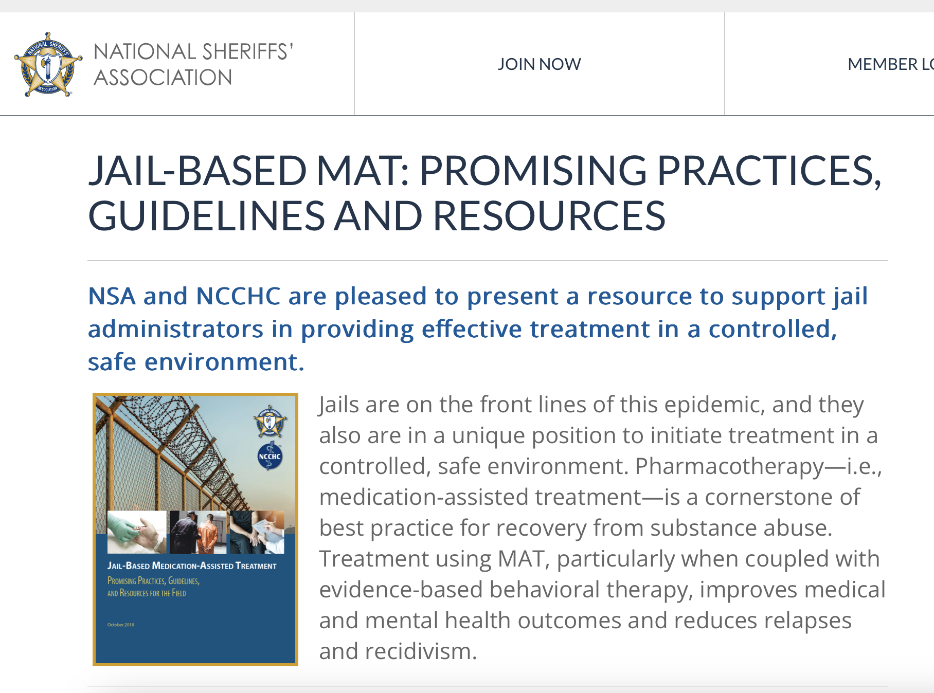
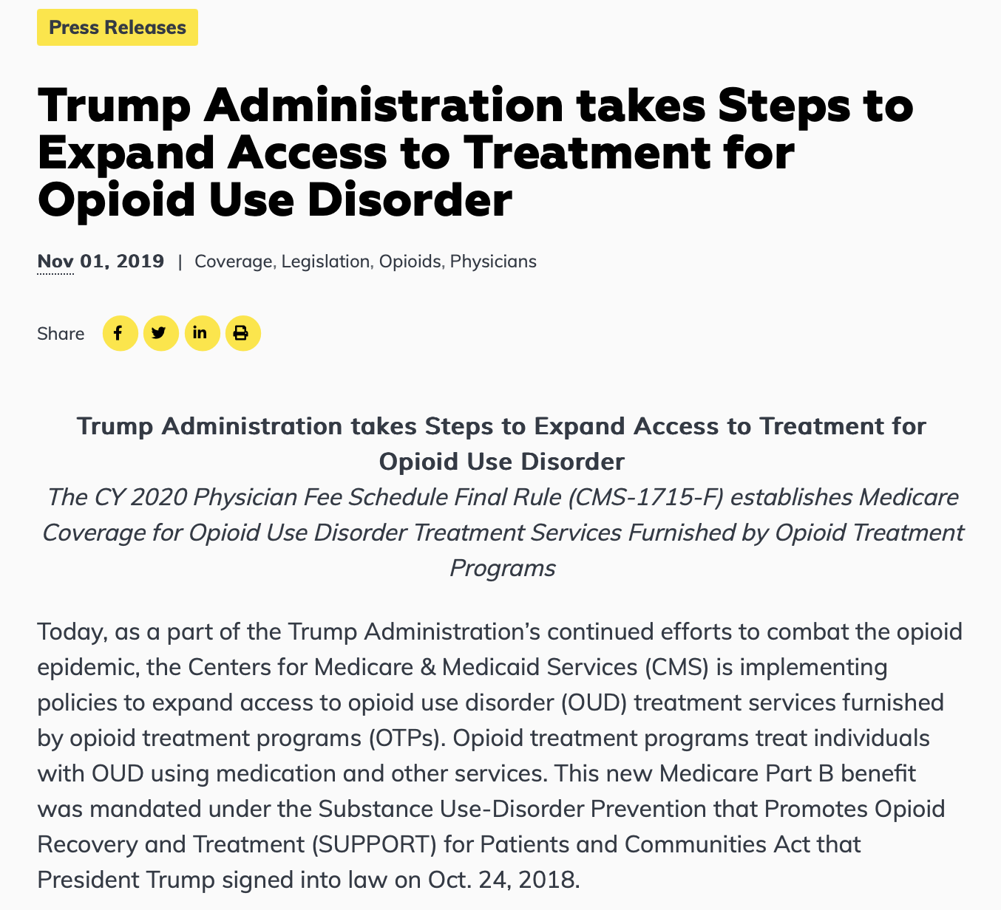
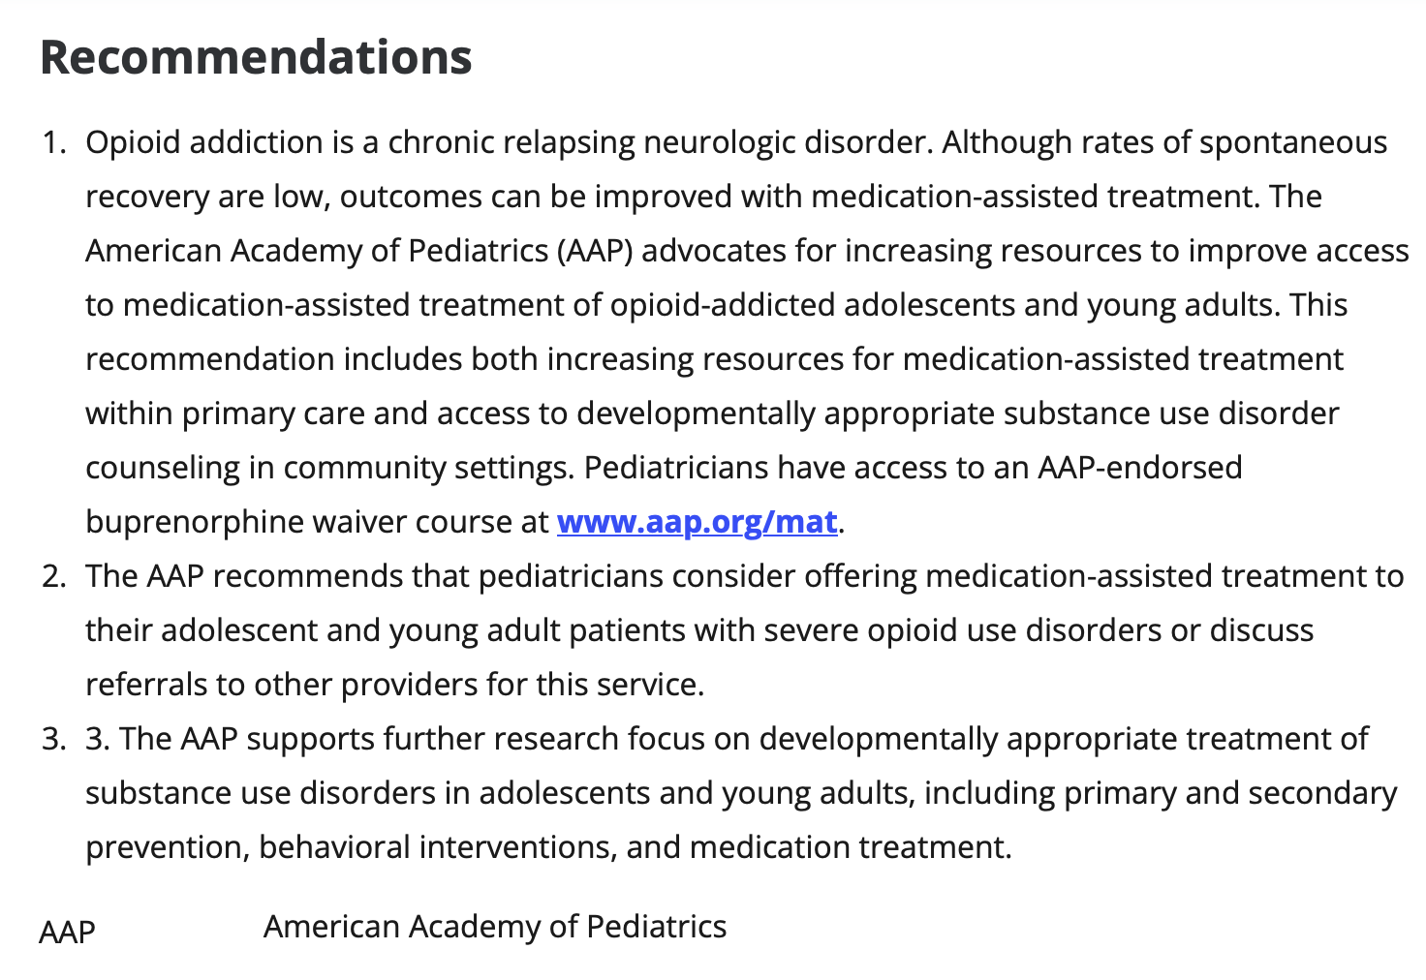
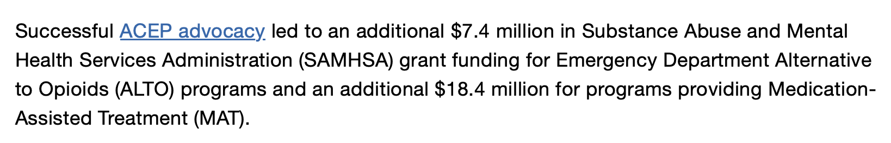
Trusted Treatment

Slide 19
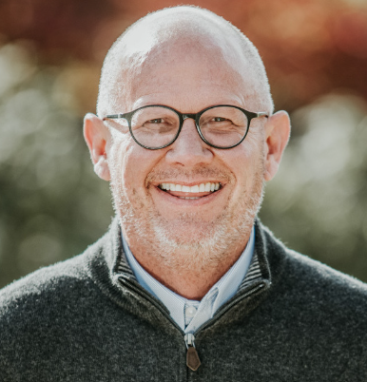
Dr. Stephen Loyd, M.D.
Serves as Chief Medical Officer of Cedar Recovery
Founded and served as Medical Director of New Hope OTP in Newport, TN.
Served as Asst. Commissioner of TDMHSAS
Served as Chair, Tenn. Opioid Abatement Council
Served as Vice Chair, Tenn. Bd. Of Medical Examiners
Served on Gov. Bill Haslam’s Opioid Workgroup, 2017
Served on Dangerous Drugs Task Force, T.B.I.
Has testified as expert witness for FBI, TBI, and DEA

Slide 20
Just a Few of Many Organizations Endorsing Methadone as Treatment for OUD
CMS / Medicare
TennCare Bureau
Substance Abuse and Mental Health Services Administration (SAMHSA)
Tennessee Department of Substance Abuse & Mental Health Services
American Society of Addiction Medicine
American College of Emergency Physicians
American Academy of Pediatrics
National Sheriffs Association
National Institutes of Health
National Association of Drug Court Professionals

Slide 21
Rebuttal Slides

Slide 22
Opposition Claim:
Methadone has side effects and can be addicting
FACTS:
Most meds have side effects for a small number of people; any side effects are miniscule compared to effects of opioid addiction.
Any dependence to methadone is managed under physician supervision, and the goal is always to wean the patient off methadone.
Methadone does not produce the euphoria or “high” which leads to opioid addiction.

Slide 23
Opposition Claim:
Non-substitution-based treatments are adequate
FACTS:
Abstinence-based treatment works for some but does not work for most addicted individuals.
There were 159 fatal ODs and 988 non-fatal ODs in the PSA in 2022. Existing treatment options in PSA cannot be considered adequate in light of this death toll.
Even taking into account all current treatment modalities in PSA, 11 of 12 counties are “High Need” under the Criteria.

Slide 24
Opposition Claim:
The OTP will cause an increase in crime in the area.
FACTS:
T.B.I. data shows that every community in Tenn. in which an OTP has opened in the past 2-3 years, crime has decreased by up to 23%.
Narcotics-related crimes occur because the addict must support his or her expensive addiction; when in treatment, there is no reason to commit such crimes.
Opioid addicts being considered “criminals” is a misinformed stereotype.

Slide 25
Opposition Claim:
After dosing, patients might drive while impaired
FACTS:
U.S. Dept. Health & Human Services:
When properly dosed under clinical supervision methadone does not cause driving impairment.
There will be fewer addicted individuals driving while impaired under illicit drugs if the OTP is operational.

Slide 26
Opposition Claim:
Location is bad because it is too near to places where children will be present
FACTS:
This objection is based on a prejudicial stereotype of addicted individuals being “criminals” or “dangerous people.”
Location was only available property in the county after Cedar was barred from locating next to the hospital by a discriminatory zoning ordinance.
Numerous existing OTPs in Tenn. are as close or closer to schools or day care centers.

Slide 27
Opposition Claim:
Venture capitalists may gain control of this OTP
FACTS:
This is unfounded speculation with no basis in truth or fact.
Cedar Recovery is wholly owned by individual investors committed to addiction treatment and recovery.
There is no desire, need, or intent to allow investment by any venture capitalist.

Slide 28
Summation Slides

Slide 29
Summation – Need
Putnam County is centrally located in a vast geographic area of the state which has no OTP.
Those in the PSA needing to participate in a methadone assisted treatment program must travel an average of 109 miles each way daily or multiple times each week to get treatment.
Addicted individuals in the PSA will have to travel only 34.5 miles each way to access treatment at this proposed OTP.
Under the CON criteria there is a “High Need” for an OTP in the PSA.

Slide 30
Summation – Consumer Benefits
Proposed OTP will improve accessibility to treatment by reducing the distance to an OTP from 109 miles to 34 miles.
Improved accessibility will enable addicted individuals to receive treatment which can turn their lives around, and in many cases prevent fatal ODs.
Cedar Recovery participates in Medicare and TennCare, and all major commercial insurance plans, making treatment affordable. Even self-pay charges are low: under $20 per day.

Slide 31
Summation – Quality Standards
The OTP will be licensed by the TDMHSAS.
The OTP will be accredited by the Commission on Accreditation of Rehabilitating Facilities (CARF) as are all of Cedar’s existing clinics.
Dr. Loyd is one of the foremost experts in the U.S. on MAT and OTPs.
Cedar Recovery owns and operates numerous office-based outpatient addiction treatment facilities and has a sterling reputation.

