Slide 1
Using Data to Reduce Breast Cancer Disparities Project
Disparities Impact Statement Data
Audrey M Stach, DVM, MPH | Epidemiologist
Tennessee Breast and Cervical Screening Program

Slide 2
Overview
Incidence and mortality
Mammography facilities
Screening mammograms among Medicare enrollees
Health provider shortage areas & medically underserved areas
Small Area Health Insurance Estimates
Social Vulnerability Index
Tennessee Breast and Cervical Screening Program

Slide 3
Incidence and Mortality

Slide 4
Notes:
Rates are age-adjusted.

Slide 5
Notes:
Rates are age-adjusted.

Slide 7
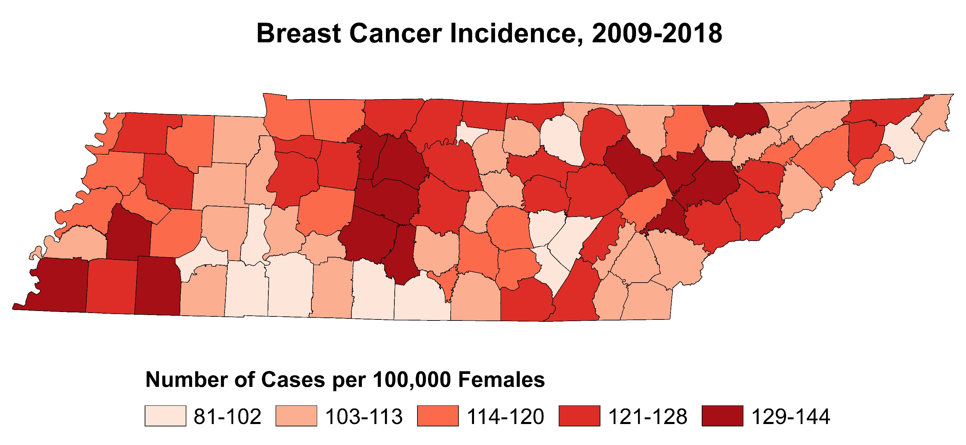
Notes:
Rates are age-adjusted.

Slide 8
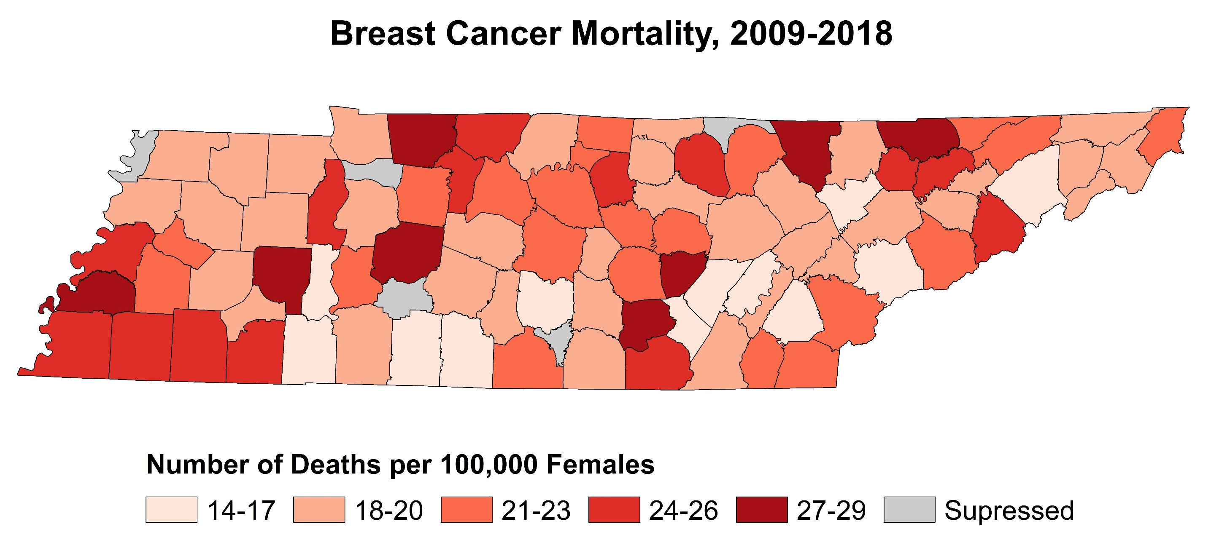
Notes:
Rates are age-adjusted.

Slide 9
Notes:
Rates are age-adjusted.

Slide 10
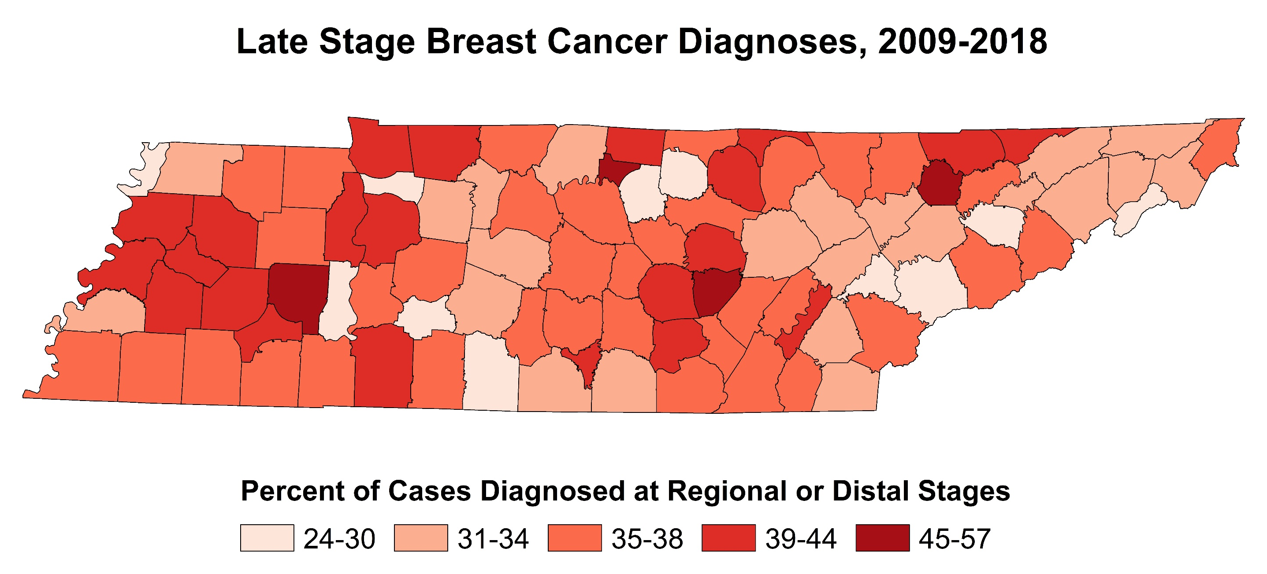

Slide 11
Mammography Facilities

Slide 12
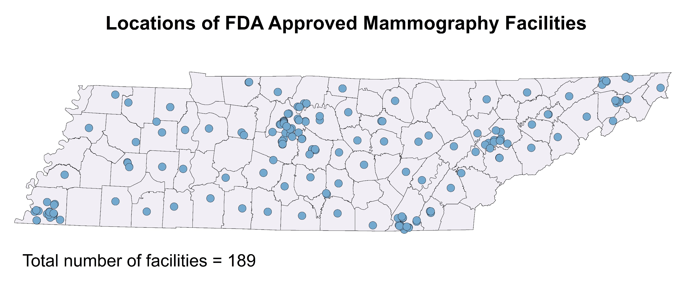

Slide 13
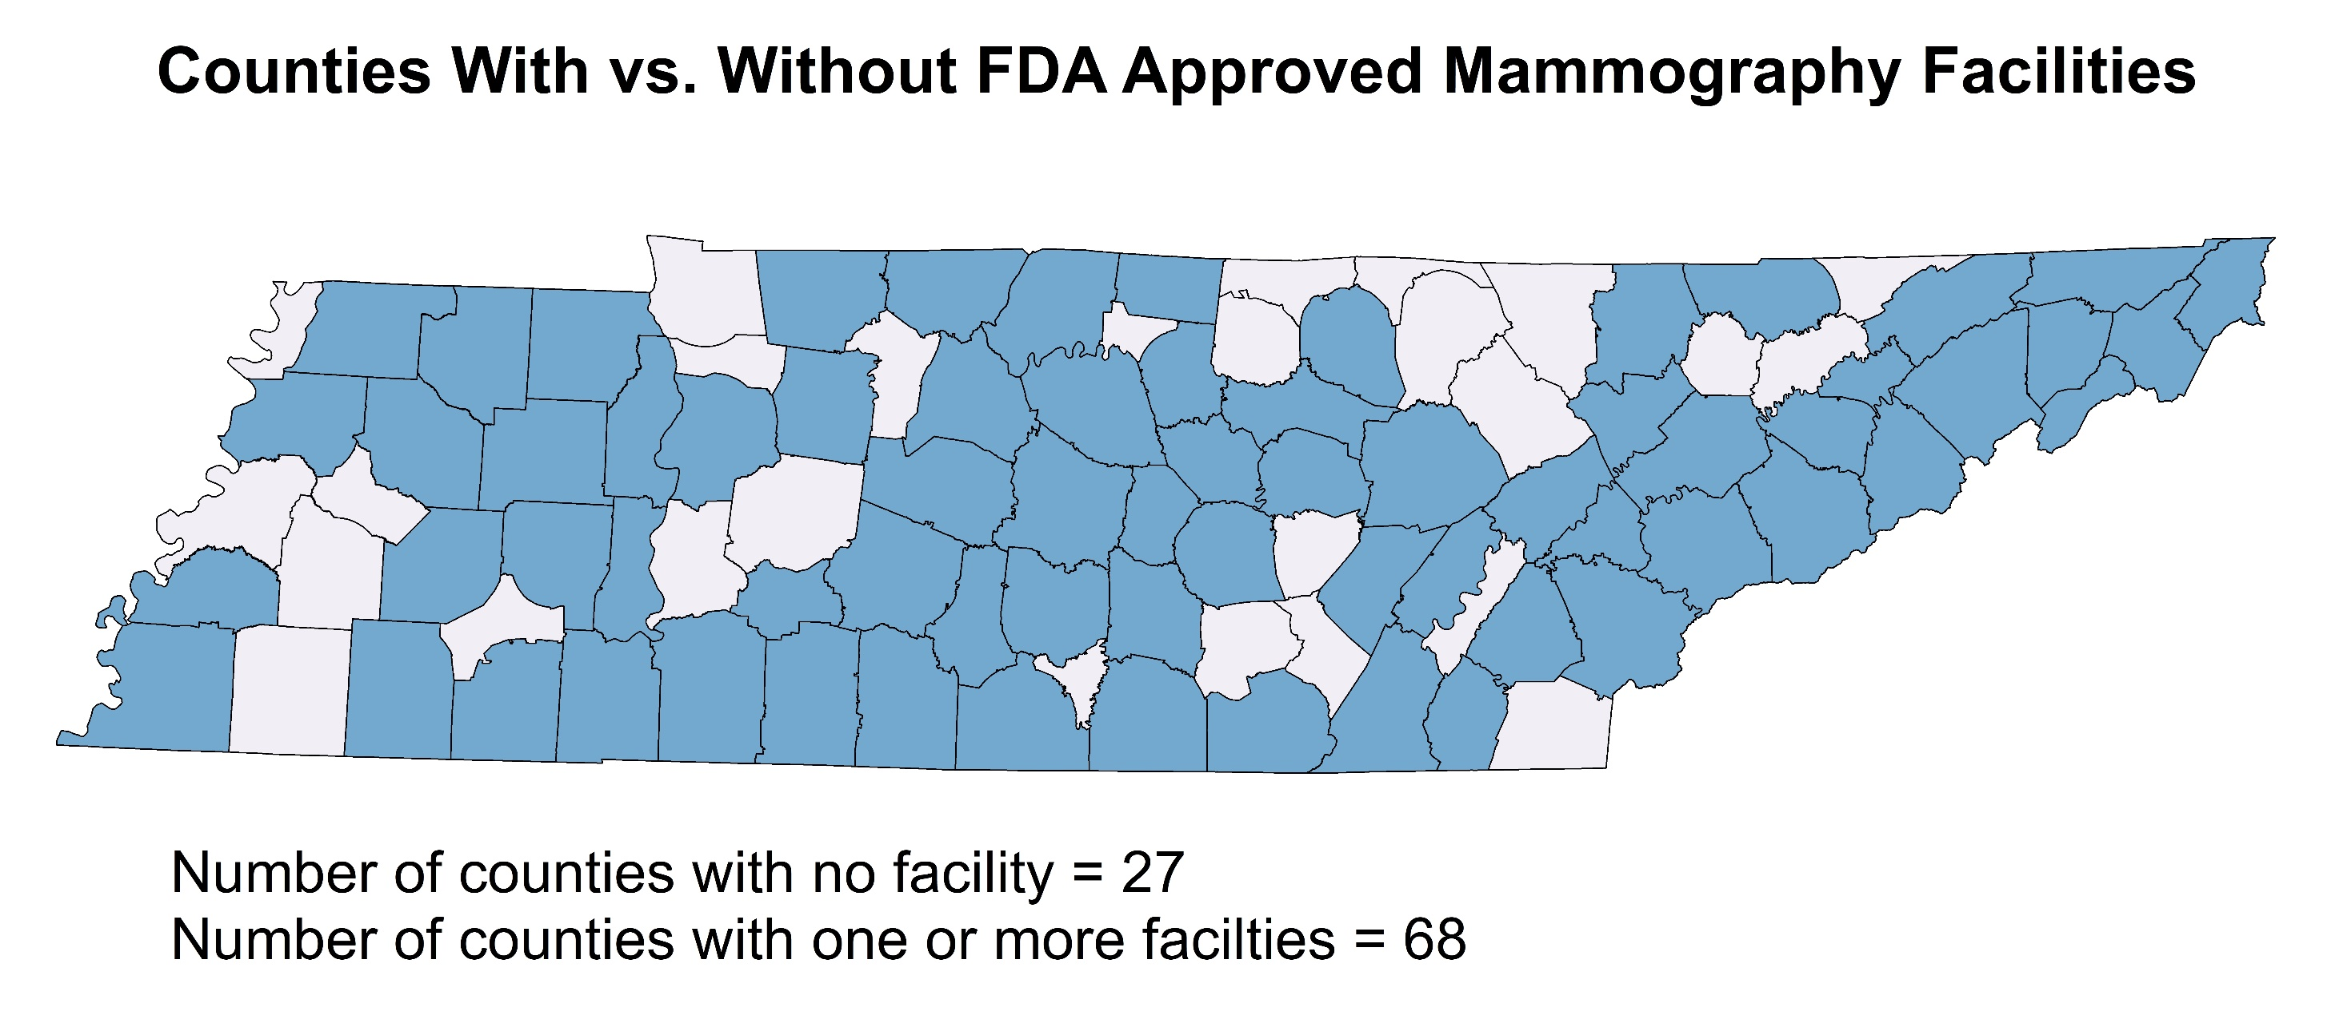

Slide 14
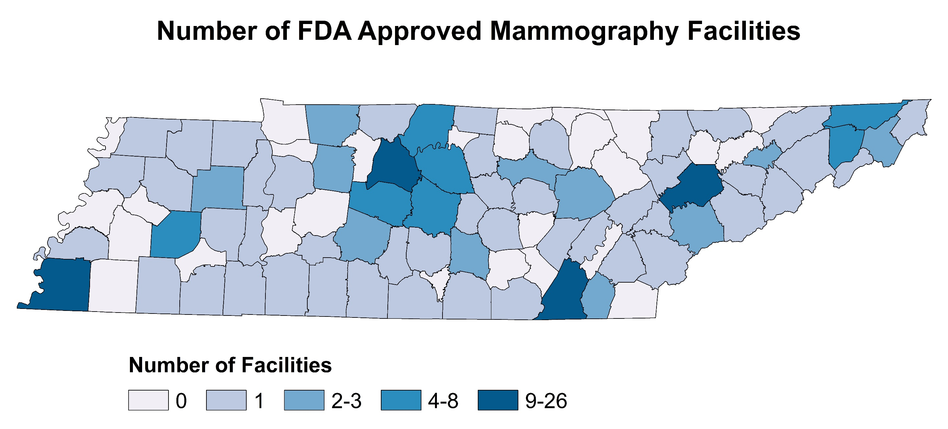

Slide 15
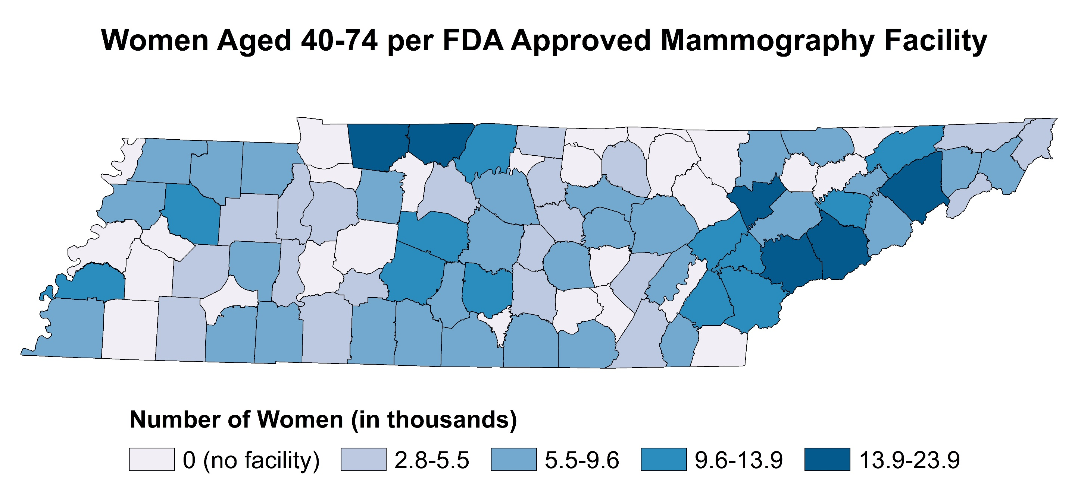
Example: There are 2 mammography facilities and 35,548 women between the ages of 40-74 years living in Montgomery County. Therefore, the county has 1 mammography facility for every 17, 774 (17.8K) resident women.

Slide 16
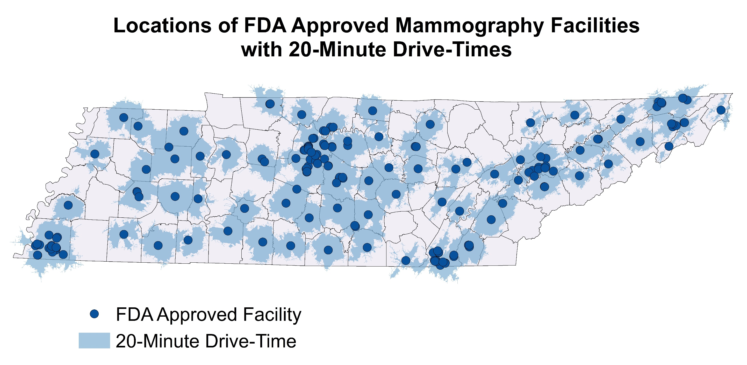

Slide 17
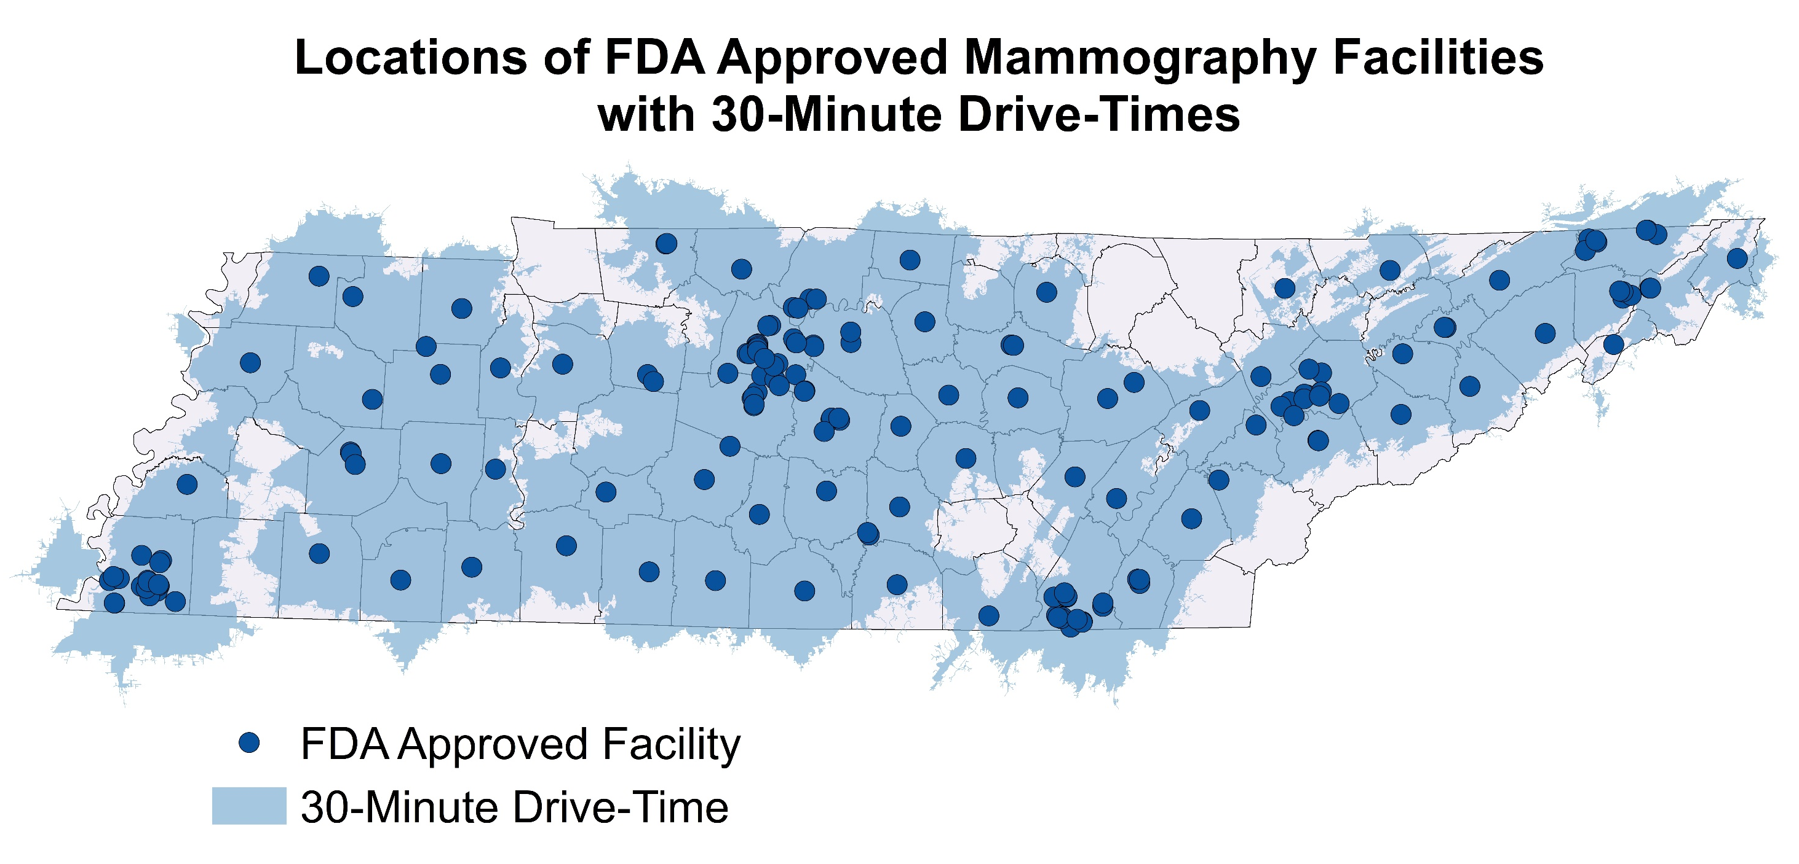

Slide 18
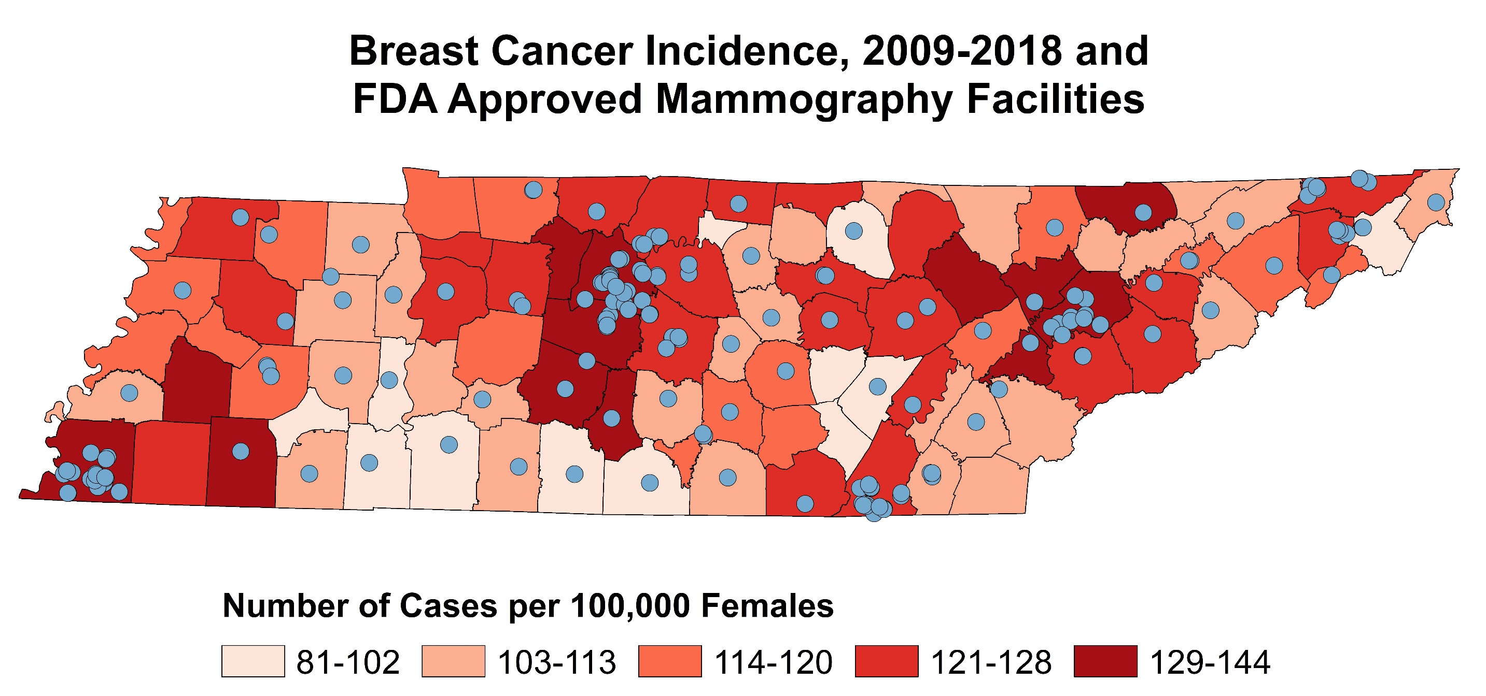
Notes:
Rates are age-adjusted.

Slide 19
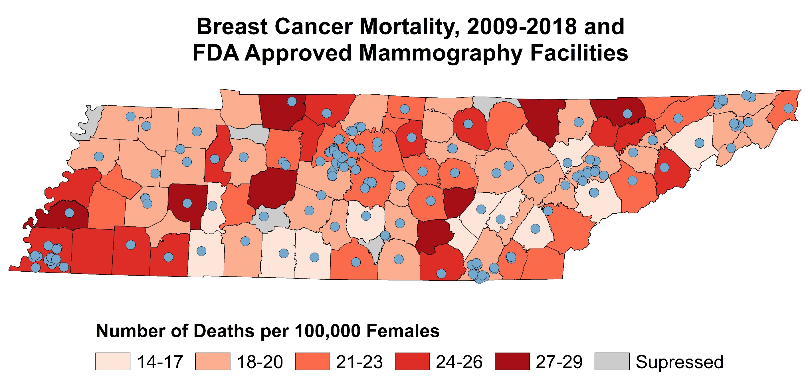

Slide 20
Screening Mammograms Among Medicare Enrollees

Slide 22
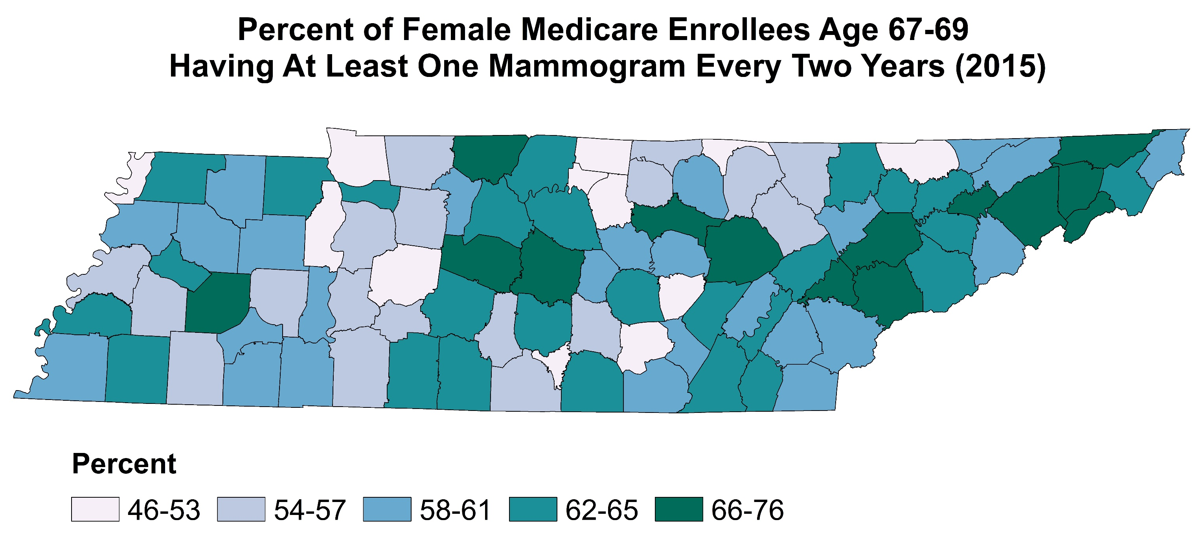

Slide 23
Notes:
Rates are age-adjusted.

Slide 24
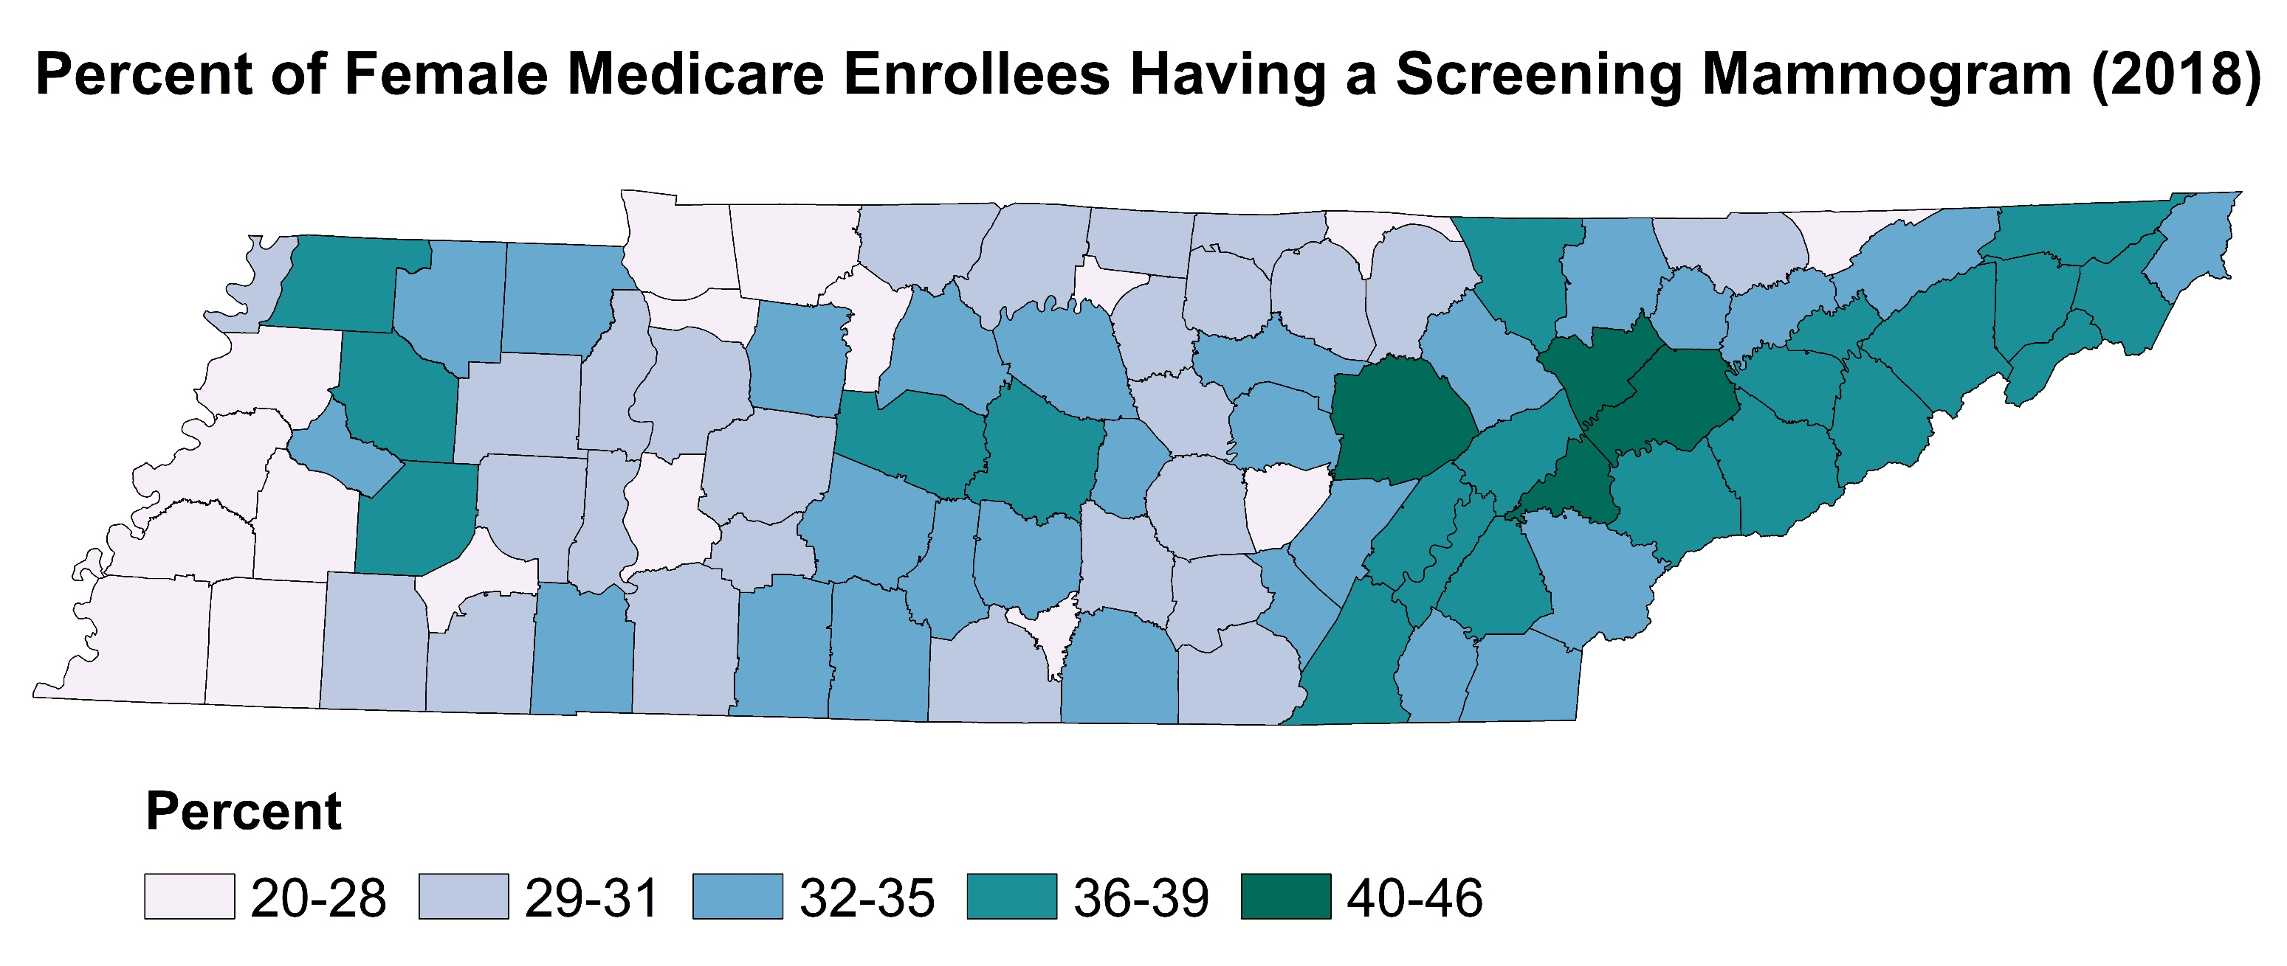
Notes:
Rates are age-adjusted.

Slide 25
Health Provider Shortage Areas &
Medically Underserved Areas

Slide 26
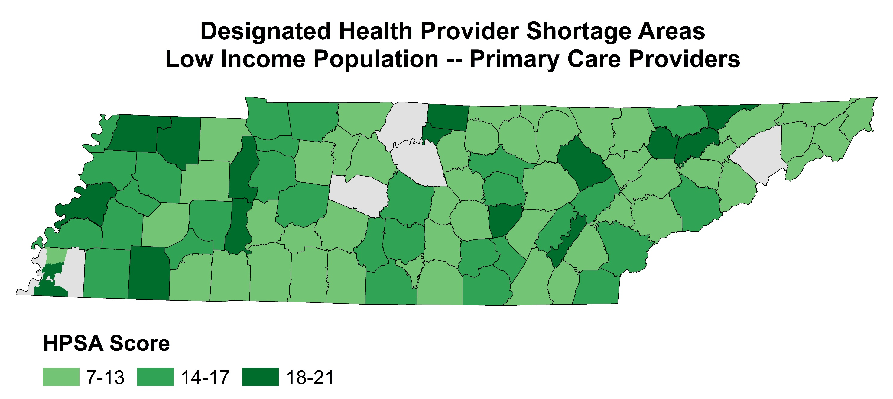
Notes:
Health Professional Shortage Areas (HPSAs) demonstrate a critical shortage of primary care [physicians (MD and DO) that primarily practice in one of the following specialties: family practice, general practice, internal medicine, pediatrics, OB/GYN, and general geriatrics], dental or mental health providers in accordance with HRSA Shortage Designation Branch guidelines. More than 37 federal programs depend on the shortage designation to determine eligibility or funding preference as a way to increase the number of physicians and other health professionals who practice in those designated areas.
State Primary Care Offices (=TDH) conduct needs assessments in their states, determine what areas are eligible for designations, and submit designation applications to HRSA. HRSA reviews the shortage designation applications, and if they meet eligibility criteria, approve the designation.
There are three HPSA subcategories: population group, geographic and facility. A population group HPSA demonstrates a shortage of providers for a specific population group (e.g. low income, migrant, homeless). The only population group designations in TN are low income.
For primary care, the Shortage Designation Branch calculates a score of 0 to 25, with 25 being the highest degree of shortage. The score is used to prioritize areas of greatest need and is based on the following criteria:
Population-to-provider ratio (providers that are accessible to persons with incomes at or below 200% of the federal poverty level if they accept Medicaid and/or offer a posted sliding fee scale)
Percent of individuals below 100% of the federal poverty level
Infant health index (infant mortality rate or low birth weight rate)
Average travel time or distance to nearest source of non-designated accessible care

Slide 27
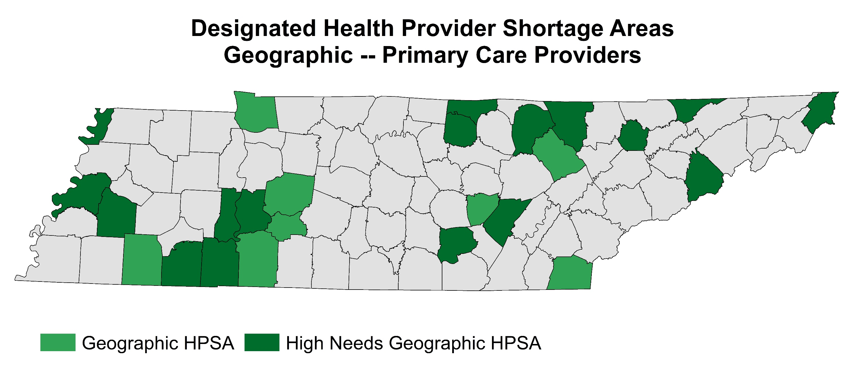
Notes:
A geographic HPSA demonstrates a shortage for the total population of an area.
A primary care geographic HPSA with high needs must meet at least one of the following criteria:
More than 20% of the population has incomes at or below 100% FPL
More than 100 births per year per 1,000 women ages 15-44
More than 20 infant deaths per 1,000 live births
Meets 2 of the following criteria for insufficient capacity
• More than 8,000 office or outpatient visits per year per FTE primary care physician serving the area
• More than 7 days waiting time for appointments for routine medical services for established patients
• More than 14 days waiting time for appointment for routine medical services for new patients
• More than one hour average waiting time for patients with appointments at primary care provider
• More than two hours average waiting time for patients without an appointments at primary care provider
• Evidence of excessive use (>35%) of emergency room facilities for routine medical care
• A substantial proportion (>65%) of the area’s physicians do not accept new patients
• Abnormally low utilization of health services, as indicated by an average of 2.0 or less visits per year on the part of the area’s population

Slide 28
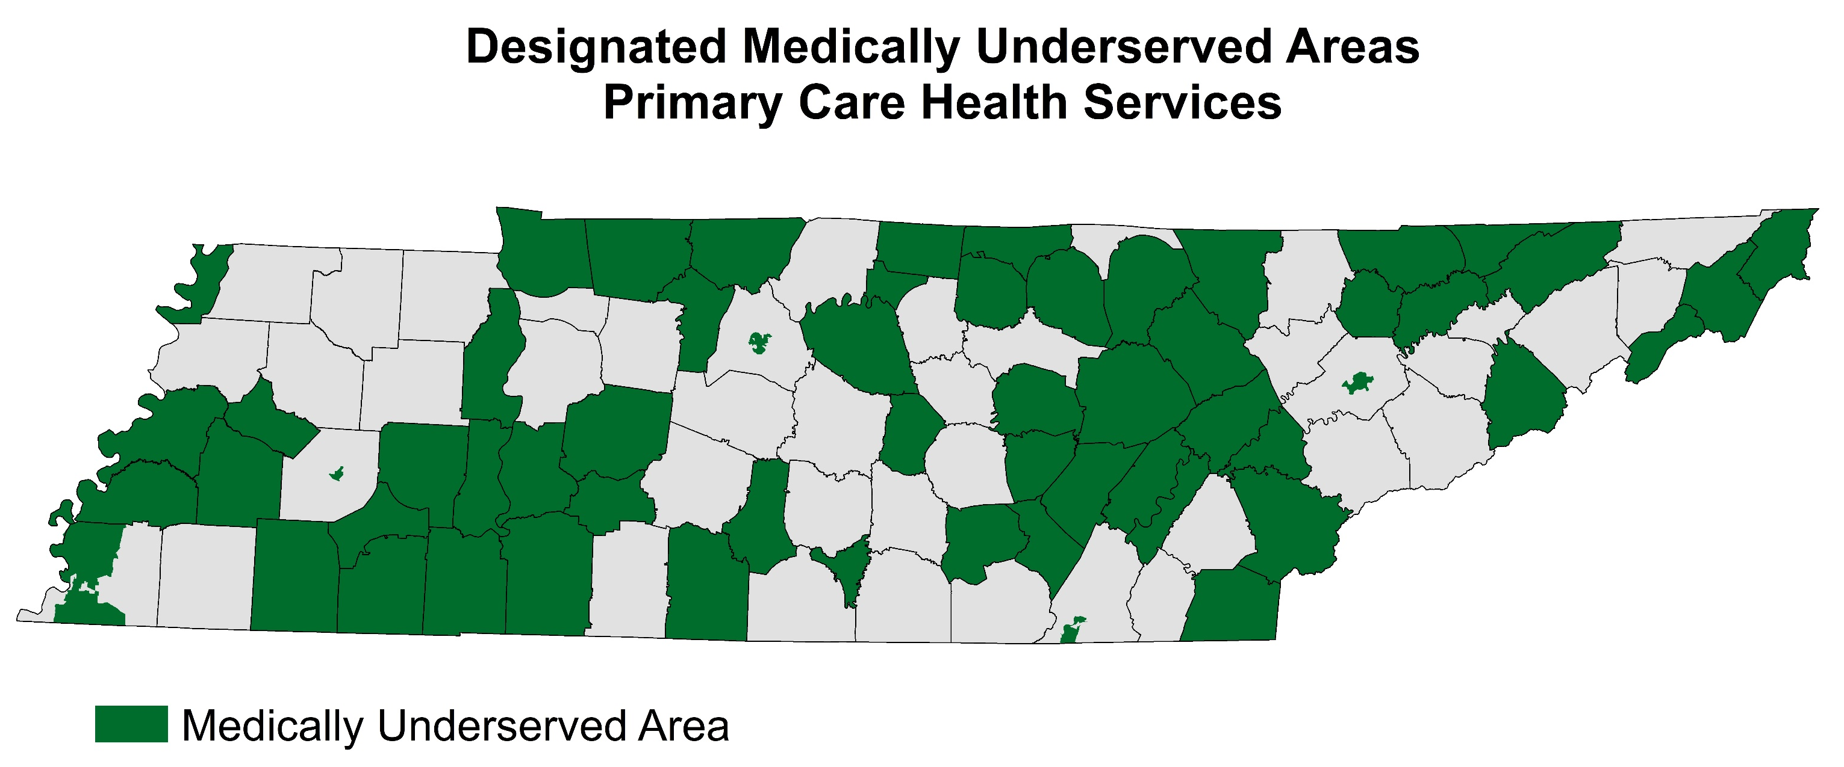
Notes:
A Medically Underserved Area (MUA) designation identifies areas with a shortage of primary health care services. Designation is based on four factors:
Health care provider-to-population ratio
Infant mortality rate
Percentage of population below 100% of the federal poverty level
Percentage of population aged 65 and over.
An MUA designation involves the application of the Index of Medical Underservice (IMU) to the data of a proposed rational service area to obtain a score for the area. The IMU scale is from 0 to 100, where 0 represents completely underserved and 100 represents the least underserved. Under established criteria, each service area found to have an IMU of 62.0 or less qualifies for designation as an MUA.

Slide 29
Small Area Health Insurance Estimates

Slide 30
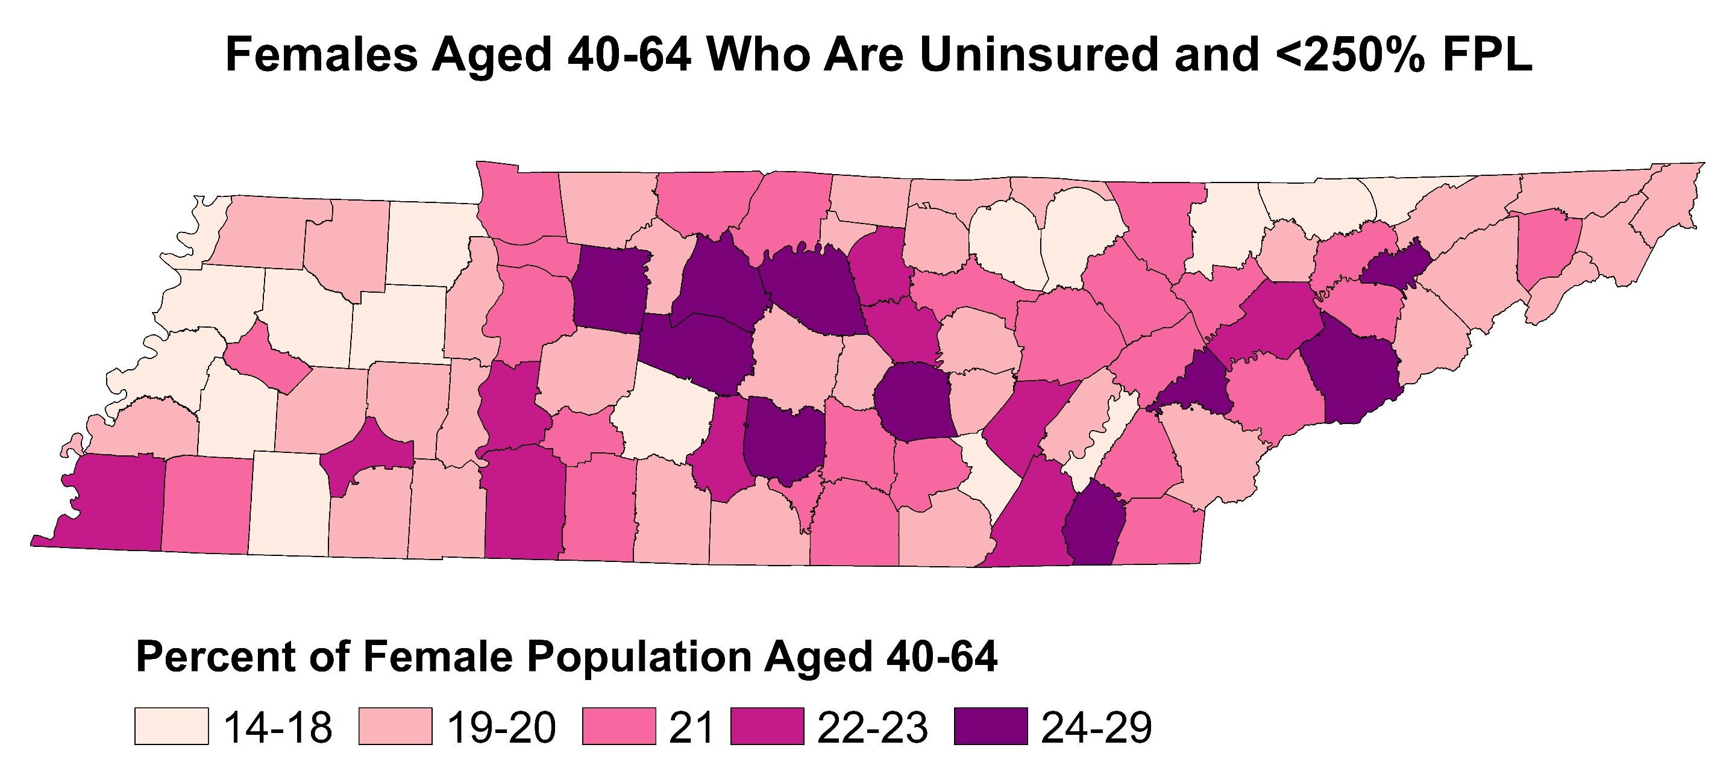

Slide 31
Social Vulnerability Index

Slide 32
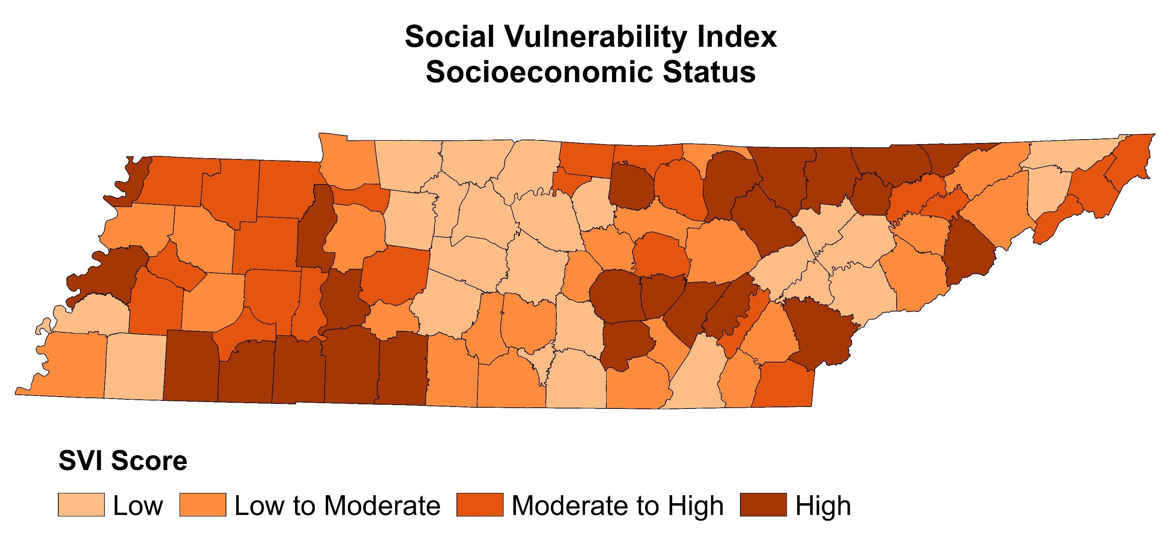
Notes:
Socioeconomic Status is based on:
Below Poverty
Unemployed
Income
No High School Diploma

Slide 33
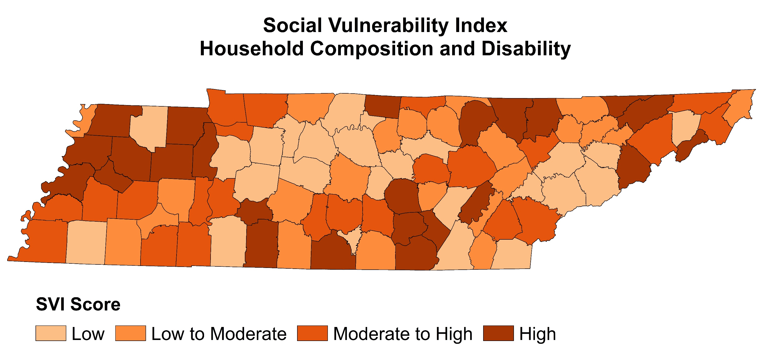
Notes:
Household Composition & Disability based on:
Aged 65 or Older
Aged 17 or Younger
Civilian with a Disability
Single-Parent Households

Slide 34
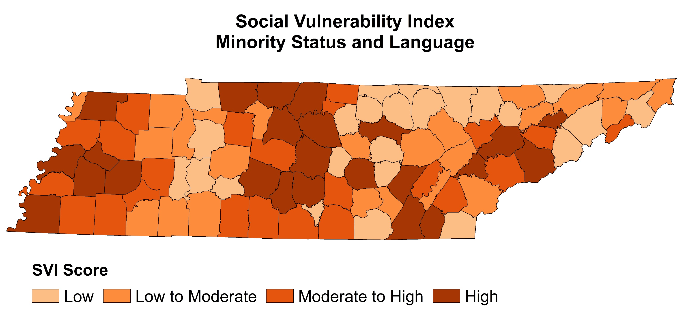
Notes:
Minority Status & Language based on:
Minority
Speaks English “Less than Well”

Slide 35
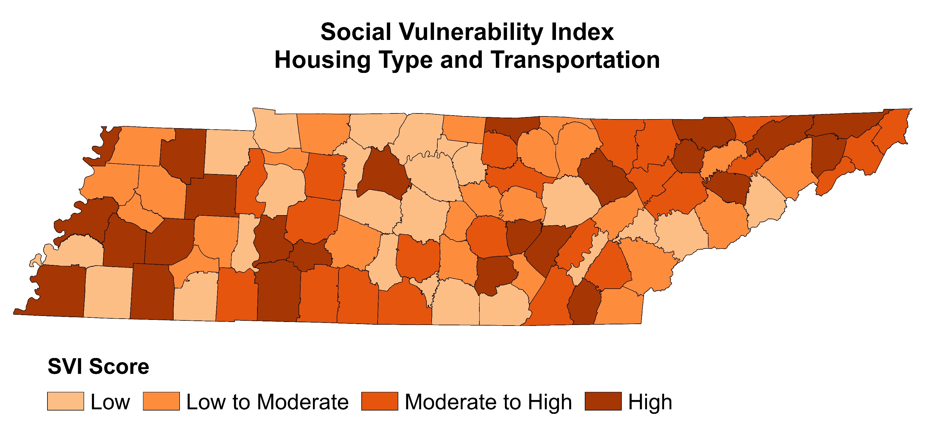
Notes:
Housing Type & Transportation based on
Multi-Unit Structures
Mobile Homes
Crowding
No Vehicle
Group Quarters

Slide 36
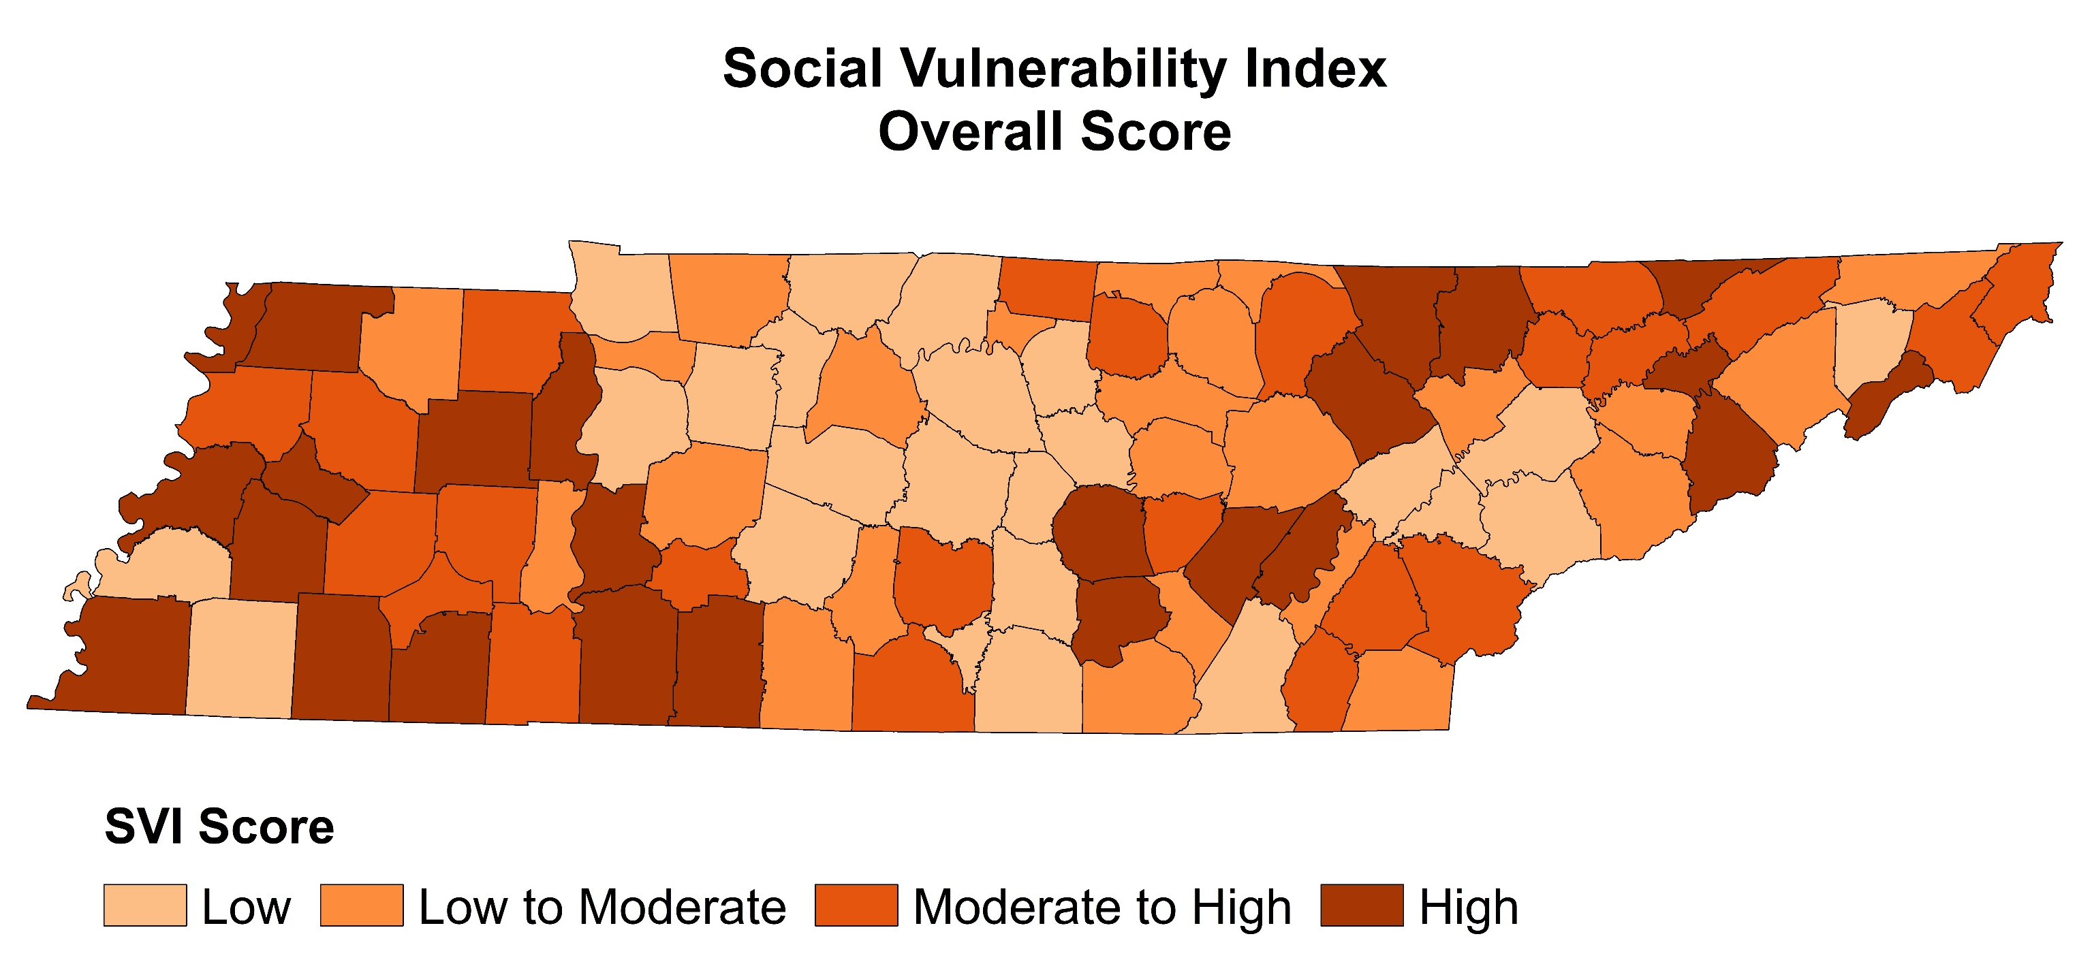

Slide 37
Tennessee Breast and Cervical Screening Program (TBCSP)

Slide 39
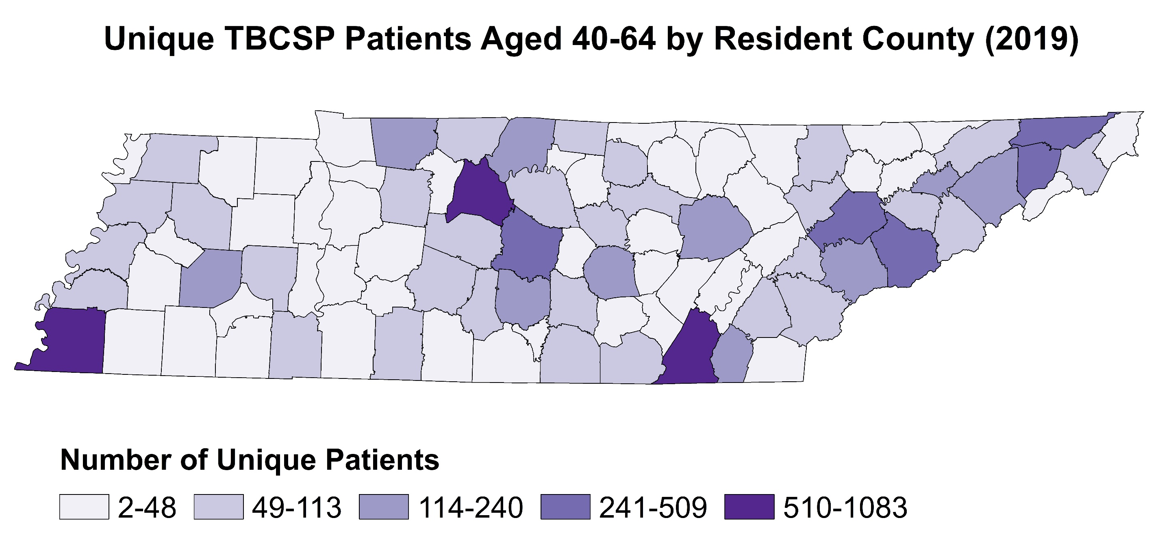

Slide 40
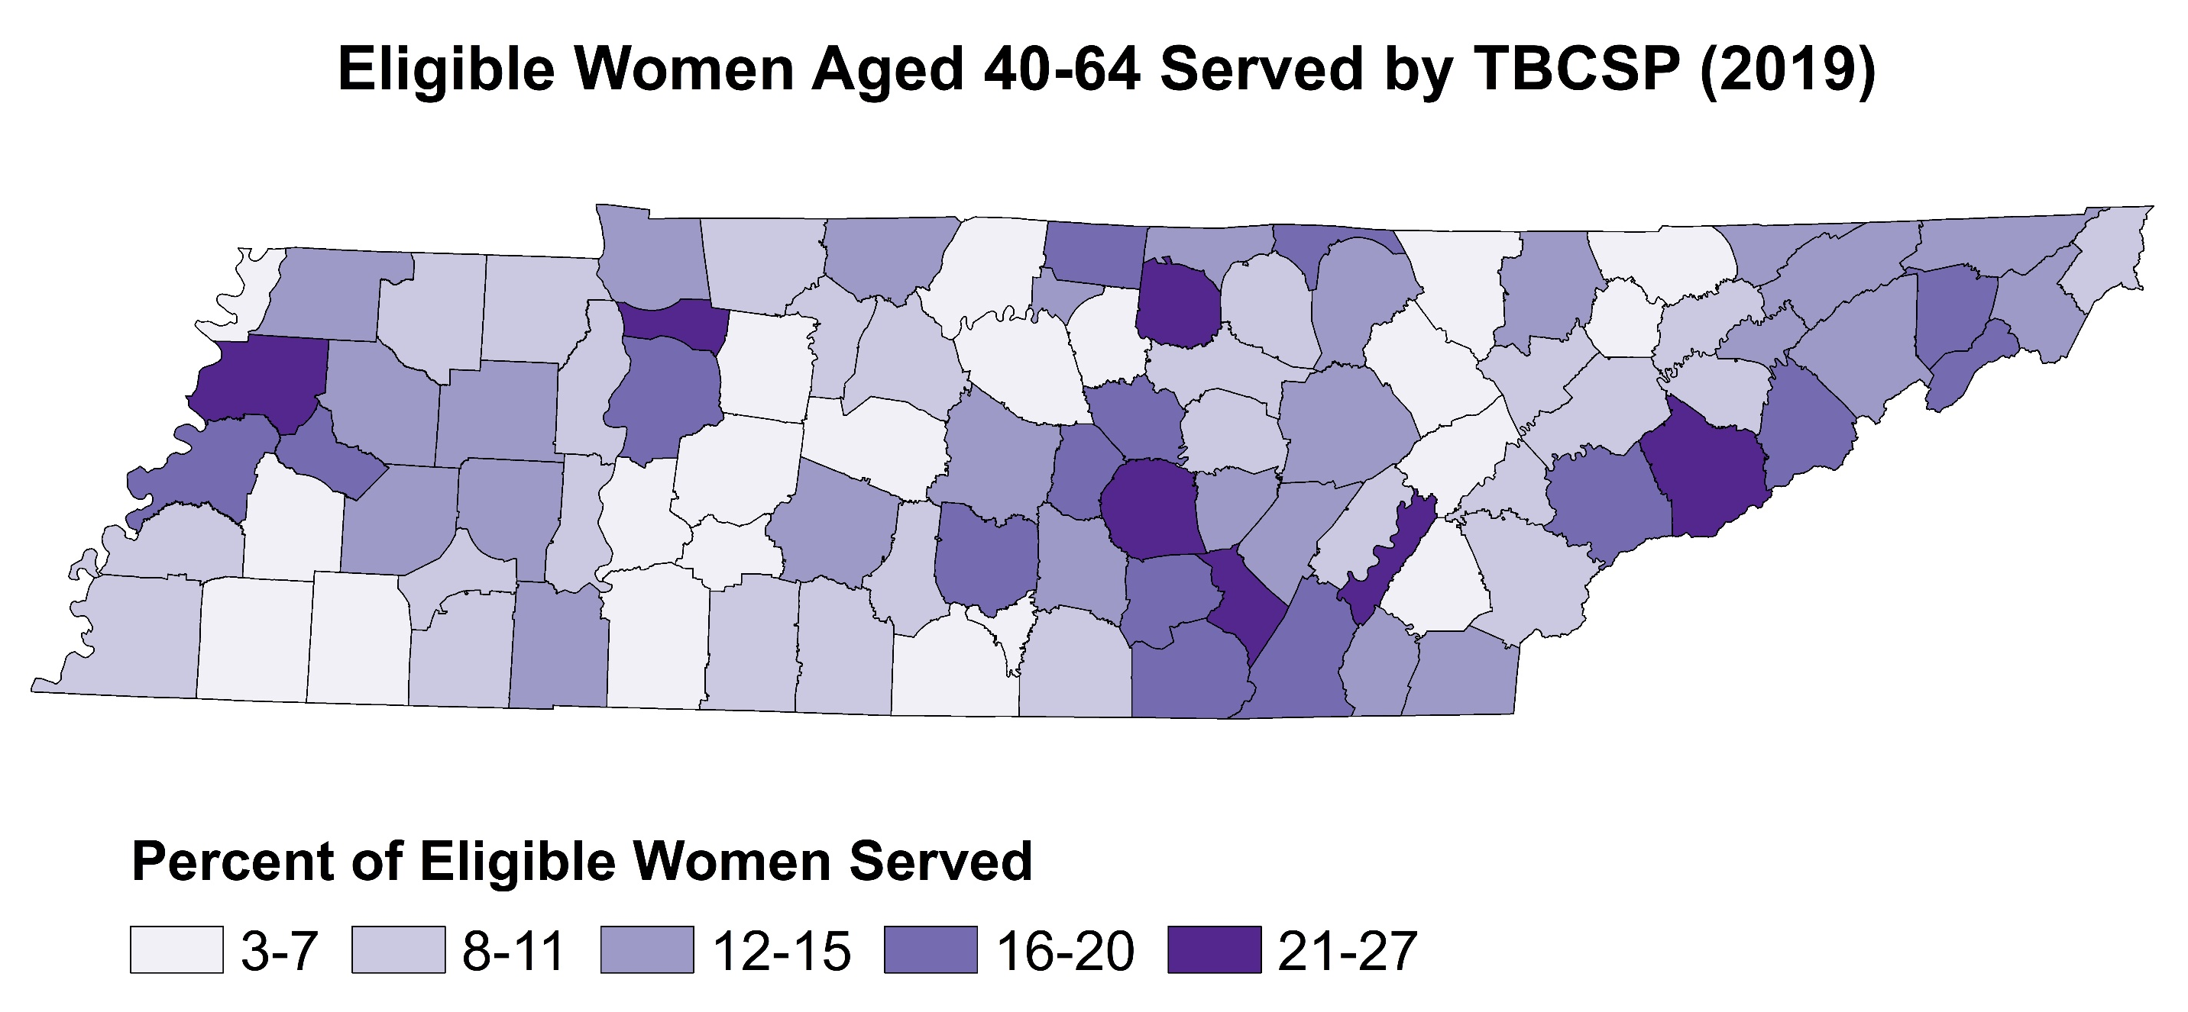
Notes:
Numerator = number of unique women aged 40-64 years that received screening and/or diagnostic services through the TBCSP (2019)
Denominator = number of women aged 40-64 years who were <250% FPL and uninsured (SAHIE, 2018)

Slide 42
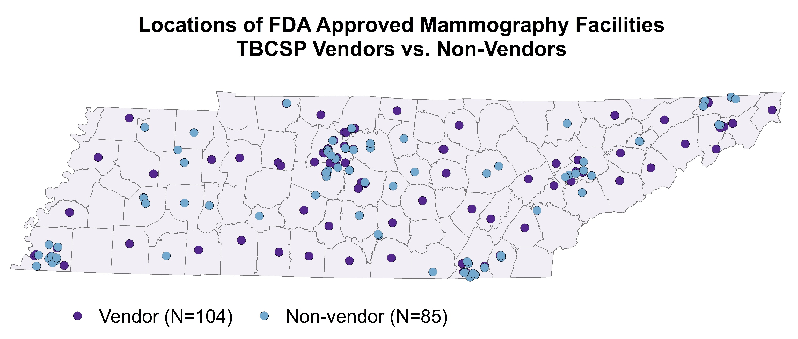

Slide 43
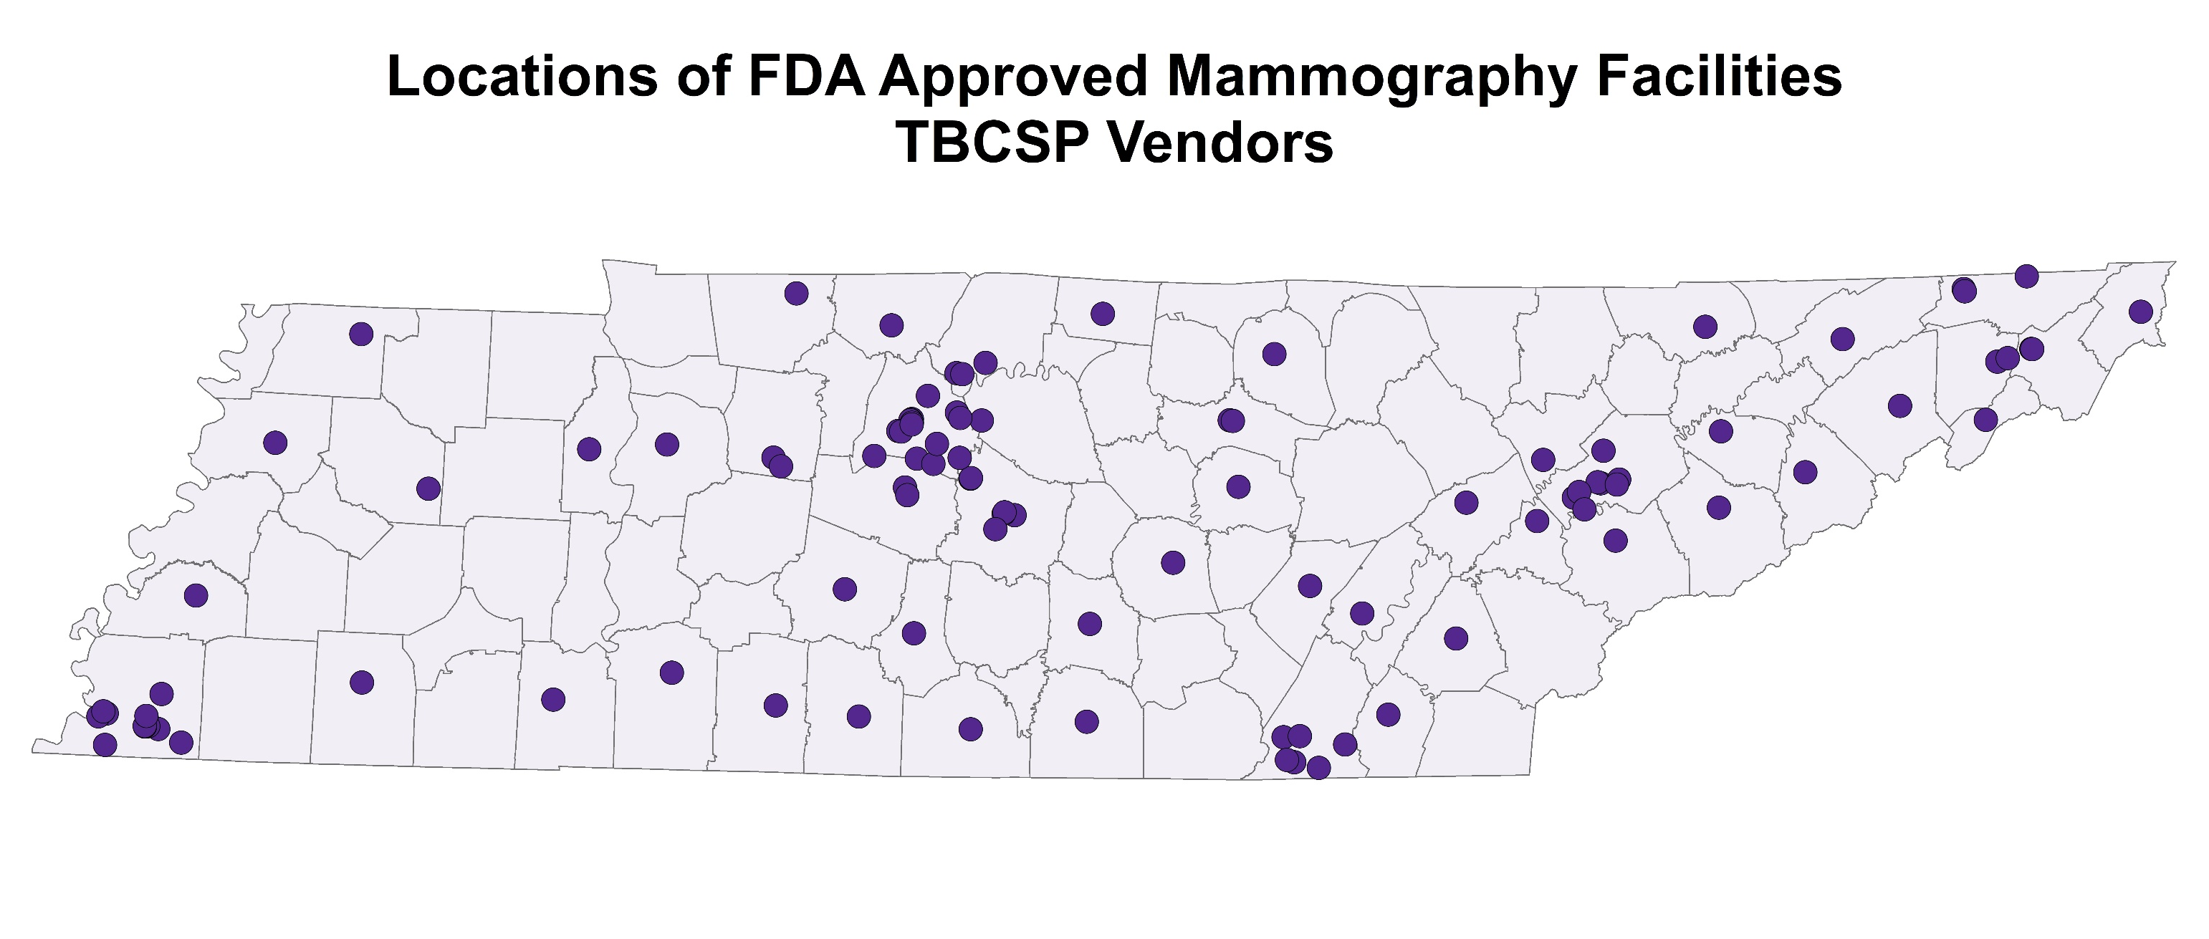

Slide 44
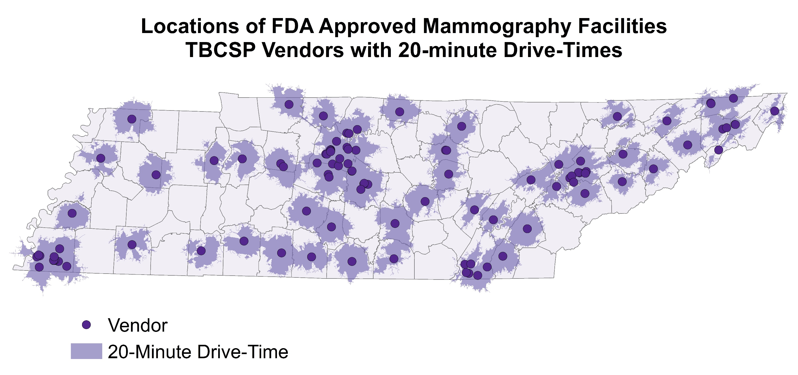

Slide 45
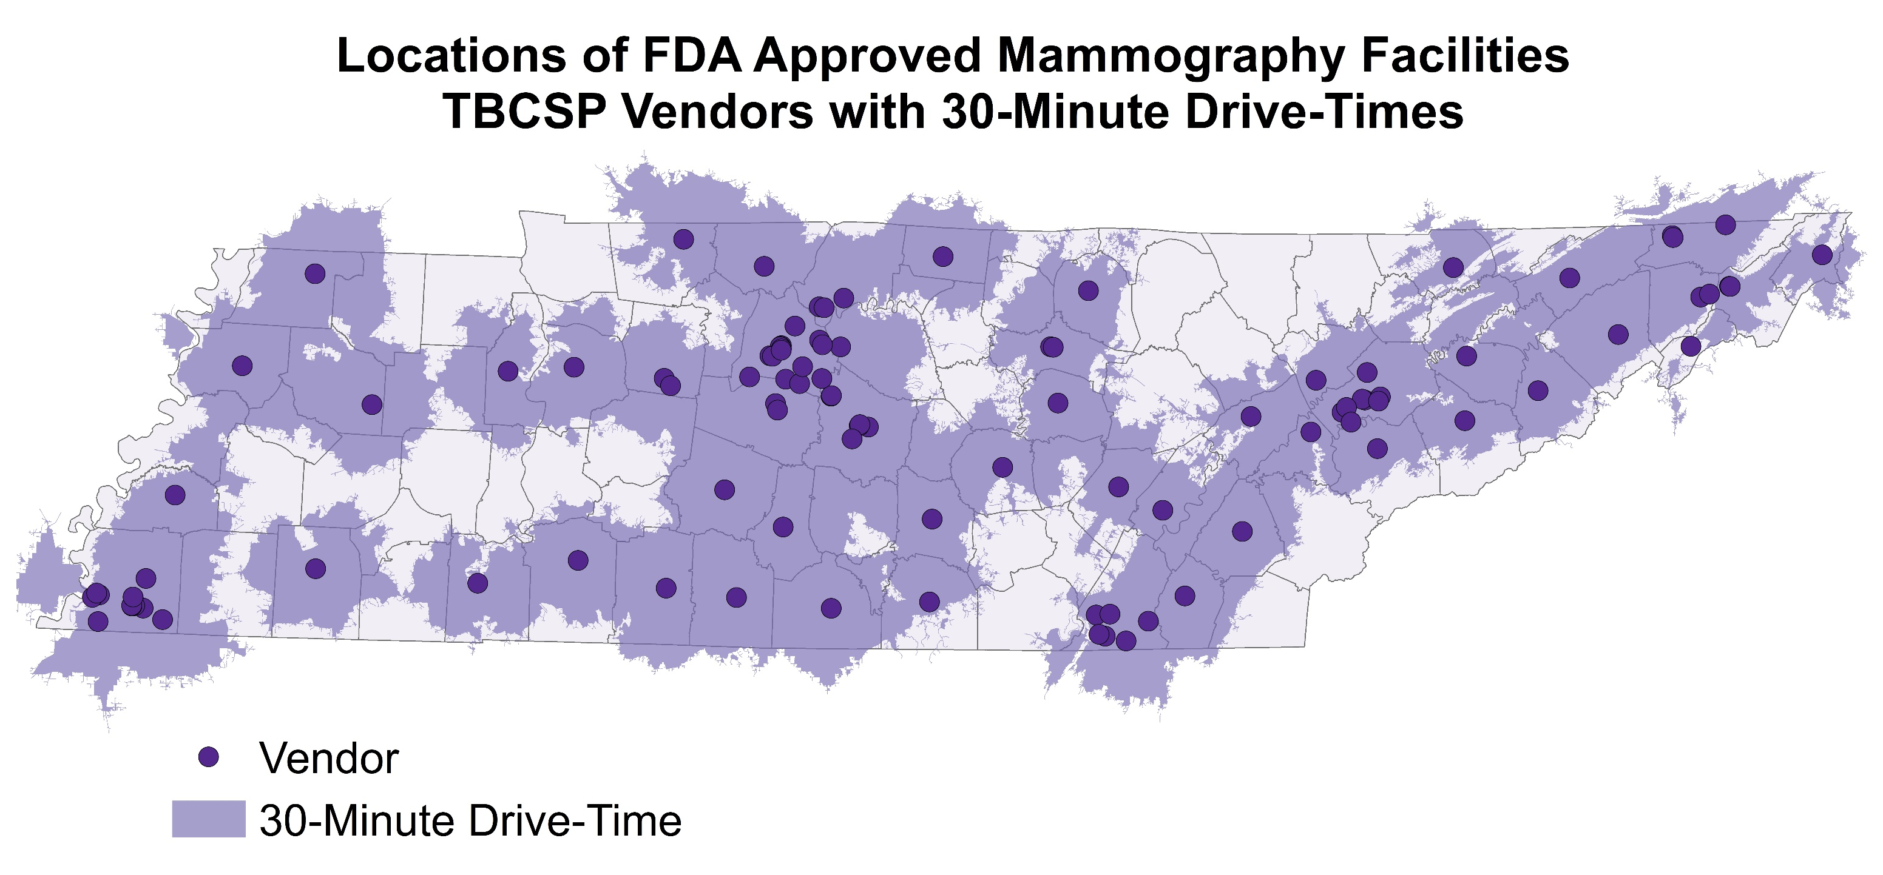

Slide 46


Slide 47
Data Sources
Tennessee Department of Health; Division of Population Health Assessment; Tennessee Cancer Registry. Rates are per 100,000 and age-adjusted to the 2000 US Std Population (19 age groups - Census P25-1130) standard. Rates are suppressed when the count of events in less than 11.
US Food and Drug Administration’s Certified Mammography Facilities Database. Accessed 1/12/2021 at https://www.accessdata.fda.gov/scripts/cdrh/cfdocs/cfMQSA/mqsa.cfm. The FDA Certified Mammography Facilities Database is a searchable listing by state and zip code of all mammography facilities certified by the FDA as meeting baseline quality standards for equipment, personnel and practices under the Mammography Quality Standards Act of 1992.
Tennessee Department of Health; Division of Population Health Assessment; population estimates based on interpolated data from the U.S. Census’s Annual Estimates of the Resident Population. Used as numerator for calculating women aged 40-74 per FDA Approved Mammography Facility and racial/ethnic distribution of TN females aged 18-64.
Dartmouth Atlas Data website, which was funded by the Robert Wood Johnson Foundation, The Dartmouth Clinical and Translational Science Institute, under award number UL1TR001086 from the National Center for Advancing Translational Sciences (NCATS) of the National Institutes of Health (NIH), and in part, by the National Institute of Aging, under award number U01 AG046830. Accessed February 2012 at https://atlasdata.dartmouth.edu/downloads/general#primary.

Slide 48
Data Sources cont.
Centers for Medicare and Medicaid Services Mapping Medicare Disparities Tool. Accessed February 2021 at https://data.cms.gov/mapping-medicare-disparities.
Health Resources and Services Administration (HRSA). Accessed February 2021 at https://data.hrsa.gov/.
U.S. Census Bureau, Small Area Health Insurance Estimates. Accessed March 2021 at https://www.census.gov/data-tools/demo/sahie/#/.
Centers for Disease Control and Prevention/ Agency for Toxic Substances and Disease Registry/ Geospatial Research, Analysis, and Services Program. CDC Social Vulnerability Index 2018 Database Tennessee. Accessed March 2021 at https://www.atsdr.cdc.gov/placeandhealth/svi/data_documentation_download.html.
Tennessee Department of Health; Patient Tracking Billing Information management System (PTBMIS). Accessed February 2021.

Slide 49
Questions?
Audrey.Stach@tn.gov
615-253-7277

