Slide 1



STATE OF
TENNESSEE
Coronavirus Relief Programs

Slide 2












CARES ACT PROGRAMS
TN
7
PROGRAMS
Private and Confidential

Slide 3
$2.3B
Awarded
545,710
Recipients
95
Counties Served
CARES ACT PROGRAMS
TN
7
PROGRAMS
Private and Confidential

Slide 4
$882M
Allocated
95,710
Recipients
95
Counties Served
CARES ACT PROGRAMS
        Economic and Pandemic Relief to Tennesseans
TN
7
PROGRAMS
*Does not include Unemployment Trust fund
Private and Confidential

Slide 5
Program | Fund Size | Recipients | Counties Served
Unemployment Trust Fund | $939M | 450,000 | 95
Broadband | $61.3M | 55,000 | 58
K-12 Education | $76 | 147 | 95
Agriculture & Forestry | $55M | 371 | 80
EMS Ambulance Assistance | $867K | 187 | 95
Hospital Staffing Assistance | $52M | 9,575 | 70
CARES ACT PROGRAMS
TN
7
PROGRAMS
Private and Confidential

Slide 6
Program | Fund Size | Recipients | Counties Served
Local Government | $115M | 358 | 93
Community CARES (Non-Profit) | $150M | 655 | 57
Small Business | $325M | 29,223 | 95
TN Tourism and Local DMO support | $25M | 112 | 95
Higher Education | $21.5M | 82 | 44
CARES ACT PROGRAMS
TN
7
PROGRAMS
Private and Confidential

Slide 7
$644M
Approved for Payment
95,710
Recipients
95
Counties Served
CARES ACT PROGRAMS
TN
7
PROGRAMS
*Does not include Unemployment Trust fund
Private and Confidential

Slide 8

$939M
Solvency maintained from
Coronavirus Relief Fund
300%
450,000
CRF funding prevented
a 300% long-term tax
increase on employers
Recipients
$1B+
Tennessee one of 7 states
with a balance over $1 billion
Other States were not as fortunate:
Tennessee was one of the first of 21 states to use CRF for this purpose.
Some states that didn’t use CRF lost as much as 95% of their trust fund (e.g., CA, CO, HI, NM NY, OH).
22 states now seeking loans from the federal gov’t, which will need to be repaid with interest from taxes.
UNEMPLOYMENT
TRUST
FUND
$1.165M
December Balance
TAX FOUNDATION REPORT 12/18/2020
As of December 17th, 20 states and the U.S. Virgin Islands have drawn a collective $44.3 billion in Title XII Advances—federal loans which will ultimately need to be paid back with interest.
States entered 2020 with aggregate trust fund balances of $75 billion. On net, these balances now stand at $25 billion, with 19 states and the Virgin Islands in the red.

Slide 9


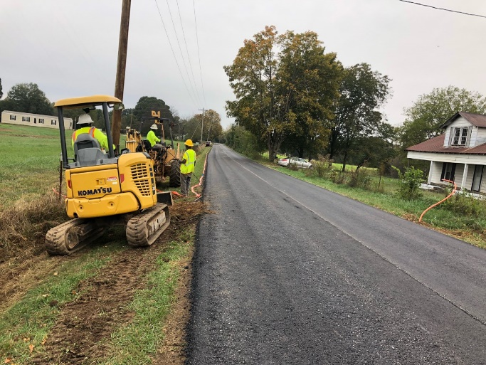
The Tennessee Emergency Broadband Fund was designed to enhance broadband infrastructure and access to individuals and families affected during the COVID-19 pandemic by the lack of broadband access in their area.
Projects ranged from infrastructure deployment connecting unserved households to free public wi-fi. Highly motivated broadband providers completed projects faster than ever, with construction occurring from August to December 2020. *Federal Communications Commission, 2020 Broadband Deployment Data
$55M
Estimated final award
Johnson County
13%
Estimated decrease in unserved Tennesseans*
BROADBAND
28
Number of participating internet service providers (ISPs)
58
Counties containing project areas
Giles County
55,000
Estimated number of unserved Tennesseans connected

Slide 10
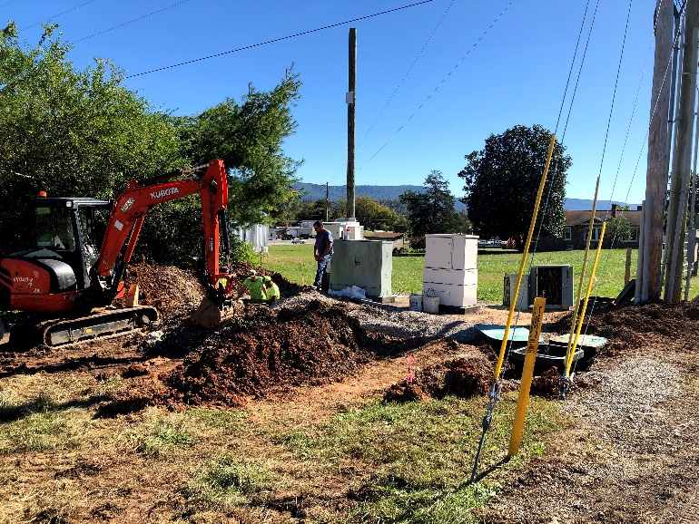
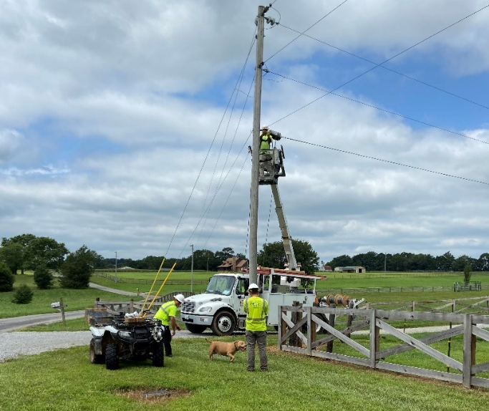
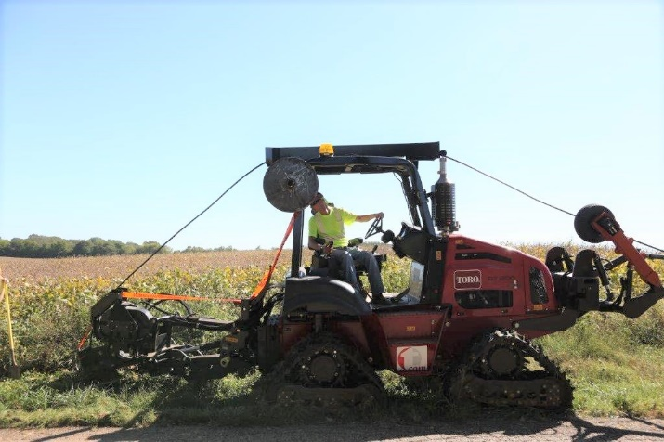
BrightRidge (Johnson City Energy Authority) made free community wi-fi available to 22 schools and 6 community centers in the northeast Tennessee region, and made residential service available to nearly 600 homes in rural Washington County.
Bledsoe Telephone Cooperative constructed high-speed internet to 685 households in a remote, mountainous area of distressed Bledsoe County.
Gibson Electric Membership Cooperative connected over 1,000 households in Obion County, and built public wi-fi hot spots in six west Tennessee counties
BROADBAND
Bledsoe County
Robertson County
Henry County

Slide 11
$42.6M
Approved for payment
Remote Technology Grant
$9.4M
Approved for payment
Connectivity Grant
$10.7M
Approved for payment
Reopening Grant
Dyer County purchased Swivl cameras for teachers to accommodate students who opted for in-person learning but might need to be quarantined or out of the classroom for extended time.
This creative solution ensured seamless support to as students transition in and out of quarantine.
The teacher places the Swivl camera near his/her computer and wears a remote sensor lanyard. The Swivl follows the teacher around the room to the remote students can see him/her at all times.
It allows the remote student to hear other student’s responses and the in-person students to hear the remote student’s responses.
This enables students who are not in the classroom to participate in the instruction just as if they were there.
K-12
EDUCATION

Slide 12
The Coronavirus Agricultural and Forestry Business (CAFB) Fund has funded lost net revenue and expenses incurred as a result of COVID-19. $55 million in relief funds were budgeted for the following CAFB categories:
                Business Disruption
                Costs Associated with Pandemic Response
                Supply Chain Enhancement
                Increased Meat Processing Capacity
AGRICULTURAL & FORESTRY
$25.2M
Approved for Payment
Funding Type across
27 INDUSTRY
CATEGORIES
371
Recipients
80
Counties Served

Slide 13

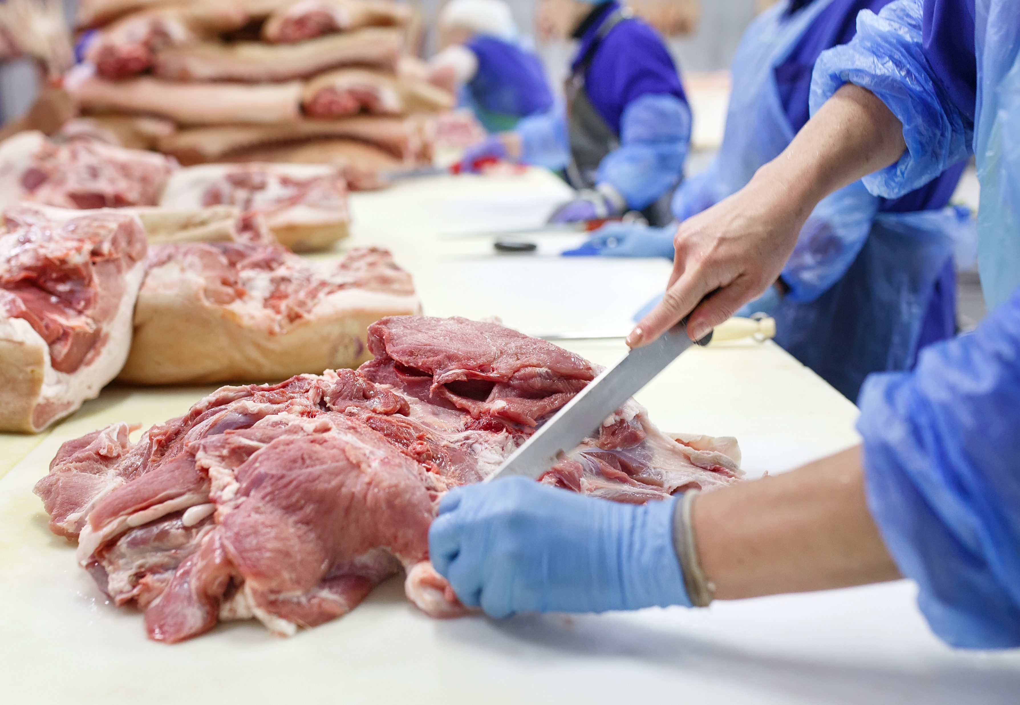
BUSINESS DISRUPTION
Jerry Norman is the sole proprietor of a logging company in Campbell County.
Because of COVID, lumber mills closed or refused to accept new logging loads, cutting off demand for their logs significantly.
Mr. Norman lost an estimated $50,000 between March and September. He was allocated $47,000 through CAFB.
AGRICULTURAL & FORESTRY
INCREASED MEAT
PROCESSING CAPACITY
D & D Meats is a meat processor in Clay County.
They are building a new meat processing facility to handle increased demand due to COVID.
D&D Meats was allocated $250,000 through CAFB to help cover the $1.2M cost.

Slide 14
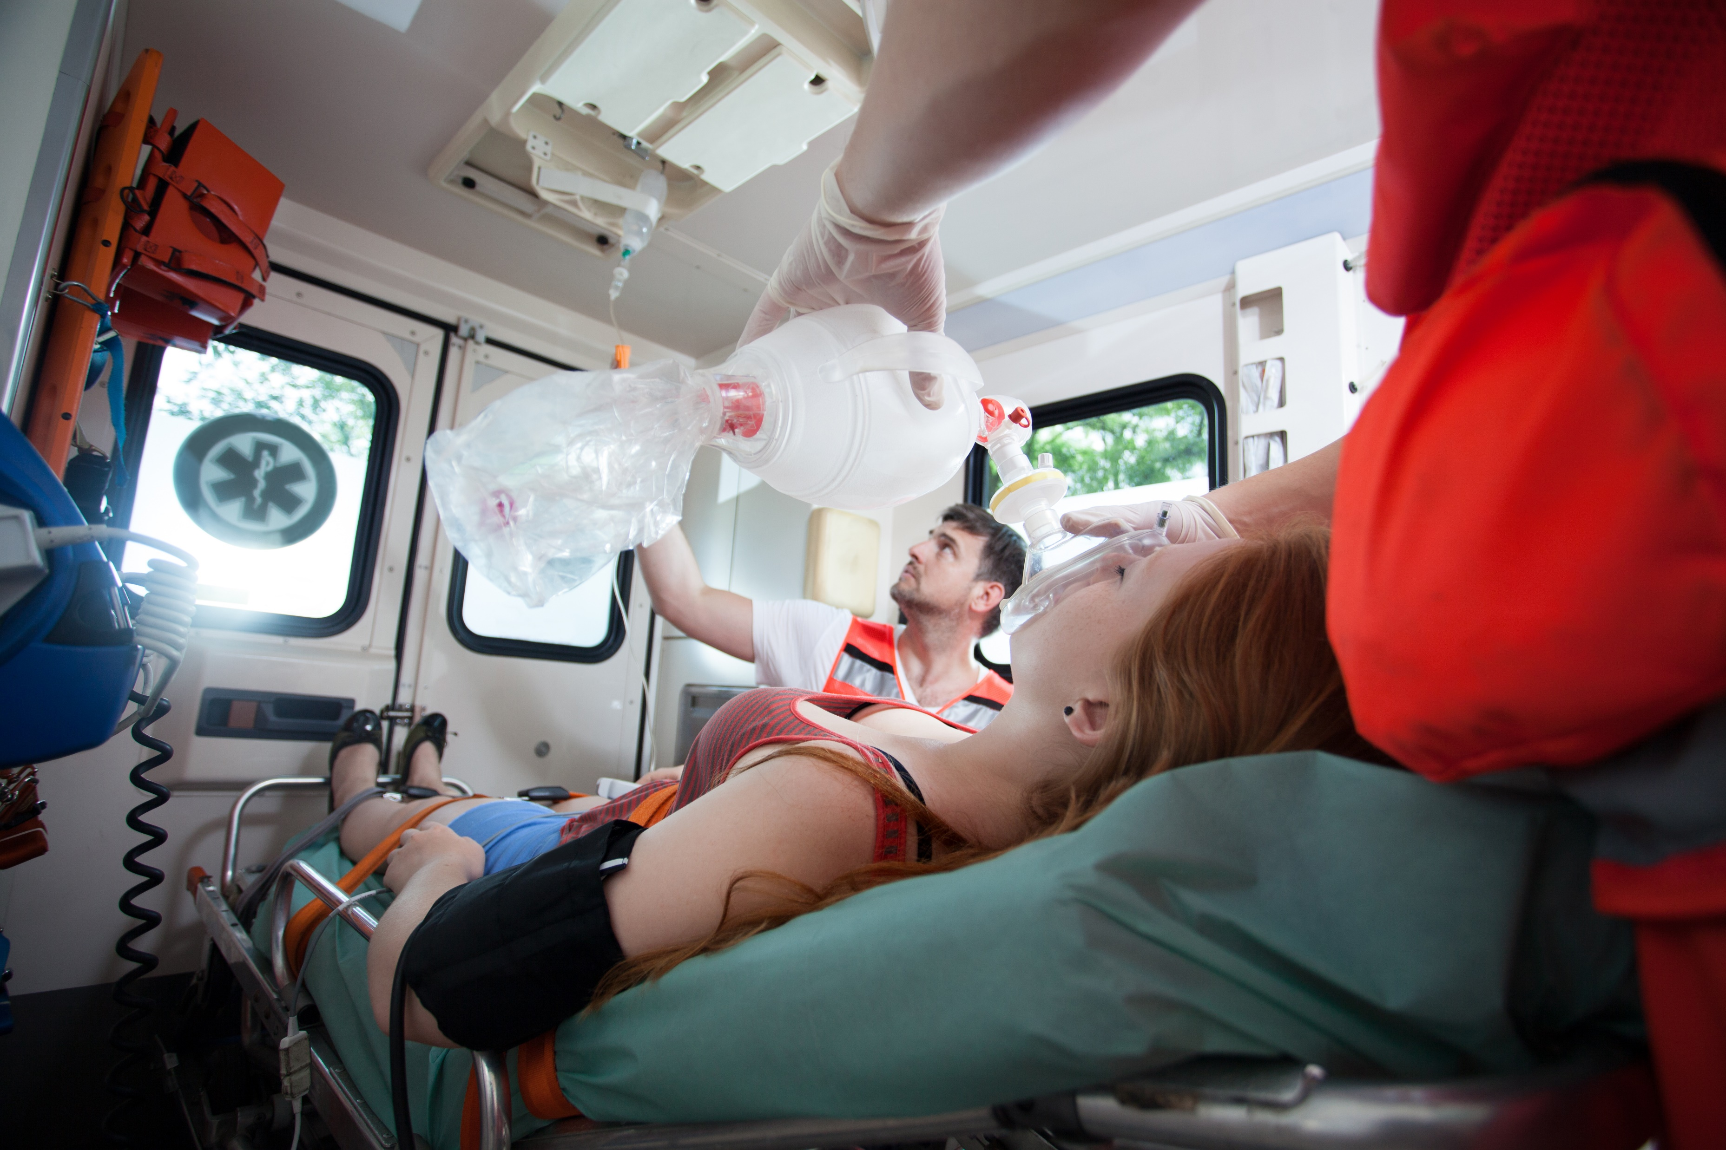

EMS
Tennessee has allocated $867,000 from the Coronavirus Relief Fund to support licensed ambulances in the state. Tennessee EMS providers are eligible to receive reimbursements for the initial costs of installing UV light systems to improve the health and safety of their ambulances.
AMBULANCE
ASSISTANCE
$79K
Approved for Payment
60
Ambulances Upgraded
To Date
These upgraded ambulances are protecting on-the-ground paramedics as they treat and transport COVID-19 patients.

Slide 15

Tennessee has allocated $51 million from the Coronavirus Relief Fund to cover increased staffing costs associated with hospital expansions throughout the state. These funds help Tennessee’s hospitals retain and compensate front line workers responding to the pandemic.
$23.6M
Approved for Payment
71
Recipient Hospitals
Funds were used to help administer the first round of
Coronavirus Vaccines
in December.
9,500
Healthcare Heroes Benefitted
HOSPITAL
STAFFING
ASSISTANCE

Slide 16

HOSPITAL
STAFFING
ASSISTANCE
The impact of the pandemic has taken a toll on our staff. We’ve been at or above capacity for much of the past 6 months. We enacted several strategies including incentive programs to encourage additional shifts. We brought in as many as 100 traveler nurses, and the CRF Hospital Assistance Program funded these pay incentives and programs.
Brad Parson CEO at Baptist Memphis
With the coronavirus surge, Baptist Memorial Hospital-Collierville's average daily census was 70% higher than October-December 2019, and our ICU remained full the last 2 months.
Our facility implemented several pay incentive programs: STAR pay, gives an employee a set amount in addition to their overtime. The COVID Flex up, gives extra payment for committing to additional shifts. A Seasonal program for 12- or 16-week assignments was used to recruit additional staff and hiring travel nurses helped meet increasing demand. The CRF Hospital Assistance Program fund helped to ensure safe, quality patient care.
Lindsay Stencel CEO at Baptist Collierville
The last year challenged Ballad Health beyond anything we’ve ever experienced. We’re immeasurably grateful to everyone who stepped forward to help, as well as to the hospital staffing assistance grant for enabling us to care for 4,202 in-patients in the Appalachian Highlands. These funds have made it possible to provide more patients with the care they deserve, when they need it most.
Lisa Smithgall, PhD, RNC-NIC, CPNP, NEA-BC
Senior Vice President, Chief Nursing Executive at Ballard Health

Slide 17
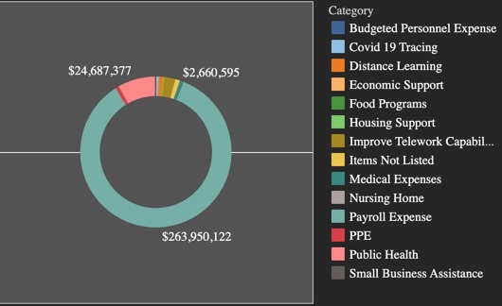
The State of Tennessee reserved $115 million of their allocation from the CRF to be further allocated to eligible local governments on a $15 per capita basis to fund unbudgeted expenses necessary due to COVID-19.
$106.6M
Approved for Payment
LOCAL
GOVERNMENT
358
Recipients
Participating jurisdictions submitted
OVER 2,500 REQUESTS
7.67M
Population Served

Slide 18
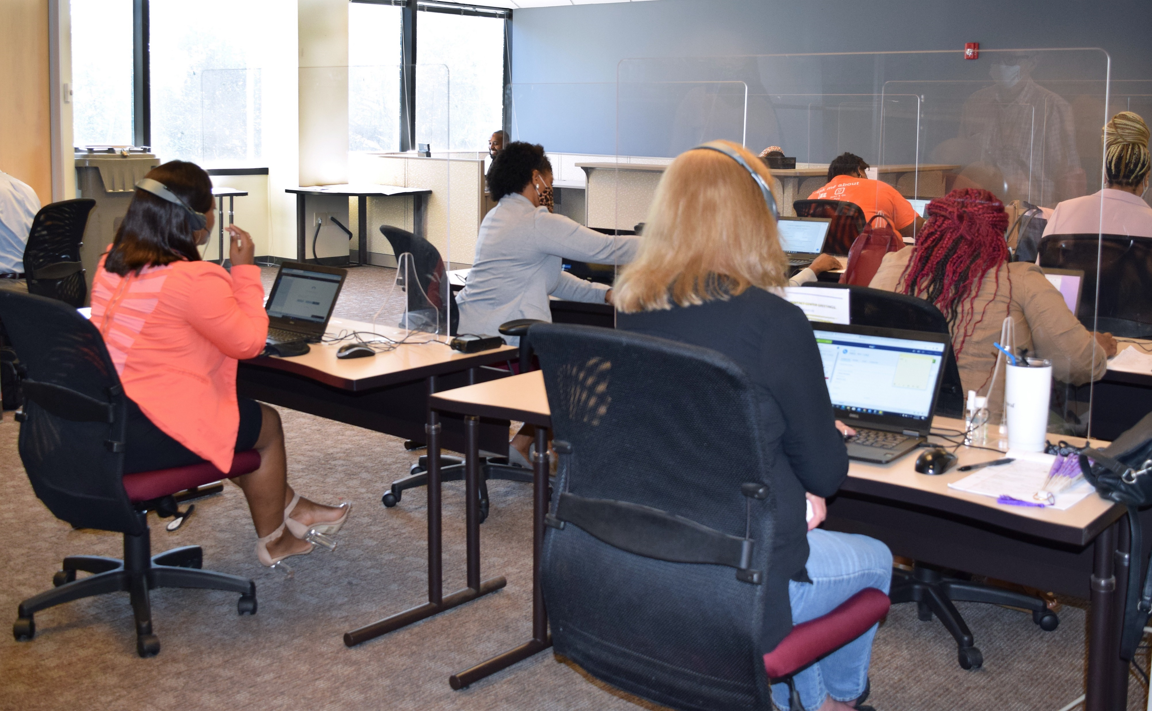
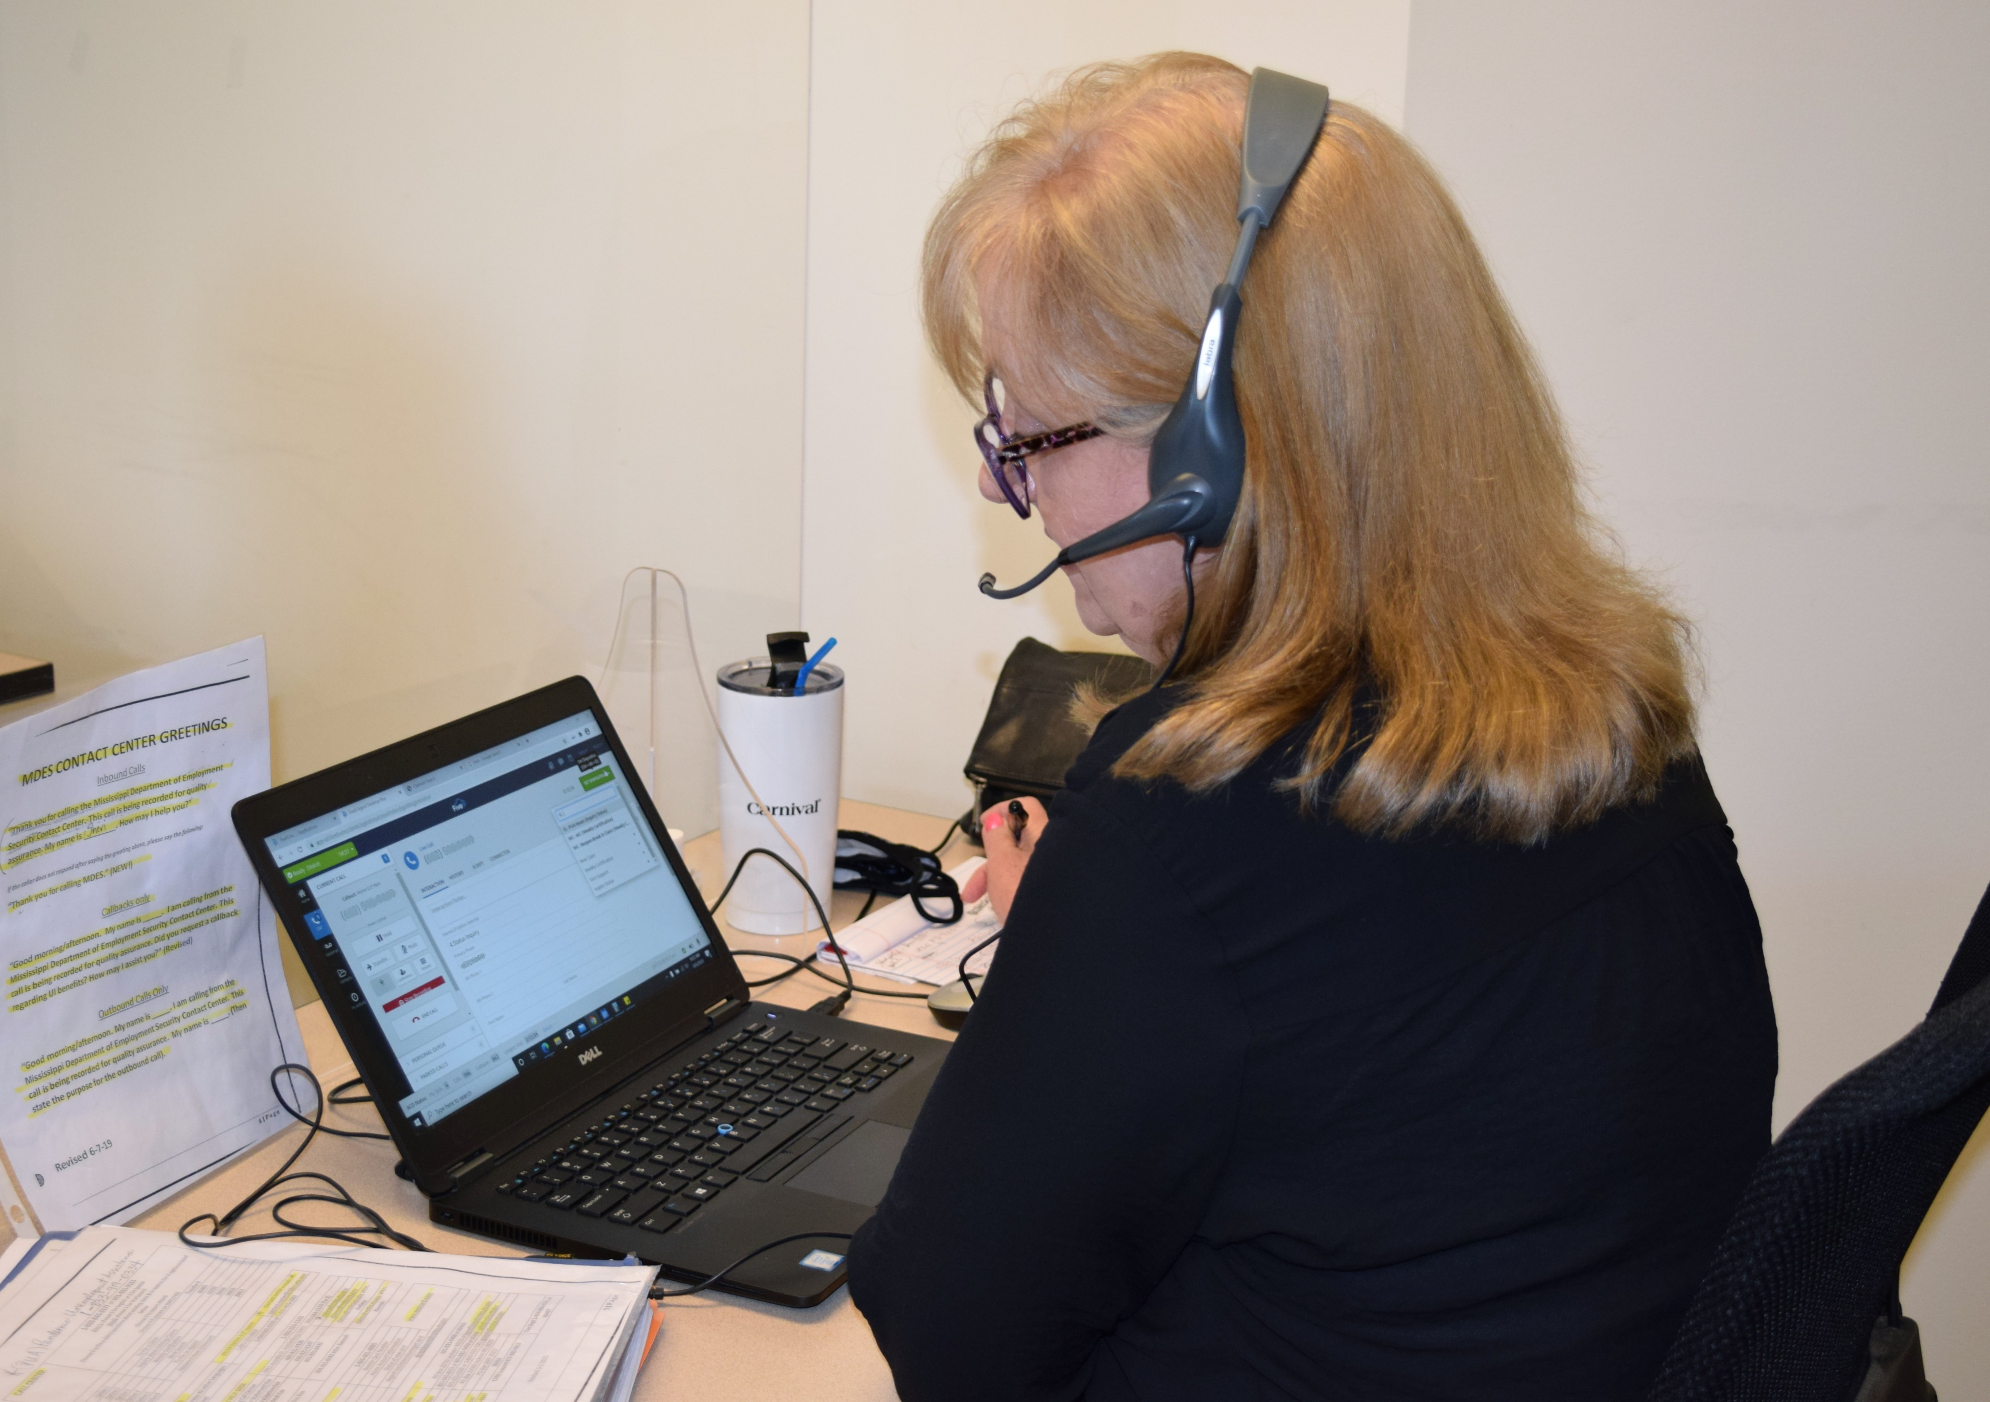
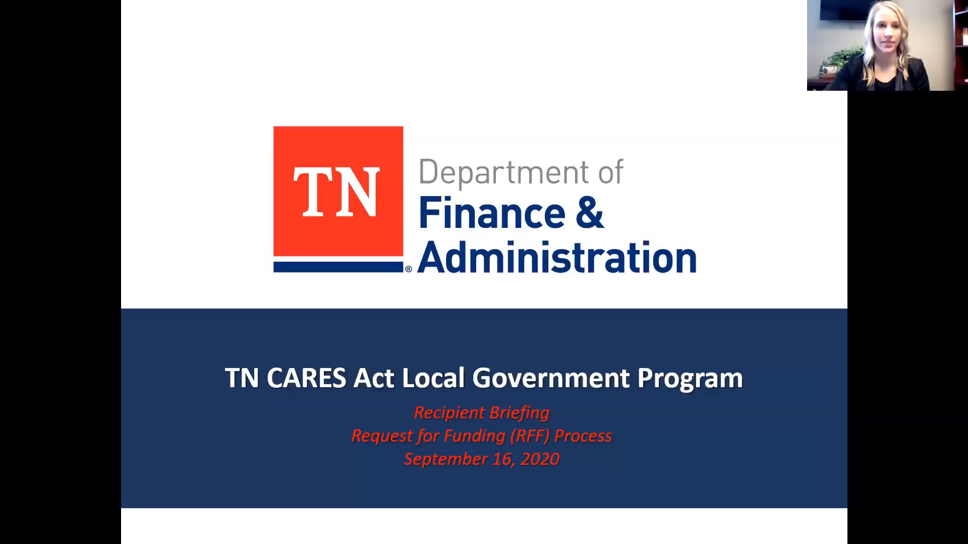
OUTREACH AND COMMUNICATION
8 Local Government Coordinators made more than 2,500 calls to the local governments of Tennessee discussing CARES Act funding and providing guidance on best practices for optimal COVID-19 relief.
LOCAL
GOVERNMENT
12 information webinars for the local government program with 2,412 instances of local government participation, averaging 6.7 webinars attended per jurisdiction with 325 unique Q&A questions answered throughout them.

Slide 19
Led by DHS, the TNCommunityCARES program oversaw $150 million in Coronavirus Relief Funds to aid non-profit organizations serving Tennesseans. To administer these funds, DHS partnered with six regional grant administrators, who worked closely with non-profit organizations to maximize available funds:
      United Way of Greater Knoxville ($30.1M)
      United Way of Chattanooga ($24.4M)
      Second Harvest Food Bank of Middle TN ($14.3M)
      United Way of Greater Nashville ($43.2M)
      United Way of the Mid-South ($26.3M)
      Women’s Foundation for a Greater Memphis ($11.7M)
$107M
Approved for Payment
$33M
Pending
Review
6
Grant
Administrators
655
Recipient
Organizations
NON–
PROFIT

Slide 20



NON–
PROFIT
TENNESSEE AQUARIUM
The aquarium upgraded 10 HVAC units equipped with ultraviolet-C light filters to increase the quality and flow of air while killing the Coronavirus.
“As a nonprofit, we were grateful to receive the funding to add another layer of safety for our guests, staff and volunteers.” - Rodney Fuller, Dir. Facilities & Maintenance
PENCIL
PENCIL provides supplies to Metro Nashville Public School teachers at no cost. They used their award to renovate warehouse space to allow additional volunteers to safely help distribute supplies to metro teachers.
QSOURCE
Qsource used the grant to create video lessons and educational materials for families and teachers to use to help young children learn about COVID-19.

Slide 21
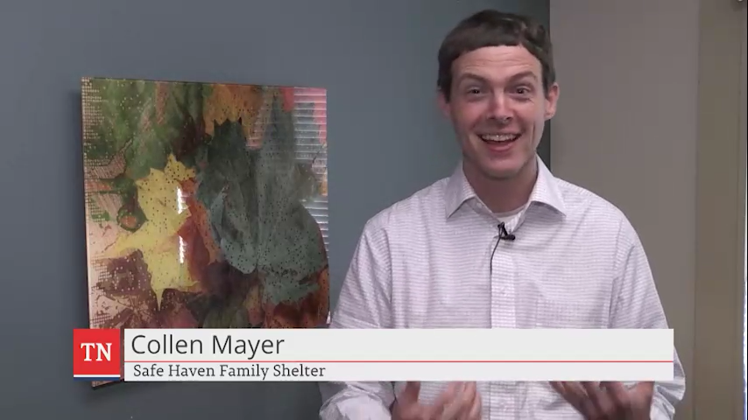
SAFE HAVEN FAMILY SHELTER
Tennessee Community CARES Program
CARES ACT PROGRAMS
HOLD for Housing example
TN

Slide 22
The TN Business Relief Program (TBRP) provided fast relief payments to small businesses impacted by closures or reductions in operation in April. To streamline the application process, the Department of Revenue pre-qualified eligible businesses using registered industry codes and sales tax filings. Payment ranged from $2,500 - $30,000 based on a business’ annual gross sales.
27,973
Approximately 70% OF PAYMENTS have been issued to businesses with annual gross sales of $500,000 or less
SMALL BUSINESS
Businesses
95
2,958 PAYMENTS to minority-owned business totaling
$18.5 million
Counties
$200M
5,206 PAYMENTS to women-owned business totaling
$24.5 million
Approved for Payment

Slide 23
The Supplemental Employer Recovery Grant (SERG) program is a small business relief program designed to reimburse any Tennessee small business for direct expenses or business interruption costs incurred due to the COVID-19 pandemic. Additional support is provided to businesses located in low to moderate income (LMI) census tracts, Opportunity zones, or Promise zones will receive an additional $500 added to the maximum $30,000 relief payment.
$30.6M
Approved for Payment
$6.7M
Approved for payment to 279 Diverse Business Enterprises
SMALL BUSINESS
1,250
Small Businesses
$24,480
Average Payment

Slide 24
How are TBRP and SERG Different?
TBR Program
SERG Program
Who?
Businesses pre-identified for eligibility using taxpayer filings and registered tax information.
$2,500 - $30,000
Fixed payment amount on gross sales revenue for April
Using sales tax data, TDOR pre-qualified and notified eligible businesses
Small business certified and attested that information was correct
Direct deposit using taxpayers registered state information
ALL small businesses meeting eligibility criteria
10% of program funds reserved for Diverse Business Enterprises
Up to $30,000
Additional $500 for low-income, opportunity zones
Loss of net income for May-Nov compared to prior year, or direct COVID expenses
Application based
Support team working with businesses to facilitate understanding and providing support for loss in electronic format
Manual review of business documents supporting actual loss with monitoring for duplication of benefits including PPP
How Much?
SMALL BUSINESS
How Calculated?
Process?

Slide 25
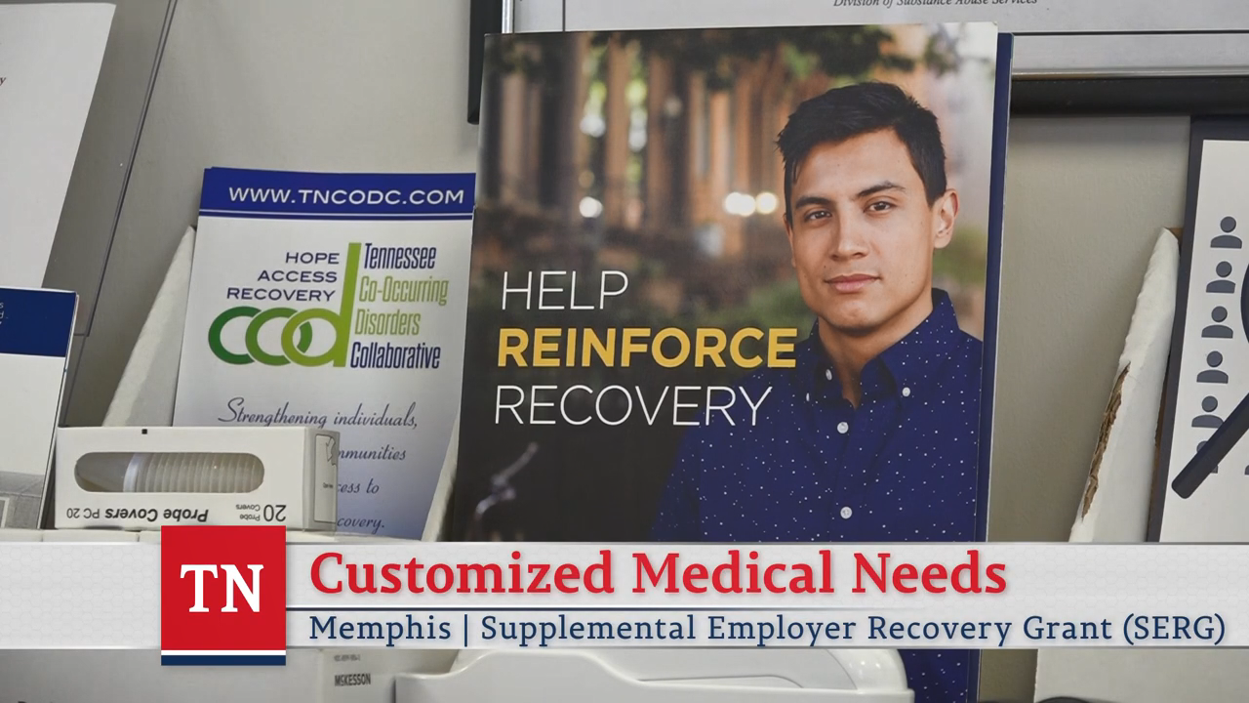
CUSTOMIZED MEDICAL NEEDS
in Memphis, Tennessee
SMALL BUSINESS

Slide 26

WATERDOGS SCUBA & SAFETY
in Clarksville, Tennessee
SMALL BUSINESS

Slide 27
The Tourism and Hospitality industries have been impacted severely by the COVID-19. To support the safe-reopening and marketing of Tennessee destinations, the State of Tennessee allocated $25,000,000 of the Coronavirus Relief Fund for Tennessee Tourism and local destination marketing organizations (DMOs).
$24.7M
Approved for Payment
“CARES funding provided Memphis and Shelby County's tourism industry the opportunity to generate visitors from important markets within a 600 mile radius. This gave us an ability to leverage additional resources along side our existing budget at Memphis Tourism. during a time our tourism related businesses and their staff's needed our support more than ever. Our tracking and results show the importance of this investment, we sincerely appreciate the state's support and look forward to working with everyone in 2021.”
Regena Bearden,
Memphis Tourism Chief Marketing Officer
TOURISM
112
Destination Marketing Organizations
95
Counties Served

Slide 28


Rutherford County
For the Love campaign
DISCOVERY PARK OF AMERICA
Let it Glow campaign
In an effort to encourage visitors to safely travel to Rutherford County, the Rutherford County CVB has launched a multi-prong digital campaign with geographical targets including Nashville, Memphis, Louisville, Huntsville and Chattanooga.
 | 2019 | 2020 | Difference
Cars | 4,500 | 11,500 | +156%
Revenue | $54,966 | $146,984 | +167%
“I just want to say a huge THANK YOU for the CARES tourism funding. We were able to advertise through multiple channels…resulting in Discovery Park of America's best year for the Let it Glow light show! Cars were wrapped around the parking lot to see the light show.”
Lindsay Frilling,
CEO of Obion County Joint Economic Development Corporation
TOURISM
WEBSITE
2,829 New Visitors
FACEBOOK
Post Reach +1.6M
INSTAGRAM
Accounts Reached +257%

Slide 29

The Tennessee Higher Education Commission (THEC) allocated $21.45 million in Coronavirus Relief Funds (CRF) to cover the cost of transitioning to online education and to equip campuses to offer postsecondary education in a socially distanced environment. Funds were allocated according to each campus’ share of undergraduate, low-income students. These funds purchased new technologies, improved campus networking infrastructure, and procured PPE for faculty, staff, and students.
$21.45M
HIGHER EDUCATION
Total Allocation
82
At TCAT McKenzie, CRF funds purchased Virtual Welding equipment that allowed additional course sections to be offered. This purchase increased access to critical educational opportunities that develop the skilled workers that drive the State’s economy.
At Pellissippi State Community College, CRF funds purchased 210 laptops and 200 Adobe Creative Suite licenses for students, added additional WIFI accessibility outside all the buildings on the campus, increased faculty and staff access to virtual technologies and hardware to facilitate online learning, and renovated a classroom to accommodate online and hybrid instructional formats.
Colleges and Universities
99.87%
Spent

Slide 30
Special thanks to the Financial Stimulus Accountability Group members for their work and counsel in administration and oversight of the Coronavirus Relief Fund.
Governor Bill Lee
Lieutenant Governor Randy McNally
House Speaker Cameron Sexton
Senator Bo Watson
Senator Raumesh Akbari
House Speaker Pro Tempore Pat Marsh Representative Harold Love Jr.
Jason Mumpower, Comptroller of the Treasury
Commissioner Butch Eley, Dept of F&A

