Slide 1



Tuesday, December 11, 2018
University of Memphis, FedEx Institute of Technology – The Zone, Memphis, TN
Blake Harrison, CPA, LBMC
Chris Coffman, FBT

Slide 2
What is a Qualified Opportunity Zone (QO Zone)?
Enacted as part of sweeping federal tax legislation commonly referred to as the Tax Cuts and Jobs Act of 2017.
Internal Revenue Code (IRC) Section 1400Z-2 provides significant tax incentives for taxpayers to reinvest unrealized capital gains in certain property and businesses located or operating in low-income census tracts that Treasury has designated as qualified opportunity zones (“QO Zone”).

Slide 3
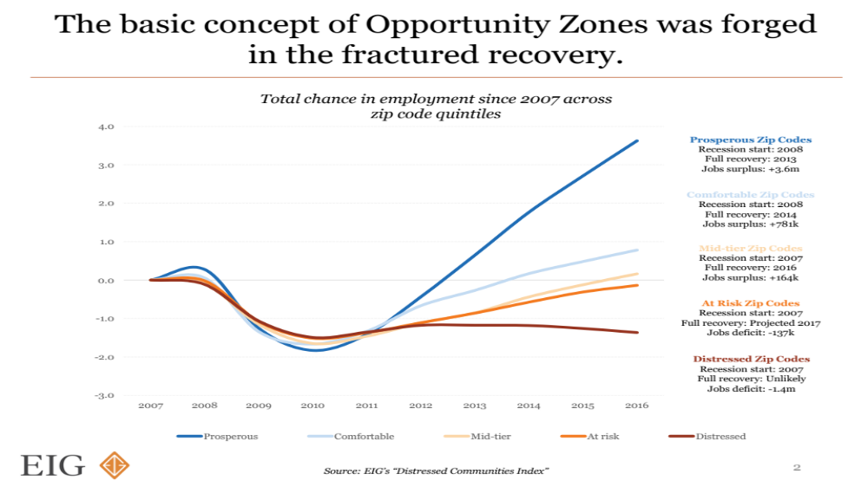

Slide 4
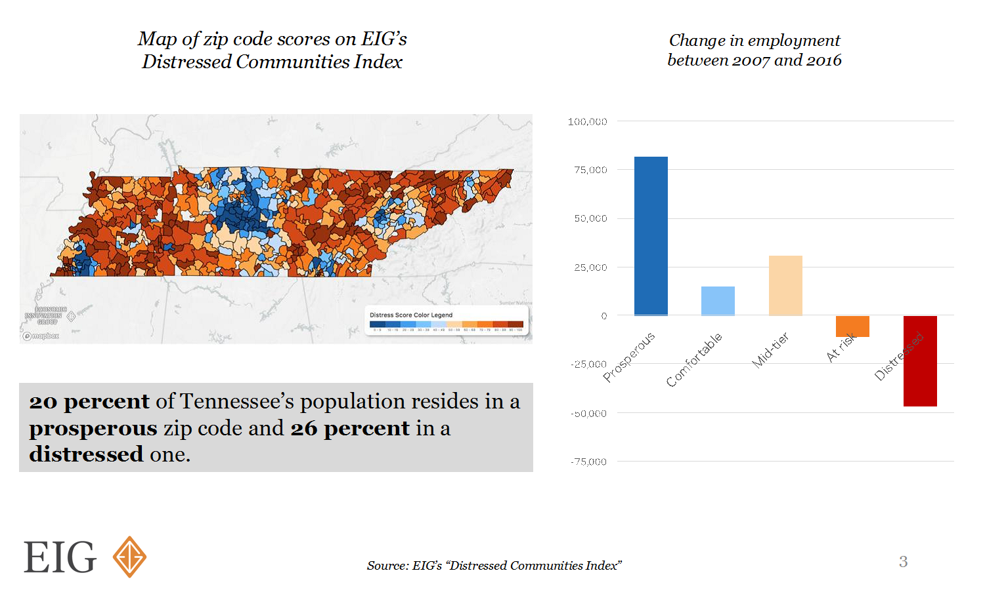
Map of Zip Code Scores on EIG’s Distressed Communities Index (Source: EIG’s “Distressed Communities Index”)

Slide 5
Change in Employment Between
2007 and 2016 by Zip Code (Source: EIG’s Distressed Communities Index)

Slide 6
What is a Qualified Opportunity Zone (QO Zone)?
Census tract determined to be a low-income community.
Low-income census tract has individual poverty rate of at least 20% and median family income no greater than 80% of the area median.
Governors of each State nominated eligible low-income census tracts and contiguous tracts. In each state, only 25% of qualified low-income census tracts could be designated as Opportunity Zones. Only 5% of the designated Opportunity Zones could qualify as contiguous tracts.
The Department of the Treasury then designated the census tracts nominated by each state as QO Zones. National map of QO Zones is now in place. Treasury certified final round of states’ nominations on June 14.
QO Zones retain designation for ten years (expire 12/31/2028) – proposed regulations provide that “permanent exclusion” election can be made until 12/31/2047.

Slide 7
What is a Qualified Opportunity Zone (QO Zone)?
Treasury has designated QO Zones in all 50 states, the District of Columbia, and five U.S. possessions.
  More than 8,700 tracts across all states, territories, and the District of Columbia.
In Tennessee, Treasury designated 176 tracts in 75 counties throughout the state as QO Zones.
  32 designated QO Zones in Shelby County.
  18 designated QO Zones in Davidson County.
  8 designated QO Zones in Knox County.
  7 designated QO Zones in Hamilton County.
  2 designated QO Zones in Lauderdale and Tipton County.
  1 designated QO Zone in Fayette, Hardeman, and Haywood County.

Slide 8
QO Zones Nationally
(Source: EIG)
Governors prioritized higher-need places. Zones have an average poverty rate of nearly 31 percent, well above the 20 percent eligibility threshold, and an average median family income of only 59 percent of its area median, compared to the 80 percent eligibility threshold.
Selected tracts have high need as well as proven growth potential. The country’s Opportunity Zones already contain 24 million jobs and 1.6 million places of business. Many can harness some positive momentum as well: Three-quarters of zones are located in zip codes that experienced at least some level of post-recession employment growth from 2011 to 2015.
Less than 4 percent of zones have recently experienced high levels of socioeconomic change, a proxy for gentrification and displacement risk.
The average Opportunity Zone’s housing stock has a median age of 50 years, more than ten years older than the U.S. median—a sign that many of these neighborhoods urgently need reinvestment.

Slide 9
Process of Choosing QO Zones in Tennessee
Tennessee’s 176 tract designations were chosen using a strategic, data-driven approach.
Tennessee’s tract recommendations were determined based on a working group’s review of data analytics, county/mayor feedback and public comment in addition to consideration of state priorities and initiatives including:
  Business development and brownfield redevelopment opportunities
  Retail, commercial and tourism development opportunities
  Community and rural development initiatives
  Low-income housing development opportunities
  Proximity to entrepreneur centers, technology transfer offices, and colleges and universities

Slide 10
Process of Choosing QO Zones in Tennessee
Tennessee’s working group included representation and recommendations from TNECD, the Tennessee Department of Environment and Conservation, Tennessee Housing Development Agency, Tennessee Valley Authority and LaunchTN.

Slide 11
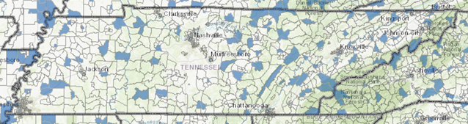
QO Zones in Tennessee
Source: https://www.cims.cdfifund.gov/preparation/?config=config_nmtc.xml

Slide 12
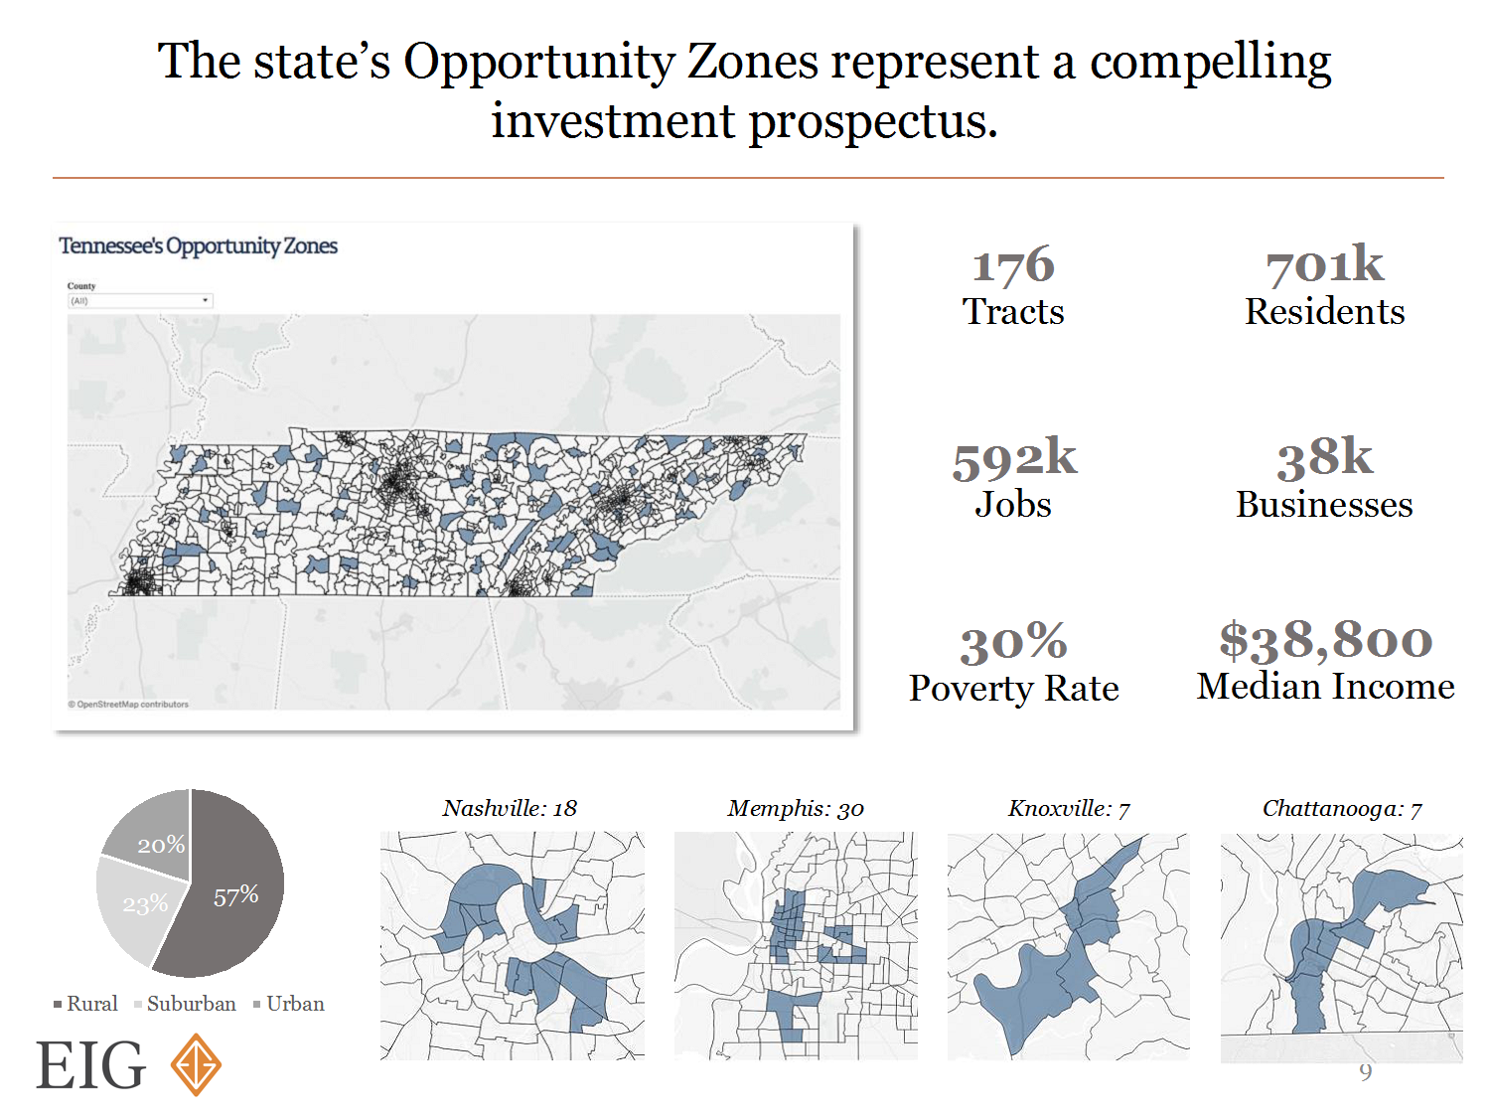
QO Zones in Tennessee by the Numbers
(Source: EIG)

Slide 13
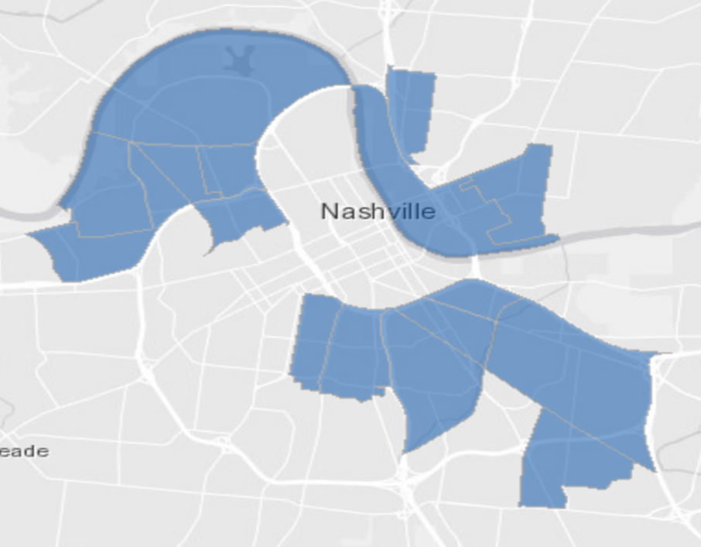
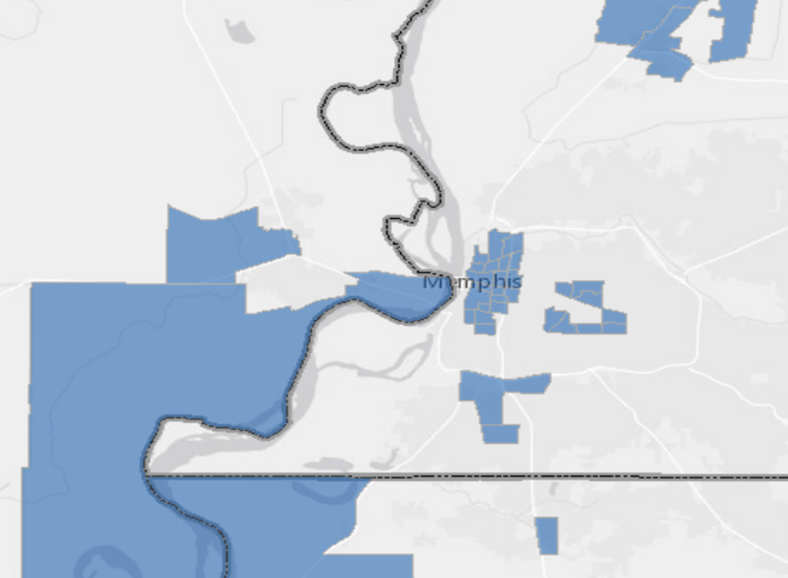
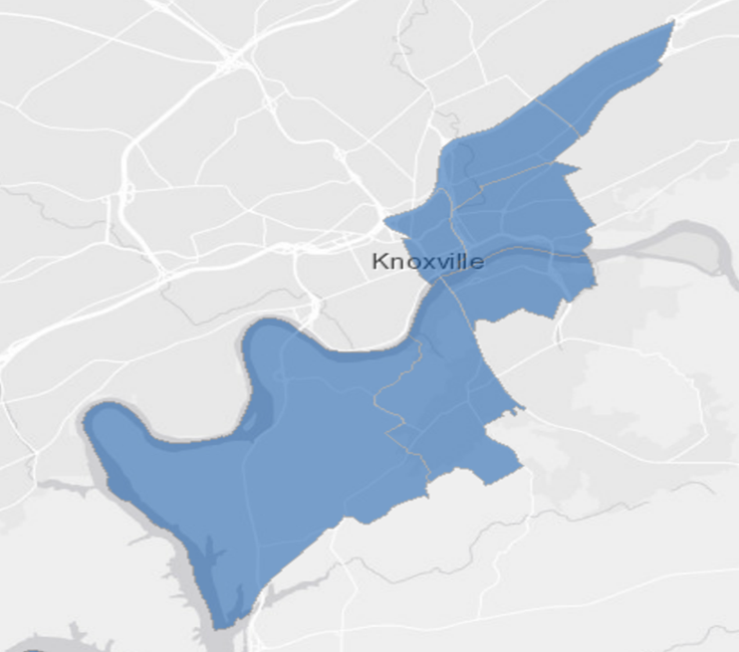
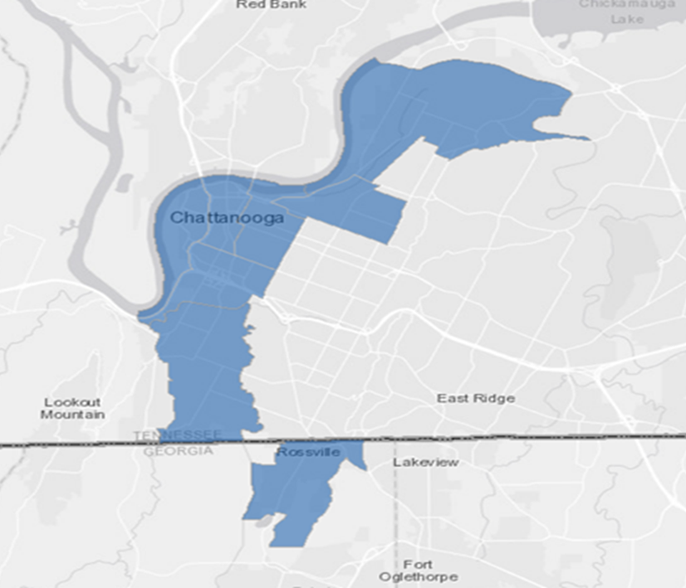
QO Zones in Tennessee by the Numbers
(Source: EIG)
Nashville
Memphis
Knoxville
Chattanooga

Slide 14
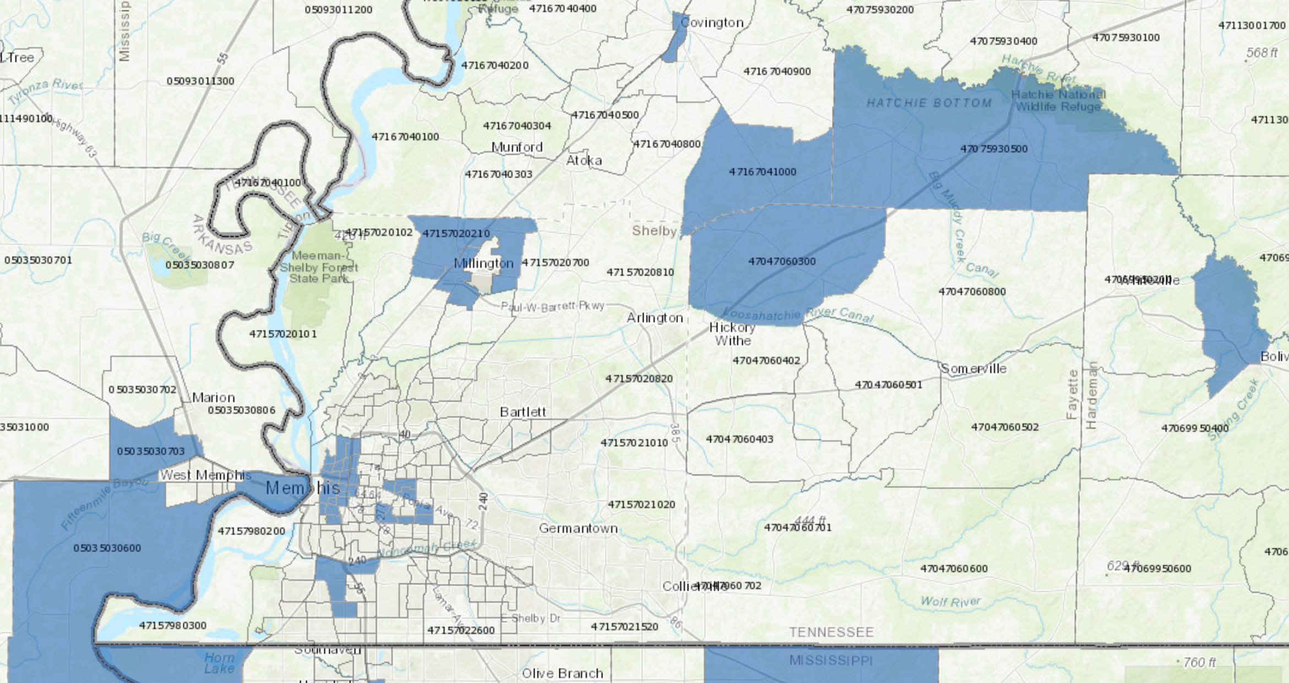
QO Zones in the Region
Source: https://www.cims.cdfifund.gov/preparation/?config=config_nmtc.xml

Slide 15
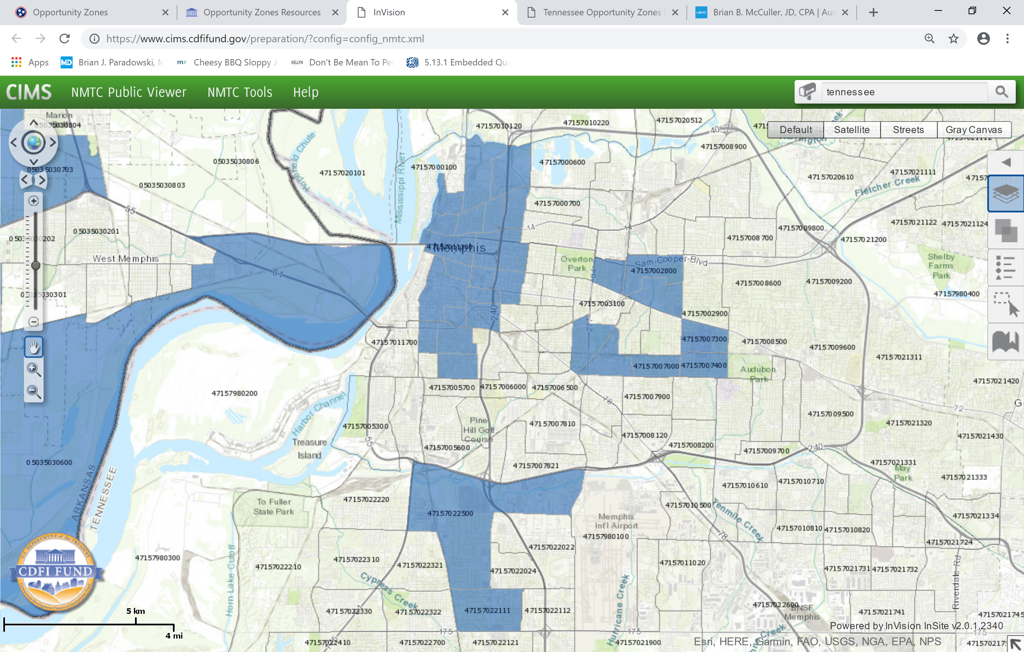
QO Zones in Memphis
Source: https://www.cims.cdfifund.gov/preparation/?config=config_nmtc.xml

Slide 16
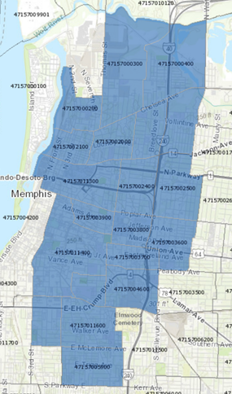
QO Zones in Memphis
Source: https://www.cims.cdfifund.gov/preparation/?config=config_nmtc.xml

Slide 17
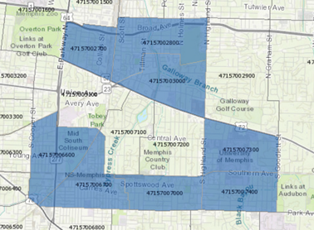
QO Zones in Memphis
Source: https://www.cims.cdfifund.gov/preparation/?config=config_nmtc.xml

Slide 18
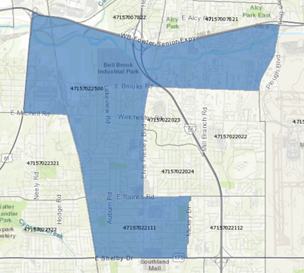
QO Zones in Memphis
Source: https://www.cims.cdfifund.gov/preparation/?config=config_nmtc.xml

Slide 19
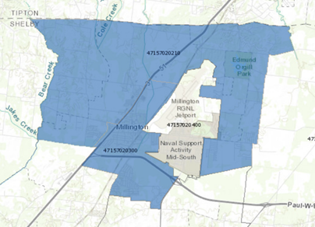
QO Zones in Shelby County
Source: https://www.cims.cdfifund.gov/preparation/?config=config_nmtc.xml

Slide 20
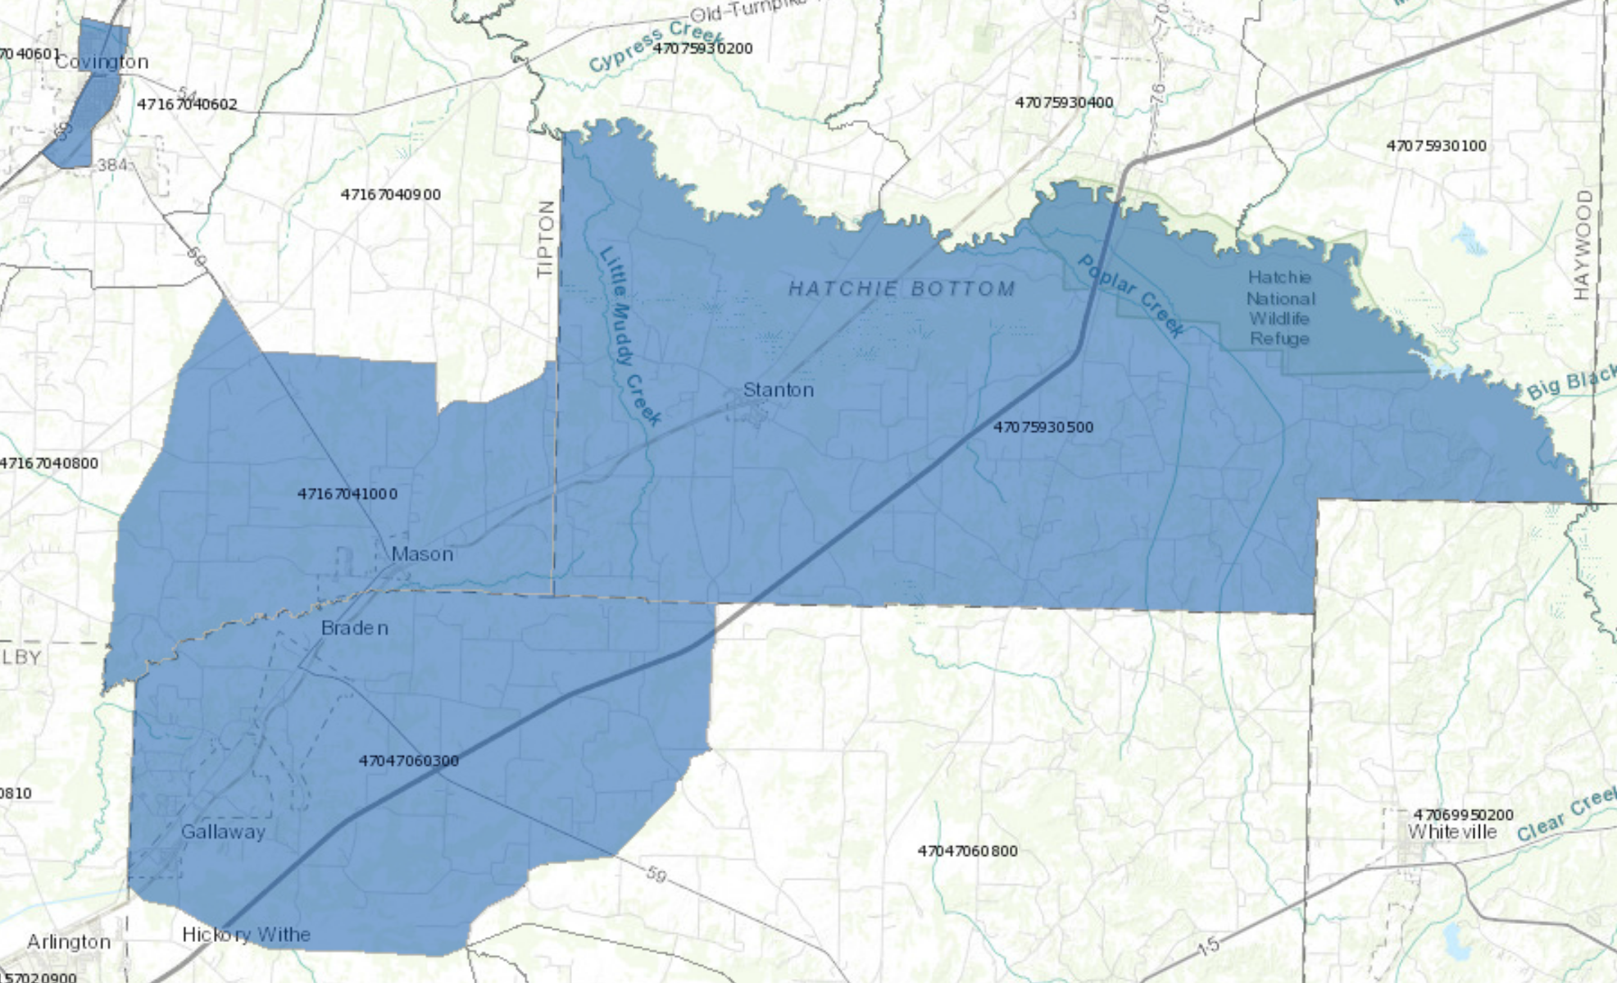
QO Zones – Fayette, Haywood, and Tipton
Source: https://www.cims.cdfifund.gov/preparation/?config=config_nmtc.xml

Slide 21
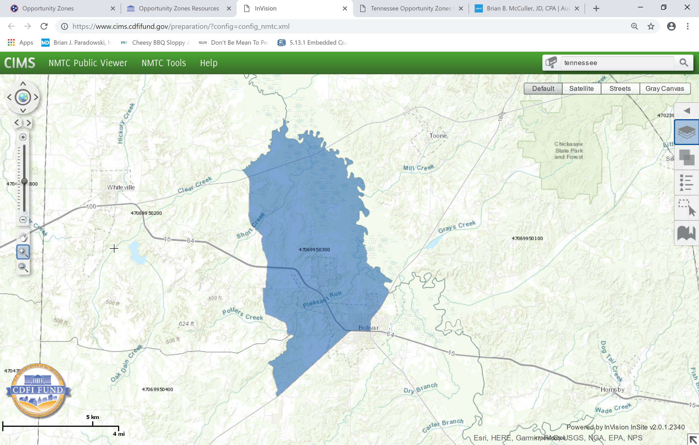
QO Zone in Hardeman County
Source: https://www.cims.cdfifund.gov/preparation/?config=config_nmtc.xml

Slide 22
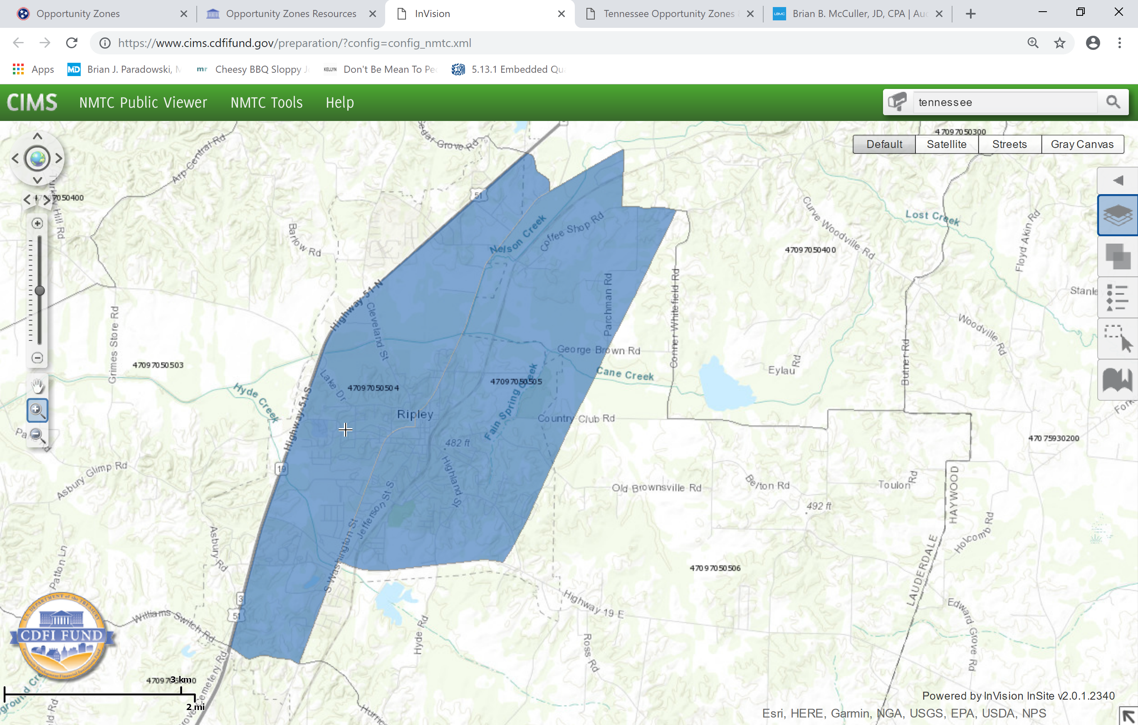
QO Zones in Lauderdale County
Source: https://www.cims.cdfifund.gov/preparation/?config=config_nmtc.xml

Slide 23
Opportunity Zones – Interactive Map
An interactive map that permits the user to zoom in on specific addresses, census tracts, and opportunity zones across the country can be found at the following links:
  https://www.cims.cdfifund.gov/preparation/?config=config_nmtc.xml
  https://eig.org/news/opportunity-zones-map-comes-focus
Tennessee Department of Economic and Community Development opportunity zone page can be found at the following link:
  https://www.tn.gov/ecd/opportunity-zones.html

Slide 24
Purpose of QO Zones
To encourage economic development in “low income areas” by providing various tax incentives for private investments in QO Zones.
Based on analysis of Federal Reserve data, the Economic Innovation Group, a bipartisan research and advocacy organization that helped plan the initial legislation that formed the basis for the QO Zones incentives, estimated that U.S. taxpayers held $6.1 trillion in unrealized capital gain at the end of 2017. https://eig.org/news/joint-economic-hearing-promise-opportunity-zones
This significant amount of capital available for reinvestment makes the QO Zones program potentially the largest economic development initiative in the country.

Slide 25
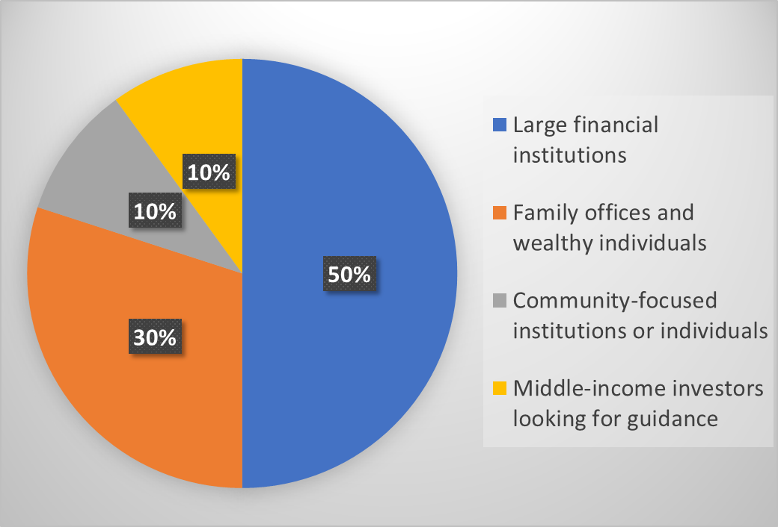
Types of QO Zone Investors

Slide 26



QO Zone Benefits
Qualified Opportunity Zone Funds (QOFs)
Defer taxes by making
timely investments
when invested in
Taxpayers
Qualified Opportunity Zone Property

Slide 27
QO Zones – What are the Incentives?
There are three separate investment incentives that a taxpayer can elect to take advantage of with respect to their investment.
  Temporary deferral of capital gain.
  Step-up in basis.
  Permanent exclusion of gain on appreciation.

Slide 28
QO Zone Incentive – Temporary Deferral
Taxpayer can elect under IRC Section 1400Z-2(a)(1)(A) to temporarily defer capital gain from the sale or transfer to an unrelated party of any property that the taxpayer owns as long as the taxpayer reinvests the deferred amount in a qualified opportunity fund (“QO Fund”).
  GAINS DEFERRED – Proposed regulations make it clear that deferral is only available for gain that is treated as capital gain for federal tax purposes – Section 1231 property.
  ANY PROPERTY – There does not appear to be any restrictions on the types of property that can be sold to generate the gain – not limited to real property or business property.
Taxpayer must reinvest the deferred amount within the 180-day period beginning on the date of the sale or transfer of the property generating the gain – proposed regulations address deferral of gain from partnership or other PTE

Slide 29
QO Zone Incentive – Temporary Deferral (cont.)
Gain deferral is temporary because the taxpayer must recognize the income in the tax year the investment is sold or the tax year that includes December 31, 2026, whichever is earlier.
Treasury released guidance indicating that a taxpayer can make an election to defer gain when it files a federal income tax return in the year gain would have been realized.
  Anticipated that taxpayers will use Form 8949 to elect to defer gain.

Slide 30
QO Zone Incentive – Basis Step-Up
Where a taxpayer has elected temporary gain deferral, IRC Section 1400Z-2(b)(2)(B) provides a tiered “step-up” in the taxpayer’s basis in the gain it reinvests in the QO Fund depending on how long the taxpayer holds the investment.
Absent this statutory “step-up,” the taxpayer’s initial basis in the reinvested gain is zero.
“Step-Up” Holding Period
  If the taxpayer holds the investment for at least five years, the taxpayer’s basis in the investment is increased by an amount that is equal to ten percent (10%) of the amount of capital gain that the taxpayer elected to defer.
  If the taxpayer holds the investment for seven years, the taxpayer’s basis is increased by an additional five percent (5%) of the deferred gain.

Slide 31
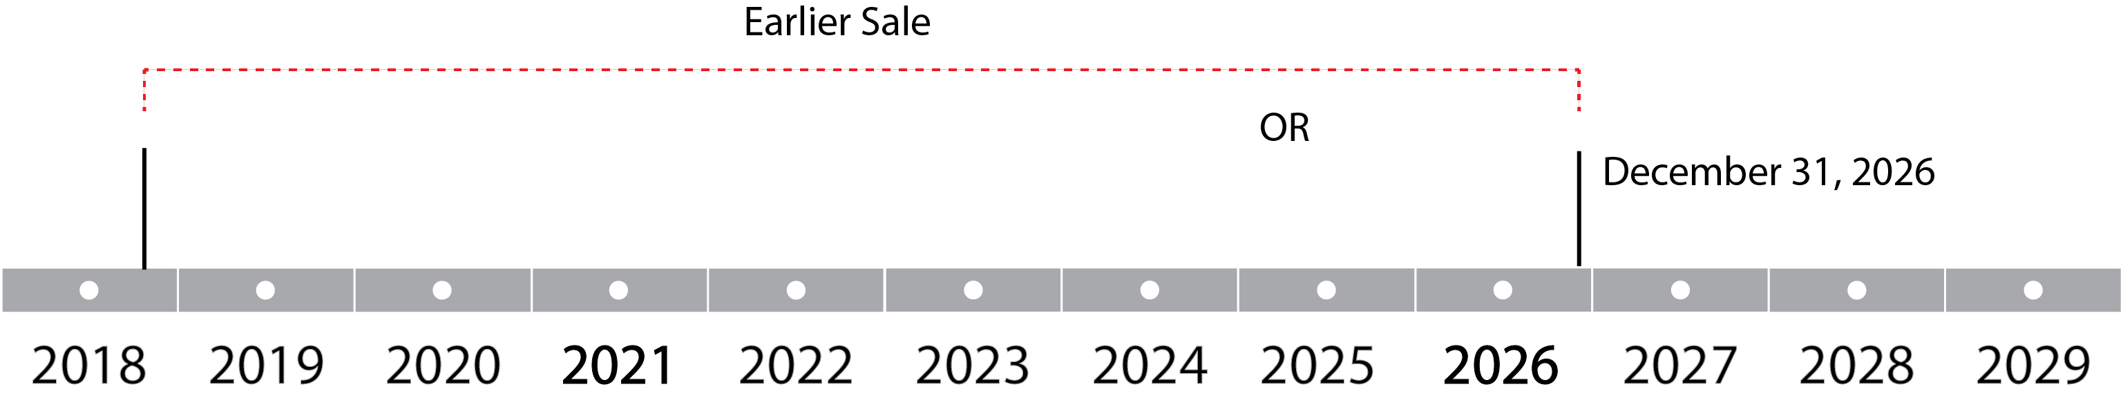
QO Zone Incentive – Basis Step-Up (cont.)
Because the temporary gain deferral period ends no later than the tax year including December 31, 2026, the taxpayer will need to reinvest capital gain in a QO Fund and elect deferral treatment by December 31, 2019 to permit the taxpayer to hold the investment for seven years and receive the full benefit of the basis step-up provision.

Slide 32
QO Zone Incentive – Permanent Exclusion
Taxpayer can elect under IRC Section 1400Z-2(a)(1)(C) for an additional basis “step-up” that permanently excludes capital gain on the sale or transfer of an investment that the taxpayer holds for at least ten years.
Where the taxpayer makes an election and holds the investment for at least ten (10) years, the taxpayer’s basis in the investment is equal to the fair market value of the investment on the date the investment is sold – taxpayer is able to dispose of the property tax-free.
Assumed that taxpayer would use IRS Form 8949 to elect permanent gain exclusion.
  Optional – taxpayer can use stepped-up basis if FMV of property decreases.
  Proposed regulations make clear that taxpayer’s ability to make election is preserved until 12/31/2047

Slide 33

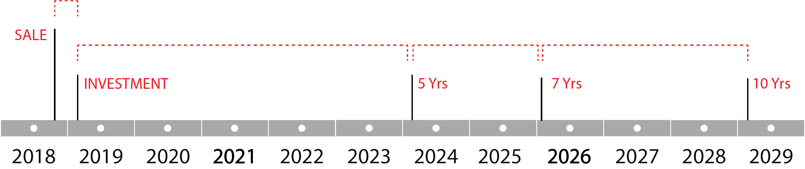
Basis increased by
Additional 5% of the deferred gain
Up to 85% taxed
Basis is equal to
Fair Market Value
Exclusion of
gains on appreciation of investment
Basis increased by
10% of the deferred gain
Up to 90% taxed
Within
180 Days

Slide 34
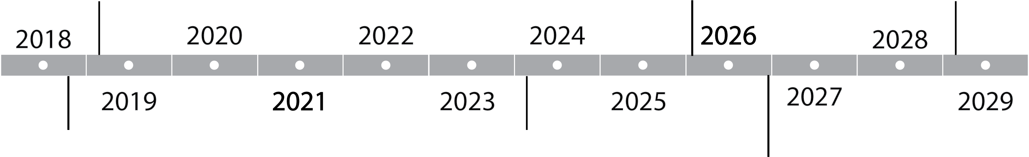
QO Zone Incentives – Example
April 28, 2029
(10 years) Taxpayer sells its investment for $3M. The basis is equal to the FMV. No additional tax is owed on the appreciation.
Before April 28, 2019
Taxpayer contributes the $1M of capital gain to a QOF
April 28, 2026
(7 years) Taxpayer’s basis in investment in QOF increases another 5% from $100k to $150k
QOF makes a timely investment of the $1M in Qualified Opportunity Zone Property
Oct. 30, 2018
Taxpayer enters into a sale that generate $1M of capital gain
April 28, 2024
(5 years) Taxpayer’s basis in investment in QOF increases 10% from $0 to $100k
December 31, 2026
$850k of the $1M of initial capital gains are taxed and the basis in QOF investment increases to $1M
Notes:
The Taxpayer’s initial basis is deemed to be $0 in the QOF investment

Slide 35
QO Zone Incentives - Example
INVESTMENT HOLDING PERIOD | GAIN ON SALE OF ORIGINAL ASSET | GAIN ON APPRECIATION OF OZ INVESTMENT* | TOTAL TAXABLE GAIN
3 Years | $1 million | $2 million | $3 million**
5 Years | $900,000 | $2 million | $2.9 million
7 Years | $850,000 | $2 million | $2.85 million
10 Years | $850,000 | -0- | $850,000
* Assume OZ Investment is sold for $3 million at the end of each holding period.
** Absent QO Zone, this would likely be the tax result to Taxpayer for the same course of action – initial sale of asset, reinvestment in new project, and eventual sale - $1 million of gain recognized at time of asset sale and $2 million of gain recognized when new project is sold.

Slide 36
What is a Qualified Opportunity Fund (QO Fund)?
A QO Fund is any investment vehicle organized as either a partnership (including an LLC treated as a partnership for tax purposes) or corporation that was formed for the purpose of investing in qualified opportunity zone property (“QOZ Property”).
At least 90 percent of the QO Fund’s assets must consist of QOZ Property.
IRS confirmed that a taxpayer can self-certify to become a QO Fund - Taxpayers are not required to seek pre-approval or related action to establish a QO Fund.
To self-certify, the taxpayer will simply complete a form and attach the form to a timely filed federal income tax return for the relevant taxable year. IRS Form 8996 used for self-certification – form also used for annual 90% compliance.
Self-certification process should simplify the general complexity typically associated with other federal incentive programs and expedite the ability of QO Funds to invest in or acquire QOZ Property.

Slide 37
Types of Qualified Opportunity Zone Funds
Individual Project-focused
Industry-focused
Geography-focused
Social Impact-focused

Slide 38



Investment Types in Opportunity Zones
New Businesses created in Opportunity Zones
Real Estate
Development and Rehab Project
in Opportunity Zones
Expansion of
Businesses already
in Opportunity Zones
Businesses expanding into
Opportunity Zones

Slide 39
What is QOZ Property?
There are three categories of QOZ Property permitted under IRC Section 1400Z-2(d)(2)(A):
  Qualified opportunity zone stock (“QOZ Stock”);
  Qualified opportunity zone partnership interest (“QOZ Interest”); or
  Qualified opportunity zone business property (“QOZ Business Property”).
QOZ Property cannot include an interest in another QO Fund.

Slide 40
QOZ Stock
Any stock in a domestic corporation if:
  the QO Fund acquired the stock after December 31, 2017 at its original issue for cash;
  at the time of issue, the corporation was a qualified opportunity zone business (“QOZ Business”) or was organized to be a QOZ Business; and
  during substantially all of the time the QO Fund held the QOZ Stock, the corporation qualified as a QOZ Business.
At this time, there is no guidance as to what period of time a corporation must qualify as a QOZ Business to satisfy the “substantially all” requirement for QOZ Stock.

Slide 41
QOZ Interest
Consists of any capital or profits interest in a domestic partnership (including an LLC treated as a partnership for federal tax purposes) if:
  the QO Fund acquired the interest after December 31, 2017 in exchange for cash;
  at the time the QO Fund acquired the interest in the partnership, the partnership was a QOZ Business or was organized to be a QOZ Business; and
  during substantially all of the time the QO Fund held the interest, the partnership qualified as a QOZ Business.
At this time, there is no guidance as to what period of time a partnership must qualify as a QOZ Business to satisfy the “substantially all” requirement for a QOZ Interest.

Slide 42
QOZ Business Property
Tangible property that a QO Fund or QOZ Business purchased after December 31, 2017 and that is used by the QO Fund/QOZ Business in a trade or business operating in a QO Zone for substantially all of the time that the QO Fund/QOZ Business owns the property.
The original use of the property in the QO Zone must begin with the QO Fund or QOZ Business, or the QO Fund/QOZ Business must substantially improve the property.
  “Original use” – not defined in the statute. Regulations/caselaw address use of the term in other statutory contexts – “First use to which the property is put, whether or not such use corresponds to the use of such property by the taxpayer.”

Slide 43
QOZ Business Property
Property will be treated as “substantially improved” if the basis of the QO Fund or QOZ Business in the property increases over a 30-month period beginning at acquisition by an amount that exceeds its initial basis (i.e., the purchase price) in the property.
  The improvement expenditures of the QO Fund or QOZ Business in the property over the 30-month period must exceed the original acquisition price.
  Permits parties to purchase and develop property without having to meet the “original use” requirement. Does not permit parties to purchase developed property with little or no additional improvement.
  Revenue Ruling 2018-29 – substantial improvement measured by addition to adjusted basis of the building, not the underlying land.
The statute does not define what period of time or what amount of use would satisfy the “substantially all” requirement for QOZ Business Property.

Slide 44
QOZ Business Property – Related Party Restriction
To qualify as QOZ Business Property, the QO Fund or QOZ Business can only acquire the property from an unrelated party.
Property that a QO Fund or QOZ Business purchases in a transaction involving certain prohibited relationships such as individuals from the same family, entities related through common ownership or control, or entities from the same controlled group, may NOT be considered QOZ Business Property.

Slide 45
What is a QOZ Business?
REQUIREMENTS:
The activity must be a trade or business in which substantially all of the tangible property owned or leased by the taxpayer is QOZ Business Property.
  Proposed regulations define “substantially all” in this limited context to mean at least 70%.
At least 50% of the total gross income of the taxpayer must be from the active conduct of such trade or business activity WITHIN THE ZONE, and the taxpayer must use a substantial portion of its intangible property in the active conduct of such trade or business.
Less than 5% of the average aggregate unadjusted bases of the property of the entity may be attributable to nonqualified financial property (e.g., debt, stock, partnership interests, options, futures contracts, forward contracts, warrants, notional principal contracts, or annuities).
“Sin Business” Restriction The trade or business activity must not constitute a private or commercial golf course, country club, massage parlor, hot tub facility, suntan facility, racetrack or other facility used for gambling, or any store the principal business of which is the sale of alcoholic beverages for consumption off premises.

Slide 46
Mixed Fund Investment
A taxpayer is permitted to invest funds in a QO Fund of which only a portion of the investment consists of gain for which the taxpayer made a deferral and exclusion election under IRC Section 1400Z-2.
However, taxpayer will only be entitled to Opportunity Zone tax incentives on the portion of the investment for which the taxpayer made the election (i.e., the reinvested capital gain).
If the taxpayer makes a “mixed fund” investment, the taxpayer is treated as having made two separate investments in the QO Fund – one investment to which the deferral election was made, and the other investment consisting of the remaining amount. The tax incentives only apply to the former investment and not the latter.

Slide 47
Civil Penalties for Noncompliance
If a QO Fund fails to meet the requirement that it must hold at least 90 percent of its assets in QOZ Property, the QO Fund must pay a penalty for each month that the fund is in non-compliance.
No penalty will be imposed where there is reasonable cause for the QO Fund’s failure to meet the threshold. At this time there is no guidance as to what might constitute “reasonable cause”.

Slide 48
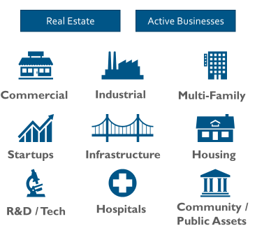
Creating Opportunity
Need
Tax Law Compliant Project
No Sin Businesses
Need Qualified Deal Structure

Slide 49
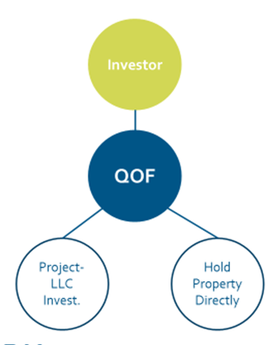
General Structure and Concerns
QOF Concern:
  90% QOZ Property
QOZ Business Concerns:
  70% of Tangible Property Leased or Owned:
    Acquired after 2017 from unrelated party
    “Substantially all” use in OZ
    Original Use or “Substantial Improvement” -> double cost basis in 30 month period (*special rule for buildings*)
  50% income from “active conduct” within OZ
  Substantial intangible property use within OZ
  Non-Qualified Financial Property Test” (31-month working capital safe harbor)

Slide 50
General Structure and Concerns (cont.)
Investor Level Concerns:
  Any gain treated as capital gain for federal tax purposes
  180 day period to invest (PTE owner timing)
  Unlimited # of investors or $ of investment
QOF Concerns:
  New 6 month clock to meet 90% test
  Can leverage equity invested
  “Self-Certification” process (Form 8996 – choose month/year)
QOZ Business Concerns:
  31-month or shorter buildout
  Hold project for full 10-year period (condo/single family home problem)?
  “Active Management” component?

Slide 51



Basic Model for Real Estate Development
or direct ownership of
QOZ Business Property
within
180 days
Investors
QOF
QOZ Partnership
QOZ
Business Property
Rental Real Estate
New construction
Substantial improvement of adjusted basis excluding land

Slide 52
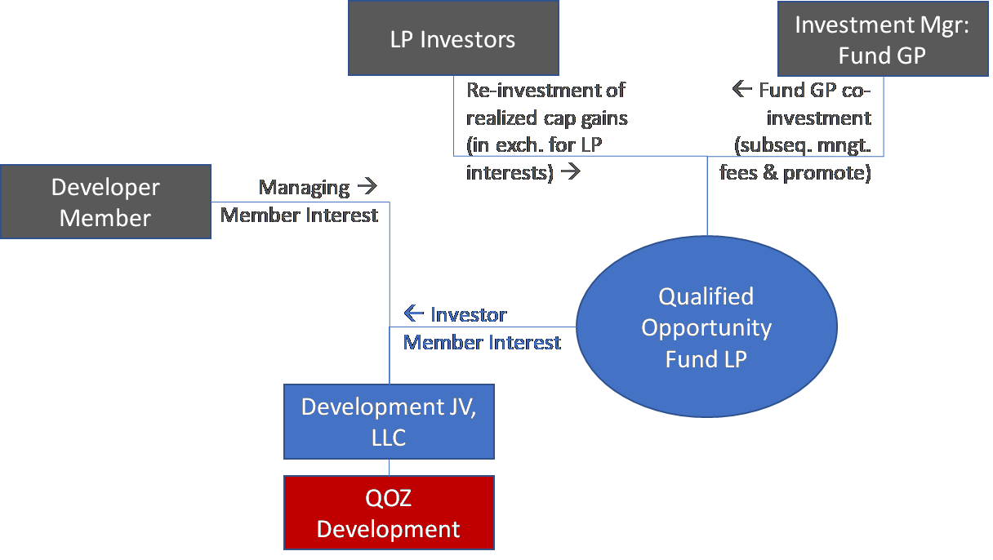
Basic Model for Real Estate Development

Slide 53
Real Estate Development Concerns
Real Estate Joint Ventures: fresh acquisition of land & subsequent development
QOF’s partnership interest is funded with cash. QOF equity serves as limited partner
QOZB most likely will be able to perform a cash-out recapitalization to buy out GP/developer at deal stabilization.
< 5% NQFP requirement forces thoughtful matching of capital gains harvesting and construction draws
Presuming development satisfies “substantial improvement” and site is purchased in 2018+ from an unrelated party, the development, which is the QOZB’s sole asset, is indeed QOZ business property.
> 50% of gross income derived from active conduct: preclude NNN leases? Require active management?
Real Estate Joint Ventures: OZ recapitalization of existing development
QOZ business is partnership. OZ equity serves as limited partner to a developer/GP that already owns the site. The newly formed partnership purchases the land from the developer and builds – related party concerns.
< 5% NQFP requirement forces thoughtful matching of capital gains harvesting and construction draws
Substantial Improvement.
> 50% of gross income derived from active conduct: preclude NNN leases? Require active management?

Slide 54
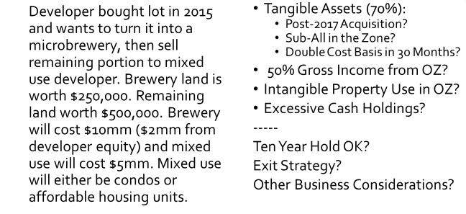
Real Estate/Mixed Use Example
(Source: OPAL)

Slide 55
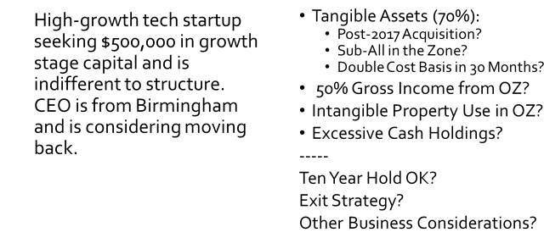
Tech Startup Example
(Source: OPAL)

Slide 56
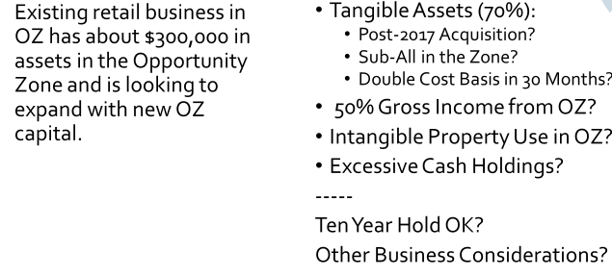
Retail Business Example
(Source: OPAL)

Slide 57
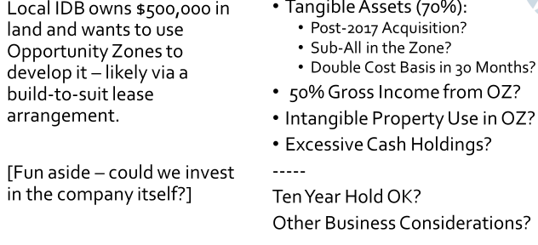
Manufacturing Example
(Source: OPAL)

Slide 58
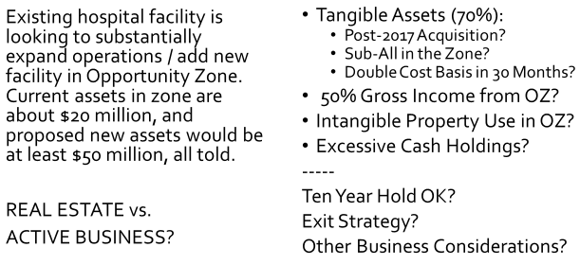
Healthcare Example
(Source: OPAL)

Slide 59
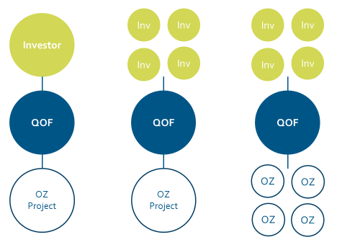
Opportunity Fund Investment Structure

Slide 60
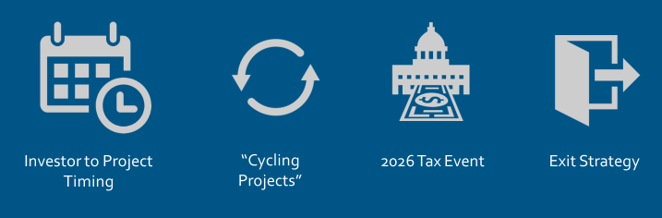
General Business Considerations

Slide 61
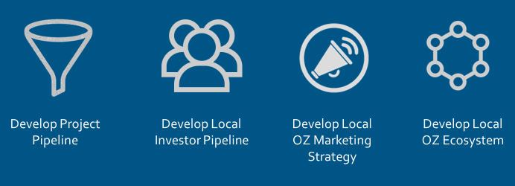
Community Takeaways
(Source: OPAL)

Slide 62
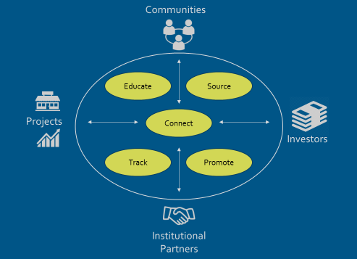
OZ Ecosystem
(Source: OPAL)

Slide 63
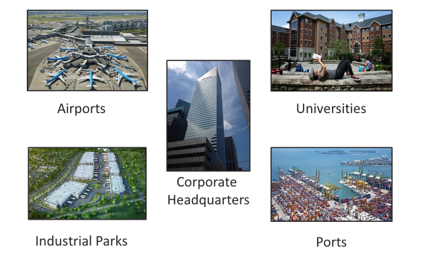
Leveraging Anchor Assets

Slide 64
Leveraging Anchor Assets
Anchor institutions, e.g. industrial parks, universities, manufacturing, tourist destinations
Consider
  Special market advantages & purposes
  Recent demographic trends
  Employment density
  What’s missing (e.g., zoning, permits) – proactive preparation
Align assets with market distinctions

Slide 65
Next Steps
General OZ Education / Project Assessment / Fund Information
  Listing of national QOFs:
    https://www.ncsha.org/resource/opportunity-zone-fund-directory/
    https://www.novoco.com/resource-centers/opportunity-zone-resource-center/opportunity-zone-funds-listing
  Identify / Track local and regional QOFs
Institutional Partner Engagement / “Concierge” Service
Fund / Deal Introductions
Community Ecosystem Working Group
Community Prospectus Development
Needs Identification / Impact Tracking
Direct Community Investment Mechanisms

Slide 66
  The Proposed Regulations

Slide 67
Treasury Released First Round of Guidance
October 19, 2018, the IRS and U.S. Department of the Treasury released the first round of proposed regulations regarding the implementation and application of the opportunity zone development incentive.
IRS also issued Revenue Ruling 2018-29 to provide clarity regarding the “original use” and “substantial improvement” requirements and the application of those requirements to real property.
IRS released draft Form 8996 and draft instructions for the form.
IRS updated its FAQ document related to opportunity zones.

Slide 68
Proposed Regulations?
The proposed regulations are intended to provide guidance and clarity regarding Treasury’s interpretation of IRC 1400Z-2. However, they are not final.
There is a public comment period (60 days after publication in the Federal Register) and public hearing.
Final regulations may differ from the proposed regulations.
Taxpayers are permitted to rely on the rules outlined in the proposed regulations as long they apply the rules in their entirety and in a consistent manner.

Slide 69
Treasury’s Guidance is Incomplete
While helpful, the proposed regulations and the Revenue Ruling leave several questions unanswered.
The proposed regulations make it clear that Treasury and the IRS are working on additional guidance “expected to be published in the near future” that will address other issues under IRC 1400Z-2 that are not addressed in the first round of proposed regulations.
Time frame of additional guidance?

Slide 70
Gains Eligible for Deferral
Only capital gains are eligible for deferral.
  Gain is eligible for deferral if it is treated as a capital gain for Federal income tax purposes.
  Generally includes capital gain from an actual or deemed sale/exchange.
  Any other gain that is required to be included in a taxpayer’s computation of capital gain.
  Taxpayer can defer previously deferred gain recognized from the sale of a QOF interest if the taxpayer makes a qualifying new investment in a QOF – complete disposition required.
Deferred gain must be gain that would be recognized before January 1, 2027 absent deferral – investment in QOF by late June, 2027 (180-day period)

Slide 71
Gains Eligible for Deferral
No deferral election can be made with respect to a sale or exchange if a previously made election made with respect to the sale/exchange is in effect.
However, multiple elections can be made with respect to various parts of gain from a single sale or exchange of property.
The gain itself can only be deferred once.
All elections with respect to portions of the same gain from a single source would be subject to the same 180-day period.

Slide 72
Gains Eligible for Deferral
Section 1256 contracts – “mark-to-market”
  Brokers required to report taxpayer’s net recognized gain or loss from all 1256 contracts held during the taxable year. Some taxpayers report gain or loss on a per contract basis.
  Deferral only permitted for a taxpayer’s net capital gain income from section 1256 contracts for a taxable year.
  Determined as of the last day of the taxable year.
  180-day period for investing net 1256 gains in a QOF begins on the last day of the taxable year.
Gains from offsetting-positions transactions such as straddles do not qualify for deferral.

Slide 73
Taxpayers Eligible to Elect Gain Deferral
Any taxpayer that recognize capital gain for Federal income tax purposes:
  Individuals
  C Corporation
  Regulated Investment Company (RICs)
  Real Estate Investment Trusts (REITs)
  Partnerships
  S Corporations
  Trusts and Estates

Slide 74
Attributes of Income When Deferral Ends
All of the deferred gain’s tax attributes are preserved through the deferral period and are taken into account when the gain is included.
The preserved tax attributes include those taken into account under the following IRC sections:
  Section 1(h) – maximum capital gains rate
  Section 1222 – term of capital gain – long-term, short-term
  Section 1256 – mark-to-market contracts
  Any other applicable provisions of the IRC

Slide 75
Attributes Related to QOF Interest Sold
Confusion where Taxpayer makes investment in QOF using separate deferred gains with different attributes.
Where taxpayer makes a partial sale of its interests in a QOF that were the result of investments on different days, the proposed regulations provide that QOF interests must be identified using FIFO method.
  Addresses “mixed fund” investments – what portion of investment not entitled to deferral.
  Partial basis step-ups for gains with different holding periods.
Where FIFO method doesn’t provide complete answer – gains with different attributes invested on the same day – pro-rata method must be used to determine character and attributes of gain recognized.

Slide 76
180-Day Rule
Taxpayer must generally invest in a QOF during the 180-day period beginning on the date of the sale or exchange giving rise to the gain.
What about capital gains from a deemed sale? No specific date for the deemed sale.
  Except as specifically provided in the proposed regulations, the first day of the 180-day period is the date on which the gain would be recognized for Federal income tax purposes, without regard to deferral.

Slide 77
180-Day Rule (Partnerships and Other PTEs)
Partnership and other pass-through entities (including S Corporations, estates and trusts) can elect to defer capital gains at the entity level to the extent that the entity makes an eligible investment in a QOF.
  No part of the deferred gain is required to be included in the distributive share of the partners.
Where partnership or other pass-through entity does not elect to defer capital gain at the entity level, a partner/owner can elect to defer all or any portion of their distributive share of the gain.
  Partner/owner’s 180-day period generally begins on the last day of the partnership’s taxable year.
  Partner/owner may choose to begin 180-day period on the same day as the start of the PTE’s 180-day period – planning flexibility/pitfalls.

Slide 78
How To Elect Deferral
Currently anticipated that taxpayers will elect deferral on Form 8949.
  Taxpayers will attach Form 8949 to their Federal income tax returns for the taxable year in which the gain would have been recognized if it had not been deferred.
  Currently used to report sales/dispositions of capital assets.
  Treasury is expected to release updated form instructions related to deferral election.

Slide 79
Permanent Exclusion – 10-Year Hold Period
Taxpayer that holds QOF investment for at least 10 years may elect to increase the basis of the investment to the FMV of the investment on the date it is sold/exchanged – permanent exclusion.
Under IRC Section 1400Z-1(f), the designations of all existing QO Zones expires on December 31, 2028.
Ability to elect permanent exclusion based on 10-year hold is not impaired by expiration of QO Zone designation.
Eligible taxpayer may make an election until December 31, 2047.
Taxpayer would need to dispose of the QOF investment in order to elect the basis step-up – Proposed Regulations discuss possible presumed basis step-up.

Slide 80
Investments in a QOF
In order to be an eligible investment in a QOF, the investment must be an equity interest in the QOF.
Includes preferred stock or a partnership interest with special allocations.
An eligible interest cannot be a debt instrument.
Status as an eligible interest is not impaired by the taxpayer’s use of the equity interest in the QOF as collateral for a loan.

Slide 81
Deemed Contributions Under IRC Section 752(a)
IRC Section 752(a) provides that “[a]ny increase in a partner’s share of the liabilities of a partnership, or any increase in a partner’s individual liabilities by reason of the assumption by such partner of partnership liabilities, shall be considered as a contribution of money by such partner to the partnership.”
Any “deemed contributions” of money under IRC Section 752(a) do not result in the creation of an investment in a QOF.
As a result, a deemed contribution does not result in the partner having a separate “mixed funds” investment.
A partner’s increase in outside basis is not taken into account in determining what portion of the partner’s interest is subject to or not subject to a deferral election.

Slide 82
Rules for a Qualified Opportunity Fund

Slide 83
General Considerations
Any entity treated as a partnership or corporation for federal income tax purposes is eligible to be a QOF. Includes an LLC.
A pre-existing entity can qualify as a QOF as long as the entity satisfies all of the requirements of a QOF. Any property acquired by the pre-existing entity prior to 2018 would not qualify as QOZ Property. Additionally, any investment in the pre-existing entity prior to the month in which the entity chooses to become a QOF would not be entitled to deferral.

Slide 84
General Considerations
A QOF must be organized in one of the 50 states, the District of Columbia, or U.S. possession.
Where a QOF is organized in a U.S. possession, the QOF must be organized for the purpose of investing in QOZ Property that relates to a trade or business operating in the U.S. possession in which the QOF is organized.

Slide 85
Certification of an Entity as a QOF
Any entity that is eligible to do so can self-certify as a QOF.
Entity will self-certify using IRS Form 8996, Qualified Opportunity Fund.
  IRS has issued draft IRS Form 8996 and instructions for comment.
  Form 8996 will also be used for annual reporting of compliance with 90-Percent Asset Test.
  Expected that IRS Form 8996 will be attached to the taxpayer’s Federal income tax return for the relevant tax years.

Slide 86
Certification of an Entity as a QOF
Entity will be able to identify:
  The first taxable year in which the entity wants to become a QOF.
  The first month in that year that the entity wants to be treated as a QOF.
  CAUTION: Because a deferral election can only be made for an investment in a QOF, a deferral election will not be permitted for an otherwise qualifying investment made in an eligible entity before the date the entity has elected to become a QOF.
90% Test calculated as the average of % of QOZ Property held by the QOF on the last day of the first 6-month period of the QOF’s taxable year and on the last day of the QOF’s taxable year.
  First 6-month period means the first 6-month period consisting entirely of months in a taxable year during which the entity is a QOF – QOF chooses April 2019 then the first 6-month test takes place on September 30, 2019.
  If calendar-year QOF chooses a month after June for its first month, the only testing date for the first taxable year would be December 31.

Slide 87
Certification of an Entity as a QOF
Penalty for noncompliance with the 90% test does not apply to months prior to the month in which the entity chooses to be treated as a QOF.
Proposed regulations do not provide any additional discussion of how the penalty is applied or what conduct could lead to decertification of a QOF.
IRC Section 1400Z-2(e)(4)(B) authorizes regulations to ensure that a QOF has a “reasonable period of time” to reinvest the return of capital or sale proceeds from QOZ Property. Specific importance in the context of property sold prior to a 90% Asset testing date.
Proposed regulations offer no guidance but promise “soon-to-be-released proposed regulations” addressing these issues.

Slide 88
Valuation Method for Applying the 90% Test
Proposed regulations require the QOF to use asset values that are reported on the QOF’s “applicable financial statement” as defined in Treasury regulations Section 1.475(a)-4(h).
  Financial statement prepared in accordance with U.S. GAAP and required to be filed with the SEC (10-k or Annual Statement to Shareholders)
  Financial statement prepared in accordance with U.S. GAAP that is required to be filed with a federal agency other than the IRS
  A certified audited financial statement that is prepared in accordance with U.S. GAAP that is given to creditors for purposes of making lending decisions, given to equity holders for purposes of evaluating their investment in the eligible taxpayer, or provided for other substantial non-tax purposes.
If the QOF does not have an applicable financial statement the QOF is required to use the cost of its assets for determining the value.

Slide 89
Proposed Regulations Provide Special Rules for
Land and Improvements on Land
If a QOF purchases a building located on land wholly within a QOZ, whether the QOZ substantially improves the purchased tangible property is measured by the QOF’s additions to the adjusted basis of the building.
Measuring a substantial improvement to the building by additions to the QOF’s adjusted basis of the building does not require the QOF to separately substantially improve the land upon which the building is located.

Slide 90
Special Rules for Land and Improvements on Land
Revenue Ruling 2018-29
The requirement that the “original use” of the tangible property in the QO Zone commence with the QOF does not apply to land on which a building that the QOF has acquired is located.
The original use of the acquired building, however, does not commence with the QOF.
If a QOF purchases a building wholly within a QOZ, a substantial improvement to the building is measured by the QOF’s additions to the adjusted basis of the building.
QOF is not required to separately substantially improve the land upon which the building is located.

Slide 91
Qualified Opportunity Zone Business

Slide 92
Qualified Opportunity Zone Business – “Substantially All”
One requirement for a trade or business to qualify as a qualified opportunity zone business is that substantially all of the tangible property owned or leased by the taxpayer is qualified opportunity zone business property.
Proposed regulations provide a threshold to determine whether a trade or business satisfies the “substantially all” requirement:
  If at least 70 percent of the tangible property owned or leased by the trade or business is qualified opportunity zone business property, the trade or business is treated as satisfying the “substantially all” test.
“Substantially All” is used throughout IRC Section 1400Z-2. Proposed regulations 70 percent threshold does not apply in those other contexts.

Slide 93
Application of 70% Test
Similar to 90% Test for QOF.
If the qualified opportunity zone business has a an applicable financial statement under Treasury Regulations Section 1.475(a)-4(h), the value of each asset for purposes of evaluating the 70% test is value of the asset reported on the statement for the appropriate reporting period.
If the business does not have an applicable financial statement then a special rule applies.
  May use cost provided no other owner of the business is a Five-Percent Zone Taxpayer (another QOF that holds at least a 5% interest).
    For corporation – at least 5% in voting rights or value
    For partnership – at least 5% in profits and capital
  Value calculated using Compliance Methodology used by a Five-Percent Zone Taxpayer which produces the highest percentage.

Slide 94
Active Conduct of a Trade or Business
At least 50% of the gross income of a qualified opportunity zone business must be derived from the active conduct of a trade or business within the qualified opportunity zone.
A substantial portion of the intangible property of a qualified opportunity zone business must be used in the active conduct of a trade or business within the qualified opportunity zone.
These requirements will be deemed satisfied during the 31-month start-up period if the only income of the business during that period is from working capital.

Slide 95
Reasonable Working Capital Safe Harbor
Safe harbor allows qualified opportunity zone businesses to apply a reasonable working capital safe harbor to property held by the business for a period of up to 31 months if:
  There is a written plan that identifies the financial property as property held for the acquisition, construction, or substantial improvement of tangible property in the opportunity zone;
  There is a written schedule consistent with the ordinary business operations of the business that the property will be used within 31-months; and
  The business substantially complies with the schedule.
Business is required to retain any written plan in their records.

Slide 96
Safe Harbor for Property on which Working Capital will be Expended
Planned expenditures of reasonable working capital assets that are expected to satisfy the requirements for qualified opportunity zone businesses are not treated as failing to satisfy the requirements because the expenditure of working capital is not yet complete.

Slide 97
Treasury’s Guidance is Incomplete (Open Issues)
Are cash reserves held by a QOF designated for investment in QOZ Property considered QOZ Property?
Can gains realized by QOF from the sale or exchange of QOZ Property, be deferred if they are reinvested in replacement QOZ Property within a reasonable period beginning on the date of the sale or exchange?
Are debt-financed returns of capital (or a reduction in a partner’s share of partnership liabilities that is treated as a distribution) that do not exceed a partner’s basis in its QOF interest, considered sales or exchanges that trigger the end of the tax deferral period?
Use of “feeder partnerships” to invest in QOF.

Slide 98
Treasury’s Guidance is Incomplete (Open Issues)
What does it mean for an entity to be in the “active conduct of a trade or business in the opportunity zone” for purposes of meeting the QOZ Business requirements?
How does a QOZ Business determine whether its leased property is QOZ Business Property?
Does a business have a grace period to become a QOZ Business following an investment from a QOF?
Qualification of vacant land (where an existing building is not situated) as QOZ Business Property.
Whether substantial improvements after Dec. 31, 2017 to property purchased before Dec. 31, 2017 can be considered separate QOZ Business Property.
Whether the 70 percent substantially all test must be met at the time of investment for existing entities.
Whether non-original use property acquired by a QOF or a QOZ Business is considered QOZ Business Property during the 30-month period it is being substantially improved.
Whether residential rental property can qualify as a QOZ Business.

Slide 99

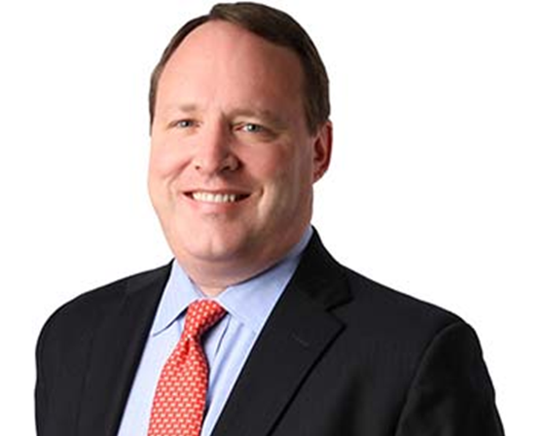
Presenters
J. Christopher Coffman
Frost Brown Todd
(o) 502.568.0373
(m) 502.744.8247
ccoffman@fbtlaw.com
Brian McCuller, JD, CPA
LBMC
(o) 615.690.1971
(m) 615.584.3459
bmcculler@lbmc.com

