Slide 1
Opportunity Zones as a Community tool
Alex flachsbart

Slide 2
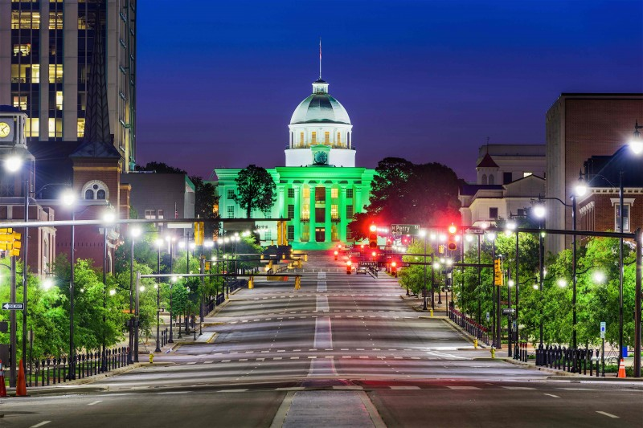
Opportunity Zones have the potential to be the largest economic development program in U.S. history
Steve Glickman
Co-Founder, Economic Innovation Group

Slide 3

What is an opportunity zone?

Slide 4
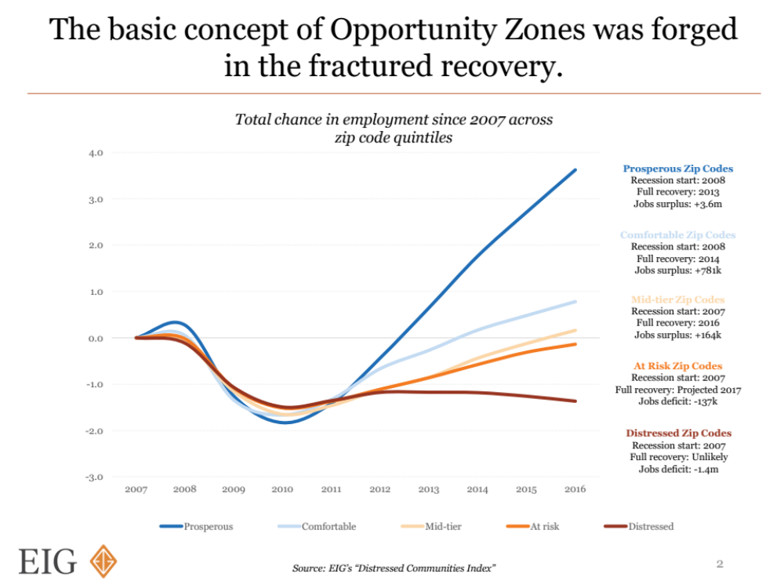

Slide 5
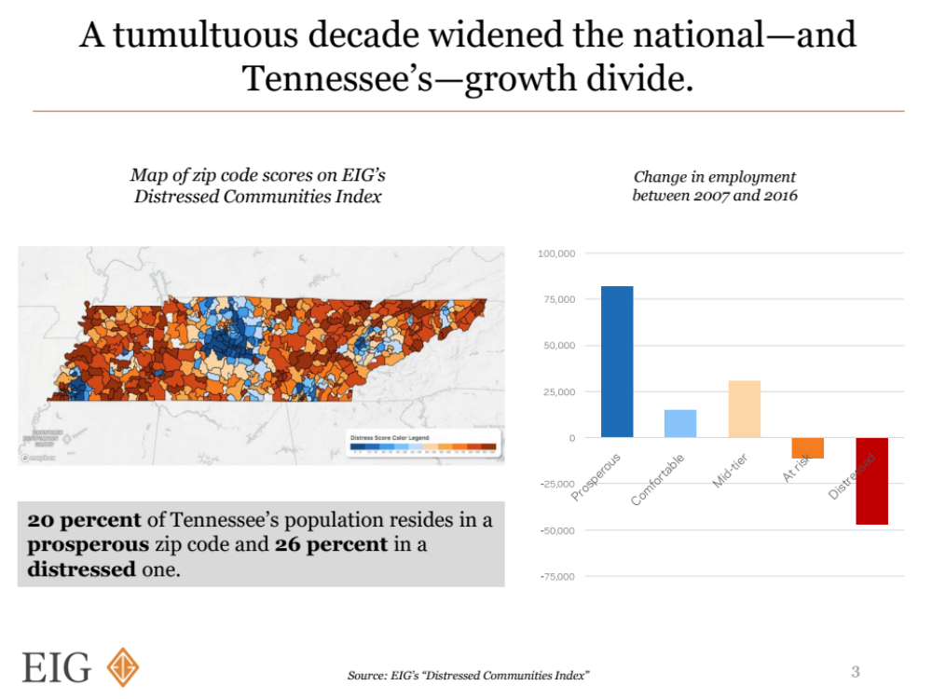

Slide 6
The history of opportunity zones
April: First OZ Approvals; Second Round of Nominations
Late Winter/Early Spring: Regulations finalized; substantial OZ investing begins Q1
Feb.: Introduced by Sen. Tim Scott
October: First Guidance Round
Dec.: Became Law
2017
2018
2019
March: First Round of OZ Nominations
Dec/Jan: Second Guidance Round
Summer: Market peaks
Nov. :Added to Tax Bill
May: Initial IRS Guidance; All OZs Approved

Slide 7
Where are the zones?

Slide 8
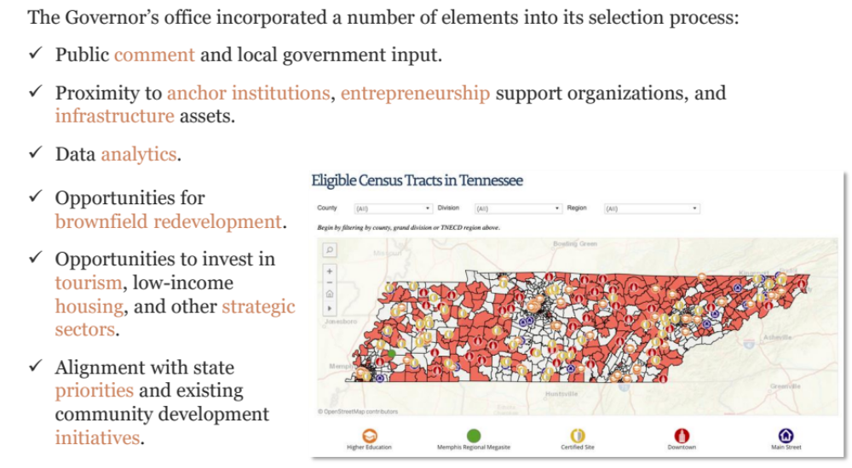
Tennessee opportunity zone selection

Slide 9
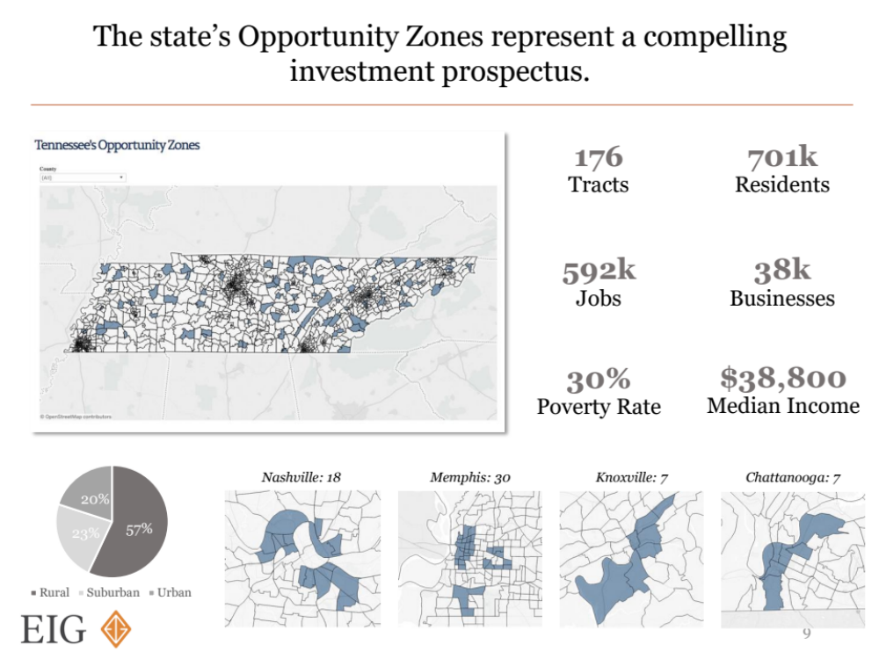

Slide 10
Best Mapping Resources
https://www.tn.gov/ecd/opportunity-zones.html
EIG.org/opportunityzones – scroll down a bit

Slide 11

How the program works
(or, how I learned to love tax law)

Slide 12


opportunity zone tax benefits
Tax Benefits
Gain Event Occurs
Gain Invested in QOF
Temporary Deferral on Original Gain Tax (until 2026 at latest)
1
$1M
$200K
$1.2M
Front End Benefit
10% Reduction in Original Gain Tax
($20K Savings) + Deferral
Held for 5 Years
Pocket principal ($200K)
2
Held for 7 Years
15% Reduction in Original Gain Tax
($30K Savings) + Deferral
Back End Benefit
Cash Out of QOF after 10 Years or More
No Cap. Gains Tax on Appreciation of Investment
3
($400K Savings)
$3M

Slide 14




INVESTOR PROFILES
Rationale for Investment
Location of Investor
Size of Investment
Source of Investment
Make a Difference
Primarily Local to OZ
Varies by Community
Varies by Community
Location
Fund Listings:
- Novogradac
- NCSHA
Make a Difference
Primarily National
Varies by Investor
Likely Not Capital Gains
Impact
Make a Profit
Local or National
Primarily Large $
Varies
Opportunity
Profit / Tax Benefits
Local or National
TBD
Capital Gains
Tax Benefit

Slide 15
Does my project qualify?
Real Estate
Active Businesses
Need
Tax Law Compliant Project
Commercial
Industrial
Multi-Family
No Sin Businesses
Need Qualified Deal Structure
Startups
Infrastructure
Housing
R&D / Tech
Hospitals
Community /
Public Assets

Slide 16
compliant project
Investor
(1) For 70% of Tangible Property:
(A) Acquired after 2017 from unrelated party
(B) “Substantially all” use in OZ
(C) Original OZ Use or “Substantial Improvement” -> double cost basis in 30 month period (*special rule for buildings*)
(2) 50% income from “active conduct” (in OZ?)
(3) Substantial intangible property use (in OZ?)
(4) “Non-Qualified Financial Property Test” (31-month safe harbor for deployment)
QOF
Project-LLC Invest.
Hold Property Directly

Slide 17
Qualified Deal Structure
Investor
Short or Long-Term Capital Gains
First 6 month clock*
Unlimited # of investors or $ of investment
New 6 month clock to meet 90% test
Can leverage equity invested
“Self-Certification” process (one-page form)
QOF
31-month or shorter buildout
Hold project for full 10-year period (condo / single family home problem)
“Active Management” component
Project-LLC Invest.
[N/A]
*For partnership gains, clock starts at end of tax year

Slide 18
How does this really work?

Slide 19
Real estate / mixed use example
Developer bought lot in 2015 and wants to turn it into a microbrewery, then sell remaining portion to mixed use developer. Brewery land is worth $250,000. Remaining land worth $500,000. Brewery will cost $10mm ($2mm from developer equity) and mixed use will cost $5mm. Mixed use will either be condos or affordable housing units.
Tangible Assets (70%):
  Post-2017 Acquisition?
  Sub-All in the Zone?
  Double Cost Basis in 30 Months?
50% Gross Income from OZ?
Intangible Property Use in OZ?
Excessive Cash Holdings?
-----
Ten Year Hold OK?
Exit Strategy?
Other Business Considerations?

Slide 20
HIGH-GROWTH COMPANY EXAMPLE
High-growth tech startup seeking $500,000 in growth stage capital and is indifferent to structure. CEO is from Birmingham and is considering moving back.
Tangible Assets (70%):
  Post-2017 Acquisition?
  Sub-All in the Zone?
  Double Cost Basis in 30 Months?
50% Gross Income from OZ?
Intangible Property Use in OZ?
Excessive Cash Holdings?
-----
Ten Year Hold OK?
Exit Strategy?
Other Business Considerations?

Slide 21
Point-of-sale example
Existing retail business in OZ has about $300,000 in assets in the Opportunity Zone and is looking to expand with new OZ capital.
Tangible Assets (70%):
  Post-2017 Acquisition?
  Sub-All in the Zone?
  Double Cost Basis in 30 Months?
50% Gross Income from OZ?
Intangible Property Use in OZ?
Excessive Cash Holdings?
-----
Ten Year Hold OK?
Other Business Considerations?

Slide 22
Manufacturing example
Local IDB owns $500,000 in land and wants to use Opportunity Zones to develop it – likely via a build-to-suit lease arrangement.
[Fun aside – could we invest in the company itself?]
Tangible Assets (70%):
  Post-2017 Acquisition?
  Sub-All in the Zone?
  Double Cost Basis in 30 Months?
50% Gross Income from OZ?
Intangible Property Use in OZ?
Excessive Cash Holdings?
-----
Ten Year Hold OK?
Other Business Considerations?

Slide 23
Healthcare example
Existing hospital facility is looking to substantially expand operations / add new facility in Opportunity Zone. Current assets in zone are about $20 million, and proposed new assets would be at least $50 million, all told.
REAL ESTATE vs.
ACTIVE BUSINESS?
Tangible Assets (70%):
  Post-2017 Acquisition?
  Sub-All in the Zone?
  Double Cost Basis in 30 Months?
50% Gross Income from OZ?
Intangible Property Use in OZ?
Excessive Cash Holdings?
-----
Ten Year Hold OK?
Exit Strategy?
Other Business Considerations?

Slide 24
Investment Structures + Terms
Inv
Inv
Inv
Inv
Investor
Inv
Inv
Inv
Inv
QOF
QOF
QOF
OZ
OZ
OZ Project
OZ Project
BUT: Major issue around “rolling projects” (called the “Interim Gains Issue”)
OZ
OZ

Slide 25
MAJOR BUSINESS CONSIDERATIONS
Investor to Project Timing
“Cycling Projects”
2026 Tax Event
Exit Strategy

Slide 26
Building a regional working group

Slide 27
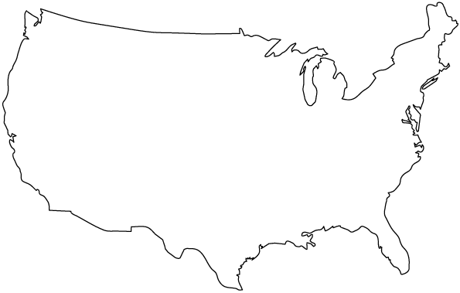
THE NATIONAL COMPETITION
Downtown
Seattle
Vail
Manhattan
Palo Alto
Detroit
Downtown Atlanta
Austin
North Miami Beach

Slide 28
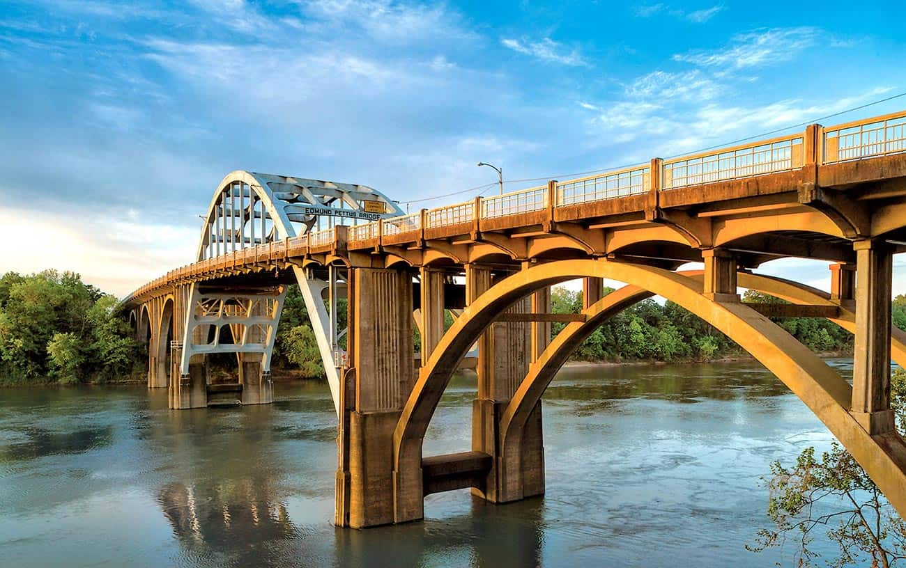
How do you build an ecosystem to maximize
Opportunity Zone investment?

Slide 29
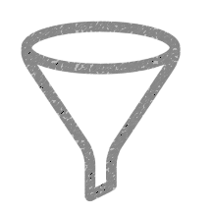

Key community takeaways
Develop Project Pipeline
Develop Local Investor Pipeline
Develop Local OZ Marketing Strategy
Develop Local OZ Ecosystem

Slide 30




Communities
Educate
Source
Projects
Connect
Investors
Track
Promote
Institutional Partners

Slide 31
What your intermediar(ies?) should do
General OZ Education / Project Assessment / Fund Information
Institutional Partner Engagement / “Concierge” Service
Fund / Deal Introductions
Community Ecosystem Working Group
Community Prospectus Development
Needs Identification / Impact Tracking
Direct Community Investment Mechanisms

Slide 32
Questions?
alex@opportunityalabama.com
334.425.4166

