Slide 1
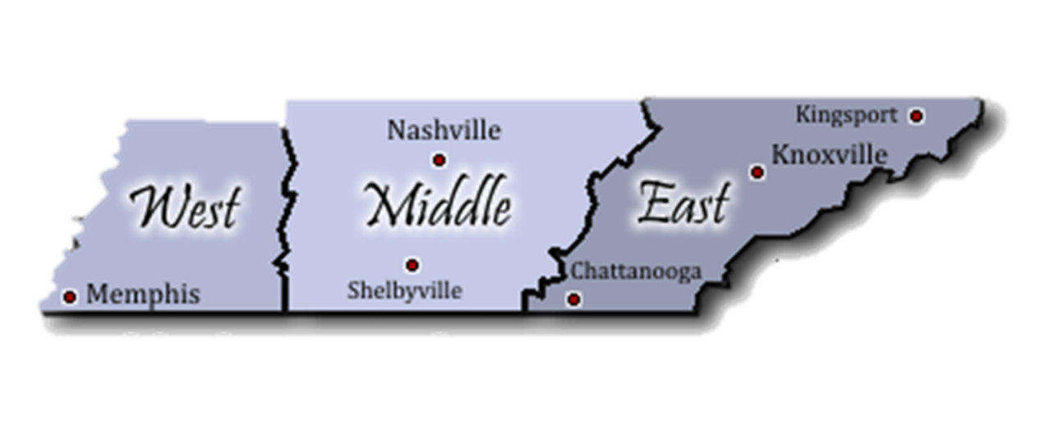
Apprenticeship TN Contacts
West TN Regional Apprenticeship Director
Shalondria Shaw
Shalondria.Shaw@tn.gov
731-202-6027
Middle TN Regional Apprenticeship Director
Charlene Sands Russell
Charlene.Russell@tn.gov
931-303-7638
State Apprenticeship Director/East TN Apprenticeship Director
Holly Free-Ollard
Holly.Free-Ollard@tn.gov
865-973-8157
State Apprenticeship Assistant Director
Jessica Barnett
Jessica.L.Barnett@tn.gov
423-440-0128
Grants Program Manager
Lynn Kirby
Lynn.Kirby@tn.gov
615-330-1631
Administrative Services Assistant
Erika Haire
Erika.R.Haire@tn.gov
615-532-0148
Notes:
Holly – Slide 3: Progress to Date (1 minute 30 seconds)
6991 Registered Apprentices and 622 completers as of July 22nd

Slide 2
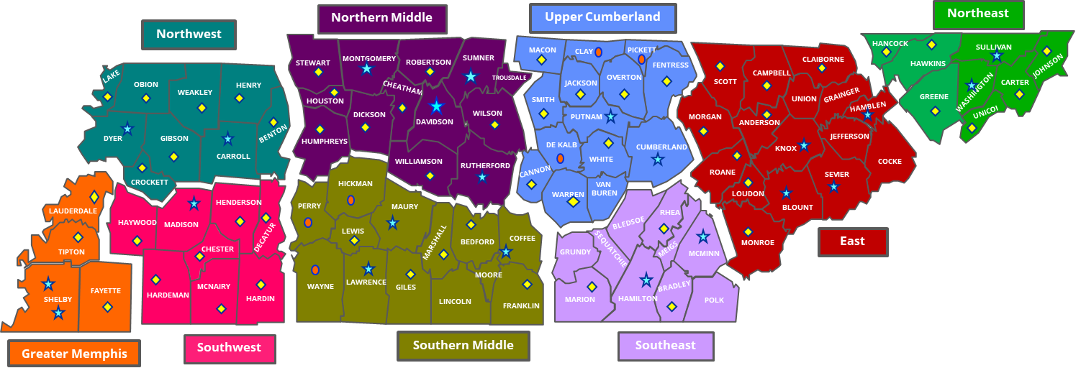
Local Workforce Development Areas
Counties by Region

Slide 3
Your Local Business Service Team
West TN
Greater Memphis
Roderick Woody Tracy Lovelace
901-573-1455 / Email
Northwest
Ginger Powell
731-286-3585 ext. 409 / Email
Southwest
Judy Moorman
731-660-6601 / Email
West TN Executive Directors
Kyla Guyette, GM
kguyette@workforcemidsouth.com
901-512-7455
Jennifer Bane, NW
jbane@nwtnworks.org
731-286-3585 ext. 406
Kena Hamm, SW
kena.hamm@swhra.org
731-983-3687 (O); 731-435-0109 (C)
Regional Director Grand West TN
Kristie Bennett
Kristie.Bennett@tn.gov
Middle TN
Northern Middle
Freda Herndon
615-533-0635 / Email
Southern Middle
Travis Wilson
931-309-0962 / Email
Upper Cumberland
Caroline Timpson
931-520-9593 / Email
Middle TN Executive Directors
Marla Rye, NM
mrye@workforceessentials.com
931-206-3783 (C)
TBD, SM
Selina.Moore@tn.gov
TBD
Becky Hull, UC
BHull@ucworkforce.org
931-520-9511 (O); 931-229-0435 (C)
Regional Director Grand Middle TN
Selina Moore
Selina.Moore@tn.gov
East TN
Southeast
Beth Keylon
423-643-2328 / Email
East
Ginger Armstrong
865-594-5500 / Email
Northeast
Brian Vaughn
423-610-0222 ext. 208 / Email
East TN Executive Directors
Michelle Holt, SE
Michele@sedev.org
423-424-4210 (O); 423-240-2180 (C)
Bill Walker, E
Bwalker@ethra.org
865-705-9765 (C)
Kathy Pierce, NE
kpierce@ab-t.org
423-547-7515 ext. 126 (O);
423-895-1105 (C)
Regional Director Grand East TN
TBD
Business Services Contacts
Local Workforce Board
Contacts

