Slide 1
Consumer & Industry
Services Division

Slide 2
Presentation Outline
Method of Sale Options
  Weight, Measure, Count, Head, or Bunch
Pre-Pack vs. Ready-to-Eat / Restaurant Style
Standard Weight Declarations
Random Weight Declarations
Scale Requirements
Vendor Options
Registration of Scales

Slide 3
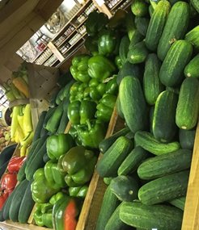
Methods of Sale for Fresh Fruits & Vegetables
Many Fruits and Vegetables may be Sold by Weight or Count
Artichokes
Eggplant
Mushrooms (large)

Slide 4

Method of Sale Options Fresh Fruits & Vegetables
Other Fruits and Vegetables may be Sold by Weight or Dry Measure
Beans (green, yellow, etc.)
Berries
Cherries
Mushrooms (small)
Tomatoes (cherry/grape)

Slide 5

Method of Sale Options Fresh Fruits & Vegetables
Some Fruits and Vegetables may be Sold by Weight, Count, or Dry Measure
Cucumbers
Squash
Peppers
Pitted Fruits
Tomatoes

Slide 6
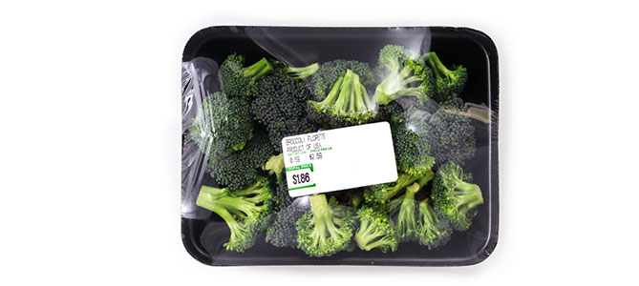
Prepacked Package Label Requirements
Requires a declaration of net quantity on the principal display panel of the consumer package and shall be in terms of the largest whole unit
(NIST Handbook 130 -2017)

Slide 7
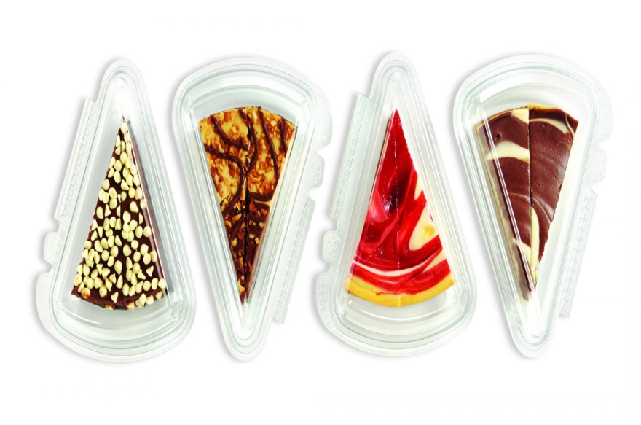
Ready-to-Eat Package Requirements
Restaurant style food offered or exposed for sale that is ready for consumption, though not necessarily on the premises
Does not include sliced luncheon products
These product may be sold by “each, slice, etc.”

Slide 8
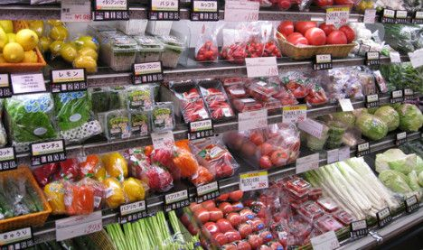
Definition of a Package
Enclosed in a container
Wrapped in any manner in advance of wholesale or retail sale
Weight or measure has been determined in advance of wholesale or retail sale
(NIST Handbook 130 -2017)

Slide 9

Subtypes of Packages – Standard Weight Package
A package that is one of a lot, shipment, or delivery of packages of the same commodity with identical net declarations

Slide 10
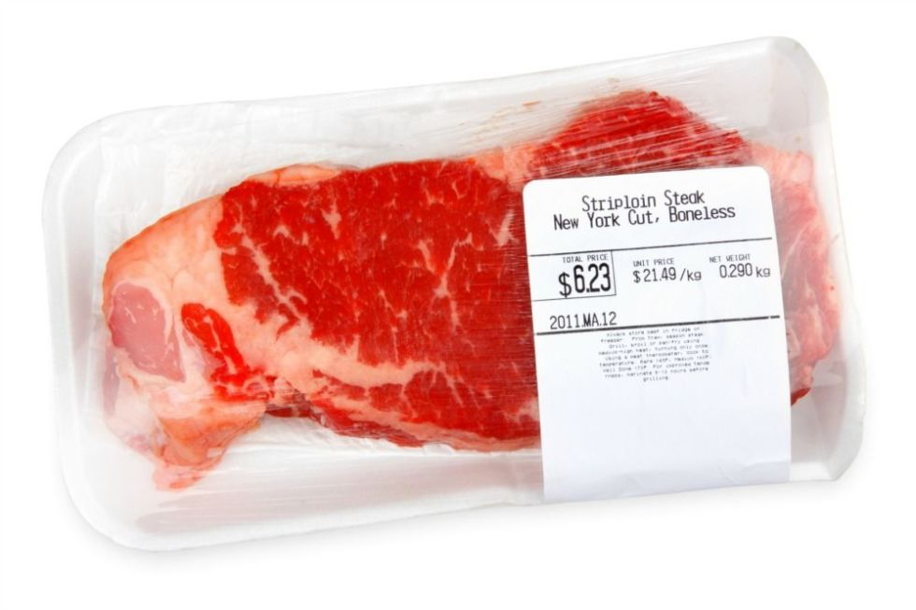
Subtypes of Packages – Random Weight Package
Same commodity with no fixed pattern of weights
Must bear a label conspicuously declaring:
the net weight
the unit price
the total price

Slide 11

Certified vs. Non-Certified Scale
Seller must determine if they want their scale officially certified or a courtesy scale test only
Certification requires the device be registered with the department and payment of the required annual device registration fee

Slide 12

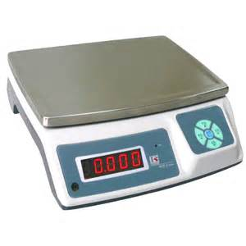
Certified* Scale Requirements
Any weighing device used for point of sale commercial transactions must:
Meet all specifications, tolerances and other technical requirements of NIST Handbook 44 and be approved by the National Type Evaluation Program (NTEP)
Only NTEP scales can be certified by the department for use in point of sale commercial transactions for Random Weight Package sales

Slide 13
Certified* Scale Requirements
Any weighing device used for point of sale commercial transactions must:
Meet all specifications, tolerances and other technical requirements of NIST Handbook 44 and be approved by the National Type Evaluation Program (NTEP)
Only NTEP scales can be certified by the department for use in point of sale commercial transactions for Random Weight Package sales

Slide 14
Non-Certified* Scale Requirements
Are NOT required to be NTEP approved devices
Still must meet accuracy tolerance requirements of NIST Handbook 44
Must be “Legal For Trade” scales
Any scale marked as “Not legal for Trade” or “Scale Used For Estimating Only” cannot be used in commercial transactions

Slide 15
Vendor Options - Method of Sale
Vendor makes business decision based on approved method of sale
Weight – Standard or Random
Standard – Scale requirements relaxed. Must meet or exceed minimum Net Weight declaration on package.
Random – Requires NTEP approved scale and register with the Department of Agriculture

Slide 16
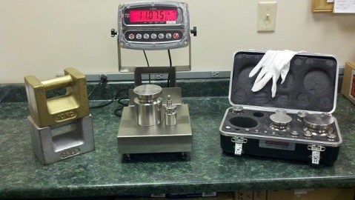
Certified Scale Test Request
To request a certified scale test and register a scale with the Department of Ag, call 615-837-5109.
Device owner may elect to:
Register the scale through their local Famers Market Association
Individually register the scale

Slide 17
Consumer Complaint Procedures
The Department of Agriculture responds to all consumer complaints and will continue to do so on both certified and non-certified scales to ensure accuracy and equity in the marketplace.

Slide 18

Contact
Please Contact TDA Weights and Measures with any Questions
615 837-5109

